Slide 1
A Case for In-Memory Random Scatter-Gather for Fast Graph Processing
Changmin Shin, Taehee Kwon, Jaeyong Song, Jaehyung Ju,
Frank Liu, Yeonkyu Choi and Jinho Lee
1

Slide 2
Introduction
Memory Wall Problem
Various Types of Function in Memory
DRAM
Bank0
Bank15
…
Sense Amplifier
Sense Amplifier
Busy!
Host

Slide 3
Introduction
Memory Wall Problem
Various Types of Function in Memory
Function in Memory
Bank0
Bank15
…
Sense Amplifier
Sense Amplifier
Processing Unit
Processing Unit
Host

Slide 4
Introduction
Huge Processor Overhead
Necessity to Consider Data Types
Function in Memory
Bank0
Bank15
Area Overhead
≳ 50%
…
Sense Amplifier
Sense Amplifier
Processing Unit
Processing Unit
Host

Slide 5
Piccolo (Pick & Collect)
Utilizing internal bandwidth w/ low overhead
Independent of data types
Low area overhead
Minimal change to DRAM

Slide 6
Piccolo: Architecture
DRAM w/ Piccolo
Bank i
Activated Row
= Cache Line (64B)
= Target Word (8B)
Sense Amplifier
Chip I/O
8 Memory Transaction
Host

Slide 7
Piccolo: Architecture
DRAM w/ Piccolo
Bank i
Activated Row
= Cache Line (64B)
= Target Word (8B)
= Column Offset
Sense Amplifier
Sense Amplifier
Internal Ctrl.
Data Buffer
Offset Buffer
Chip I/O
Host

Slide 8
Piccolo: Architecture
DRAM w/ Piccolo
Bank i
Activated Row
= Cache Line (64B)
= Target Word (8B)
= Column Offset
Sense Amplifier
Sense Amplifier
Internal Ctrl.
Data Buffer
Offset Buffer
8 Memory Transaction
Chip I/O
2 Memory Transaction
Host
→ Bandwidth gain : x4

Slide 9
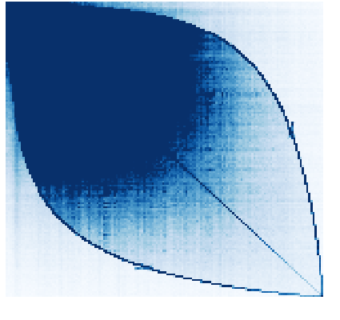
Piccolo: Graph Processing
Adjacency Matrix
Graph Processing
Irregular Access Pattern
Extremely Random Access
PageRank, BFS, CC

Slide 10
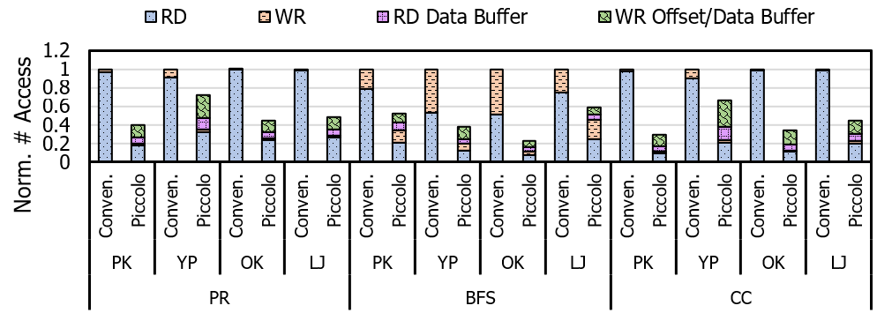
Evaluation: Speedup
External memory access: 54.3% reduced on average
Geomean speedup: 2.04x (PR), 1.37x (BFS), 2.30x (CC)

Slide 11
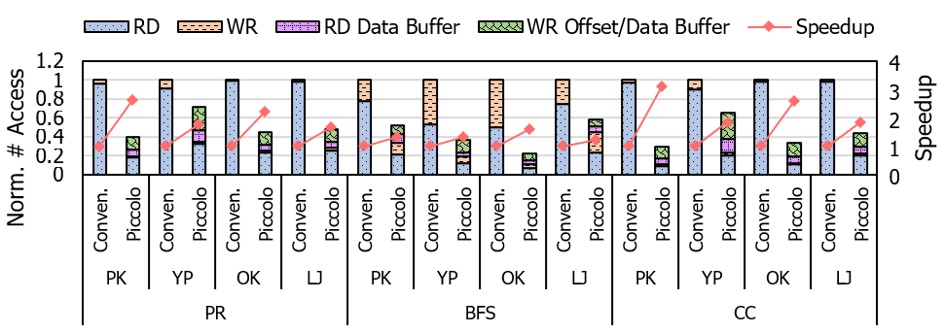
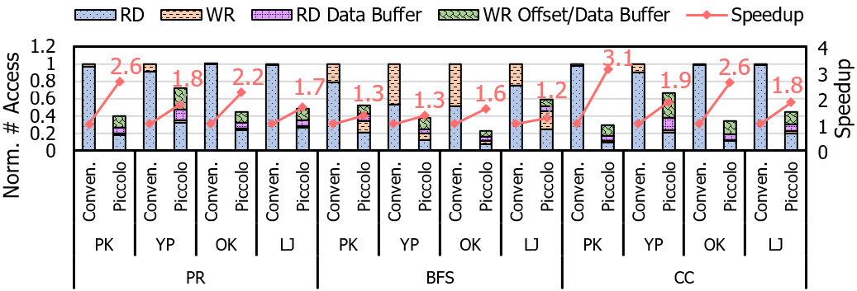
Evaluation: Speedup
External memory access: 54.3% reduced on average
Geomean speedup: 2.04x (PR), 1.37x (BFS), 2.30x (CC)

Slide 12
Thank you
scm8432@snu.ac.kr

