Slide 1



9. Optimizing Parallel Reduction in CUDA
Credit to: Mark Harris
(NVIDIA Developer Technology)
Slightly modified by Jinho Lee

Slide 2





Parallel Reduction
Common and important data parallel primitive
Easy to implement in CUDA
Harder to get it right
Serves as a great optimization example
We’ll walk step by step through 7 different versions
Demonstrates several important optimization strategies
Done over an old GPU (G80), but most of the optimizations still make sense today
Your job to see if it works on our GPUs

Slide 3













Parallel Reduction
Tree-based approach used within each thread block
3 1 7 0 4 1 6 3
4
7
5
9
11 14
25
Need to be able to use multiple thread blocks
To process very large arrays
To keep all multiprocessors on the GPU busy
Each thread block reduces a portion of the array
But how do we communicate partial results between thread blocks?

Slide 4



Problem: Global Synchronization
If we could synchronize across all thread blocks, could easily reduce very large arrays, right?
Global sync after each block produces its result
Once all blocks reach sync, continue recursively
But we do not know of any CUDA global synchronization.
It didn’t even exist in the past -- Expensive for GPUs with high processor count (possible now with cooperative groups)
Forces programmer to run fewer blocks (no more than # multiprocessors * # resident blocks / multiprocessor) to avoid deadlock, which may reduce overall efficiency (why?)
Solution: decompose into multiple kernels
Kernel launch serves as a global synchronization point
Kernel launch has negligible HW overhead, low SW overhead
Very similar to thread create() – join() instead of barrier()
Penalty: We have to drop shared memory every call

Slide 5
 | syncwarp | volatile | 결과
 | X | X | X
 | O | X | O
 | X | O | X
 | O | O | O

Slide 6

Solution: Kernel Decomposition
Avoid global sync by decomposing computation into multiple kernel invocations
3 1 7 0 4 1 6 3 3 1 7 0 4 1 6 3 3 1 7 0 4 1 6 3 3 1 7 0 4 1 6 3 3 1 7 0 4 1 6 3 3 1 7 0 4 1 6 3 3 1 7 0 4 1 6 3 3 1 7 0 4 1 6 3
4 7 5 9 4 7 5 9 4 7 5 9 4 7 5 9 4 7 5 9 4 7 5 9 4 7 5 9 4 7 5 9
11 14 11 14 11 14 11 14 11 14 11 14 11 14 11 14
25 25 25 25 25 25 25 25
Level 0:
8 blocks
3 1 7 0 4 1 6 3
4 7 5 9
11 14
Level 1:
1 block
25
In the case of reductions, code for all levels is the same
Recursive kernel invocation
Notes:
Next year: would be better if I capture the kernel invocation code

Slide 7
Recursive (or repeatitive) Kernels
…
gmem
Threadblock 0
Threadblock 1
Threadblock 2
Threadblock 3
Threadblock 4
Kernel launch
#1
…
smem
reduce
reduce
reduce
reduce
reduce
…
smem
…
gmem
Kernel launch
#2
smem
…
smem
more
kernel launches
…
gmem

Slide 8

What is Our Optimization Goal?
We should strive to reach GPU peak performance Choose the right metric:
GFLOP/s: for compute-bound kernels Bandwidth: for memory-bound kernels
Reductions have very low arithmetic intensity
1 flop per element loaded (bandwidth-optimal)
Therefore we should strive for peak bandwidth
Will use G80 GPU for this example 384-bit memory interface, 900 MHz DDR 384 * 1800 / 8 = 86.4 GB/s

Slide 9
Reduction #1: Interleaved Addressing
global void reduce0(int *g_idata, int *g_odata) { extern shared int sdata[];
// each thread loads one element from global to shared mem unsigned int tid = threadIdx.x;
unsigned int i = blockIdx.x*blockDim.x + threadIdx.x; sdata[tid] = g_idata[i];
syncthreads();
// do reduction in shared mem
for(unsigned int s=1; s < blockDim.x; s *= 2) { if (tid % (2*s) == 0) {
sdata[tid] += sdata[tid + s];
}
syncthreads();
}
// write result for this block to global mem if (tid == 0) g_odata[blockIdx.x] = sdata[0];
}
Notes:
this is called the most naïve version, but already makes use of shared memory.

Slide 10
Parallel Reduction: Interleaved Addressing
Values (shared memory)
10 | 1 | 8 | -1 | 0 | -2 | 3 | 5 | -2 | -3 | 2 | 7 | 0 | 11 | 0 | 2
Step 1
Stride 1
Thread IDs
Values
0
2
4
6
8
10
12
14
11 | 1 | 7 | -1 | -2 | -2 | 8 | 5 | -5 | -3 | 9 | 7 | 11 | 11 | 2 | 2
Step 2
Stride 2
Thread IDs
Values
0
4
8
12
18 | 1 | 7 | -1 | 6 | -2 | 8 | 5 | 4 | -3 | 9 | 7 | 13 | 11 | 2 | 2
Step 3
Stride 4
Thread IDs
Values
0
8
24 | 1 | 7 | -1 | 6 | -2 | 8 | 5 | 17 | -3 | 9 | 7 | 13 | 11 | 2 | 2
Step 4
Stride 8
Thread IDs
Values
0
41 | 1 | 7 | -1 | 6 | -2 | 8 | 5 | 17 | -3 | 9 | 7 | 13 | 11 | 2 | 2

Slide 11

Reduction #1: Interleaved Addressing
global void reduce1(int *g_idata, int *g_odata) { extern shared int sdata[];
// each thread loads one element from global to shared mem unsigned int tid = threadIdx.x;
unsigned int i = blockIdx.x*blockDim.x + threadIdx.x; sdata[tid] = g_idata[i];
syncthreads();
// do reduction in shared mem
for (unsigned int s=1; s < blockDim.x; s *= 2) { if (tid % (2*s) == 0) {
sdata[tid] += sdata[tid + s];
Problem: highly divergent
}
syncthreads();
warps are very inefficient, and
% operator is very slow
}
// write result for this block to global mem if (tid == 0) g_odata[blockIdx.x] = sdata[0];
}

Slide 12


Performance for 4M element reduction
Time (2²² ints)
8.054 ms
Bandwidth
2.083 GB/s
Kernel 1:
interleaved addressing with divergent branching
Note: Block Size = 128 threads for all tests

Slide 13


Reduction #2: Interleaved Addressing
Just replace divergent branch in inner loop:
for (unsigned int s=1; s < blockDim.x; s *= 2) { if (tid % (2*s) == 0) {
sdata[tid] += sdata[tid + s];
}
syncthreads();
}
With strided index and non-divergent branch:
for (unsigned int s=1; s < blockDim.x; s *= 2) { int index = 2 * s * tid;
if (index < blockDim.x) {
sdata[index] += sdata[index + s];
}
syncthreads();
}

Slide 14
Parallel Reduction: Interleaved Addressing
Values (shared memory)
10 | 1 | 8 | -1 | 0 | -2 | 3 | 5 | -2 | -3 | 2 | 7 | 0 | 11 | 0 | 2
Step 1
Stride 1
Thread IDs
Values
0
1
2
3
4
5
6
7
11 | 1 | 7 | -1 | -2 | -2 | 8 | 5 | -5 | -3 | 9 | 7 | 11 | 11 | 2 | 2
Step 2
Stride 2
Thread IDs
Values
0
1
2
3
18 | 1 | 7 | -1 | 6 | -2 | 8 | 5 | 4 | -3 | 9 | 7 | 13 | 11 | 2 | 2
Step 3
Stride 4
Thread IDs
Values
0
1
24 | 1 | 7 | -1 | 6 | -2 | 8 | 5 | 17 | -3 | 9 | 7 | 13 | 11 | 2 | 2
Step 4
Stride 8
Thread IDs
Values
0
41 | 1 | 7 | -1 | 6 | -2 | 8 | 5 | 17 | -3 | 9 | 7 | 13 | 11 | 2 | 2
New Problem: Shared Memory Bank Conflicts
(Padding is probably not a good solution here)

Slide 15









Performance for 4M element reduction
Step Speedup
Cumulative Speedup
Time (2²² ints)
Bandwidth
Kernel 1:
interleaved addressing with divergent branching
8.054 ms
2.083 GB/s
Kernel 2:
interleaved addressing with bank conflicts
3.456 ms
4.854 GB/s
2.33x
2.33x

Slide 16
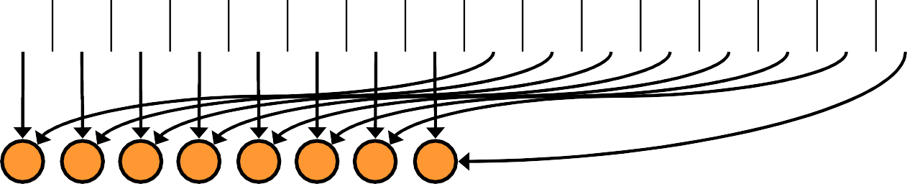
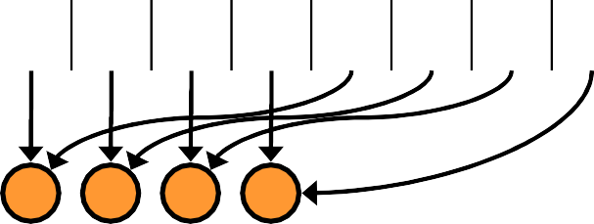
Parallel Reduction: Sequential Addressing
Values (shared memory)
10 1 8 -1 0 -2 3 5 -2 -3 2 7 0 11 0 2
Step 1
Stride 8
Thread IDs
0 | 1 | 2 | 3 | 4 | 5 | 6 | 7
8 | -2 | 10 | 6 | 0 | 9 | 3 | 7 | -2 | -3 | 2 | 7 | 0 | 11 | 0 | 2
0 | 1 | 2 | 3
Values
Step 2
Stride 4
Thread IDs
Values
Thread IDs
Values
Thread IDs
Values
8 | 7 | 13 | 13 | 0 | 9 | 3 | 7 | -2 | -3 | 2 | 7 | 0 | 11 | 0 | 2
Step 3
Stride 2
1
0
21 | 20 | 13 | 13 | 0 | 9 | 3 | 7 | -2 | -3 | 2 | 7 | 0 | 11 | 0 | 2
Step 4
Stride 1
0
41 | 20 | 13 | 13 | 0 | 9 | 3 | 7 | -2 | -3 | 2 | 7 | 0 | 11 | 0 | 2
Sequential addressing is conflict free
14

Slide 17


Reduction #3: Sequential Addressing
Just replace strided indexing in inner loop:
for (unsigned int s=1; s < blockDim.x; s *= 2) { int index = 2 * s * tid;
if (index < blockDim.x) {
sdata[index] += sdata[index + s];
}
syncthreads();
}
With reversed loop and threadID-based indexing:
for (unsigned int s=blockDim.x/2; s>0; s>>=1) { if (tid < s) {
sdata[tid] += sdata[tid + s];
}
syncthreads();
}

Slide 18








Performance for 4M element reduction
Step Speedup
Cumulative Speedup
Time (2²² ints)
Bandwidth
Kernel 1:
interleaved addressing with divergent branching
8.054 ms
2.083 GB/s
Kernel 2:
interleaved addressing with bank conflicts
3.456 ms
4.854 GB/s
2.33x
2.33x
Kernel 3:
sequential addressing
1.722 ms
9.741 GB/s
2.01x
4.68x

Slide 19

Idle Threads
Problem:
for (unsigned int s=blockDim.x/2; s>0; s>>=1) { if (tid < s) {
sdata[tid] += sdata[tid + s];
}
syncthreads();
}
Half of the threads are idle on first loop iteration!
This is wasteful…

Slide 20


Reduction #4: First Add During Load
Halve the number of blocks, and replace single load:
// each thread loads one element from global to shared mem unsigned int tid = threadIdx.x;
unsigned int i = blockIdx.x*blockDim.x + threadIdx.x; sdata[tid] = g_idata[i];
syncthreads();
With two loads and first add of the reduction:
// perform first level of reduction,
// reading from global memory, writing to shared memory unsigned int tid = threadIdx.x;
unsigned int i = blockIdx.x*(blockDim.x*2) + threadIdx.x; sdata[tid] = g_idata[i] + g_idata[i+blockDim.x];
syncthreads();
Notes:
Coalescing on the red addition!

Slide 21











Performance for 4M element reduction
Step Speedup
Cumulative Speedup
Time (2²² ints)
Bandwidth
Kernel 1:
interleaved addressing with divergent branching
Kernel 2:
interleaved addressing with bank conflicts
Kernel 3:
sequential addressing
Kernel 4:
first add during global load
8.054 ms | 2.083 GB/s
3.456 ms | 4.854 GB/s | 2.33x | 2.33x
1.722 ms | 9.741 GB/s | 2.01x | 4.68x
0.965 ms | 17.377 GB/s | 1.78x | 8.34x

Slide 22
Instruction Bottleneck
At 17 GB/s, we’re far from bandwidth bound
And we know reduction has low arithmetic intensity
Therefore a likely bottleneck is instruction overhead Ancillary instructions that are not loads, stores, or arithmetic for the core computation
In other words: address arithmetic and loop overhead
Strategy: unroll loops

Slide 23
Unrolling the Last Warp
As reduction proceeds, # “active” threads decreases
When s <= 32, we have only one warp left
Instructions are SIMD synchronous within a warp That means when s <= 32:
We don’t need to __syncthreads()
__syncwarp() is enough (you needed nothing in the past)
We don’t need “if (tid < s)” because it doesn’t save any work
Let’s unroll the last 6 iterations of the inner loop

Slide 24

Reduction #5: Unroll the Last Warp
for (unsigned int s=blockDim.x/2; s>32; s>>=1)
{
if (tid < s)
sdata[tid] += sdata[tid + s];
syncthreads();
}
if (tid < 32)
{
sdata[tid] += sdata[tid + 32];
sdata[tid] += sdata[tid + 16];
sdata[tid] += sdata[tid + 8];
sdata[tid] += sdata[tid + 4];
sdata[tid] += sdata[tid + 2];
sdata[tid] += sdata[tid + 1];
}
Note: This saves useless work in all warps, not just the last one!
Without unrolling, all warps execute every iteration of the for loop and if statement

Slide 25
Reduction #5: Unroll the Last Warp (Wrong Fix)
for (unsigned int s=blockDim.x/2; s>32; s>>=1)
{
if (tid < s)
sdata[tid] += sdata[tid + s];
syncthreads();
}
if (tid < 32)
{
sdata[tid] += sdata[tid + 32]; __syncwarp();
sdata[tid] += sdata[tid + 16]; __syncwarp();
sdata[tid] += sdata[tid + 8]; __syncwarp();
sdata[tid] += sdata[tid + 4]; __syncwarp();
sdata[tid] += sdata[tid + 2]; __syncwarp();
sdata[tid] += sdata[tid + 1]; __syncwarp();
}
Note: This saves useless work in all warps, not just the last one!
Without unrolling, all warps execute every iteration of the for loop and if statement

Slide 26
Reduction #5: Unroll the Last Warp (Correct Fix)
for (unsigned int s=blockDim.x/2; s>32; s>>=1)
{
if (tid < s)
sdata[tid] += sdata[tid + s];
syncthreads();
}
if (tid < 32)
{
int tmp;
tmp = sdata[tid + 32]; __syncwarp();
sdata[tid] += tmp; __syncwarp();
tmp = sdata[tid + 16]; __syncwarp();
sdata[tid] += tmp; __syncwarp();
tmp = sdata[tid + 8]; __syncwarp();
sdata[tid] += tmp; __syncwarp();
tmp = sdata[tid + 4]; __syncwarp();
sdata[tid] += tmp; __syncwarp();
tmp = sdata[tid + 2]; __syncwarp();
sdata[tid] += tmp; __syncwarp();
tmp = sdata[tid + 1]; __syncwarp();
sdata[tid] += tmp; __syncwarp();
}

Slide 27







Performance for 4M element reduction
Step Speedup
Cumulative Speedup
Time (2²² ints)
Bandwidth
Kernel 1:
interleaved addressing with divergent branching
Kernel 2:
interleaved addressing with bank conflicts
Kernel 3:
sequential addressing
Kernel 4:
first add during global load
Kernel 5:
unroll last warp
8.054 ms | 2.083 GB/s
3.456 ms | 4.854 GB/s | 2.33x | 2.33x
1.722 ms | 9.741 GB/s | 2.01x | 4.68x
0.965 ms | 17.377 GB/s | 1.78x | 8.34x
0.536 ms | 31.289 GB/s | 1.8x | 15.01x

Slide 28
Complete Unrolling
If we knew the number of iterations at compile time, we could completely unroll the reduction
Luckily, the block size is limited by the GPU to 512 threads Also, we are sticking to power-of-2 block sizes
So we can easily unroll for a fixed block size
But we need to be generic – how can we unroll for block sizes that we don’t know at compile time?
Templates to the rescue!
CUDA supports C++ template parameters on device and host functions
Notes:
512 is 1024 these days

Slide 29

Unrolling with Templates
Specify block size as a function template parameter:
template <unsigned int blockSize>
global void reduce5(int *g_idata, int *g_odata)

Slide 30

Reduction #6: Completely Unrolled
if (blockSize >= 512) {
if (tid < 256) { sdata[tid] += sdata[tid + 256]; } syncthreads();
}
if (blockSize >= 256) {
if (tid < 128) { sdata[tid] += sdata[tid + 128]; } syncthreads();
}
if (blockSize >= 128) {
if (tid < 64) { sdata[tid] += sdata[tid + 64]; } syncthreads();
}
if (tid < 32) {
if (blockSize >= 64) sdata[tid] += sdata[tid + 32]; if (blockSize >= 32) sdata[tid] += sdata[tid + 16];
if (blockSize >= 16) sdata[tid] += sdata[tid + 8];
if (blockSize >= if (blockSize >= if (blockSize >=
8) sdata[tid] += sdata[tid + 4];
4) sdata[tid] += sdata[tid + 2];
2) sdata[tid] += sdata[tid + 1];
}
Note: all code in RED will be evaluated at compile time.
Results in a very efficient inner loop!
26

Slide 31

Invoking Template Kernels
Don’t we still need block size at compile time?
Nope, just a switch statement for 10 possible block sizes:
switch (threads)
{
case 512:
reduce5<512><<< dimGrid, dimBlock, smemSize >>>(d_idata, d_odata); break; case 256:
reduce5<256><<< dimGrid, dimBlock, smemSize >>>(d_idata, d_odata); break; case 128:
reduce5<128><<< dimGrid, dimBlock, smemSize >>>(d_idata, d_odata); break; case 64:
reduce5< 64><<< dimGrid, dimBlock, smemSize >>>(d_idata, d_odata); break; case 32:
reduce5< 32><<< dimGrid, dimBlock, smemSize >>>(d_idata, d_odata); break; case 16:
reduce5< 16><<< dimGrid, dimBlock, smemSize >>>(d_idata, d_odata); break;
case 8:
reduce5< case 4:
reduce5< case 2:
reduce5< case 1:
reduce5<
}
8><<< dimGrid, dimBlock, smemSize >>>(d_idata, d_odata); break;
4><<< dimGrid, dimBlock, smemSize >>>(d_idata, d_odata); break;
2><<< dimGrid, dimBlock, smemSize >>>(d_idata, d_odata); break;
1><<< dimGrid, dimBlock, smemSize >>>(d_idata, d_odata); break;
27

Slide 32




Performance for 4M element reduction
Step Speedup
Cumulative Speedup
Time (2²² ints)
Bandwidth
Kernel 1:
interleaved addressing with divergent branching
Kernel 2:
interleaved addressing with bank conflicts
Kernel 3:
sequential addressing
Kernel 4:
first add during global load
Kernel 5:
unroll last warp
Kernel 6:
completely unrolled
8.054 ms | 2.083 GB/s
3.456 ms | 4.854 GB/s | 2.33x | 2.33x
1.722 ms | 9.741 GB/s | 2.01x | 4.68x
0.965 ms | 17.377 GB/s | 1.78x | 8.34x
0.536 ms | 31.289 GB/s | 1.8x | 15.01x
0.381 ms | 43.996 GB/s | 1.41x | 21.16x

Slide 33
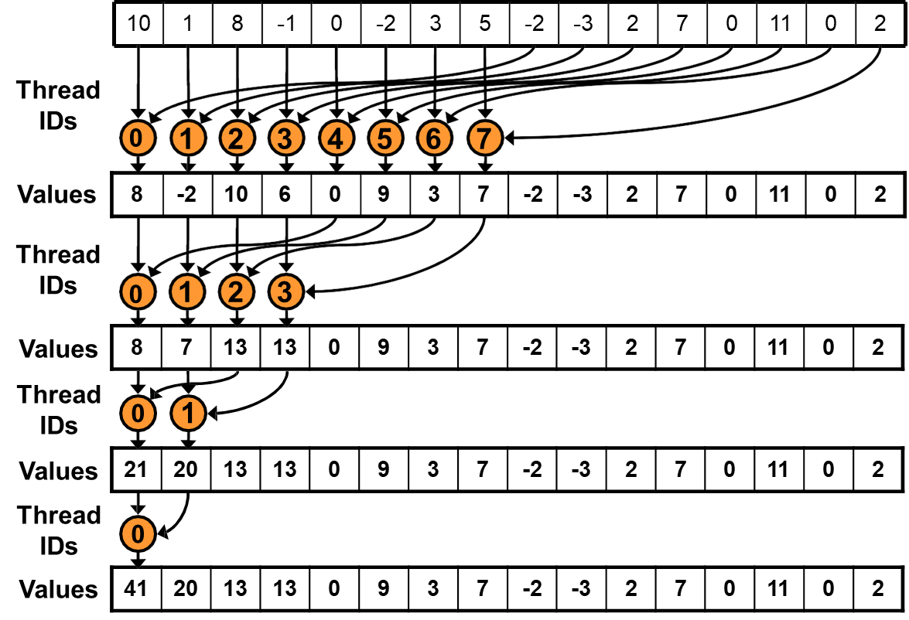
Work Efficiency
Are we utilizing the cores and threads?
Each kernel call runs in logN steps
Total amount of work (addition) is N
With P threads, the execution time of the algorithm is O(N/P + logN)
Because we set P=N, it’s O(logN)
But with P=N threads over logN time, we should be able to perform O(NlogN) amount of work
We’re getting only N
Of course, this is because the number of active threads halves each step

Slide 34
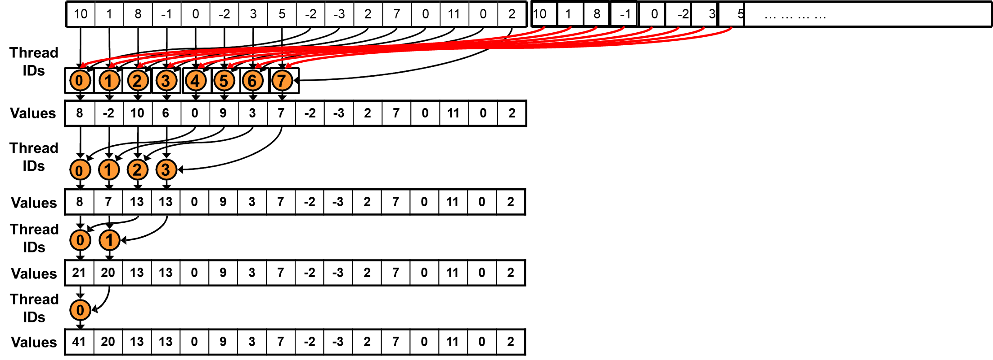
Algorithm Cascading (~=kernel fusion)
N=P for a threadblock, but Ntotal >> P
We can use sequential reduction before the parallel reduction takes part
Instead of handling N items each block, we can handle k*N items each block
Less loss from decreasing #threads
Carefully tune the number of blocks

Slide 35
Parallel Reduction Complexity
Log(N) parallel steps, each step S does N/2^{S}
independent ops
Step Complexity is O(log N)
For N=2^{D}, performs ∑_{S∈[1..D]}2^{D-S} = N-1 operations
Work Complexity is O(N) – It is work-efficient
i.e. does not perform more operations than a sequential algorithm
With P threads physically in parallel (P processors), time complexity is O(N/P + log N)
Compare to O(N) for sequential reduction In a thread block, N=P, so O(log N)

Slide 36
What About Cost?
Cost of a parallel algorithm is processors × time complexity
Allocate threads instead of processors: O(N) threads Time complexity is O(log N), so cost is O(N log N) : not cost efficient!
Brent’s theorem suggests O(N/log N) threads
Each thread does O(log N) sequential work
Then all O(N/log N) threads cooperate for O(log N) steps Cost = O((N/log N) * log N) = O(N) → cost efficient
Sometimes called algorithm cascading
Can lead to significant speedups in practice
Notes:
Brent's theorem: T_p <= T_1/p + T_inf
Since T_inf = logN, T_1 = N, we want p = N/logN

Slide 37
Algorithm Cascading
Combine sequential and parallel reduction
Each thread loads and sums multiple elements into shared memory
Tree-based reduction in shared memory
Brent’s theorem says each thread should sum O(log n) elements
i.e. 1024 or 2048 elements per block vs. 256
In my experience, beneficial to push it even further
Possibly better latency hiding with more work per thread
More threads per block reduces levels in tree of recursive kernel invocations
High kernel launch overhead in last levels with few blocks
On G80, best perf with 64-256 blocks of 128 threads
1024-4096 elements per thread
Similar to our matmul extra credit for utilizing more smem

Slide 38


Reduction #7: Multiple Adds / Thread
Replace load and add of two elements:
unsigned int tid = threadIdx.x;
unsigned int i = blockIdx.x*(blockDim.x*2) + threadIdx.x; sdata[tid] = g_idata[i] + g_idata[i+blockDim.x];
syncthreads();
With a while loop to add as many as necessary:
unsigned int tid = threadIdx.x;
unsigned int i = blockIdx.x*(blockSize*2) + threadIdx.x; unsigned int gridSize = blockSize*2*gridDim.x;
sdata[tid] = 0;
while (i < n) {
sdata[tid] += g_idata[i] + g_idata[i+blockSize]; i += gridSize;
}
syncthreads();

Slide 39

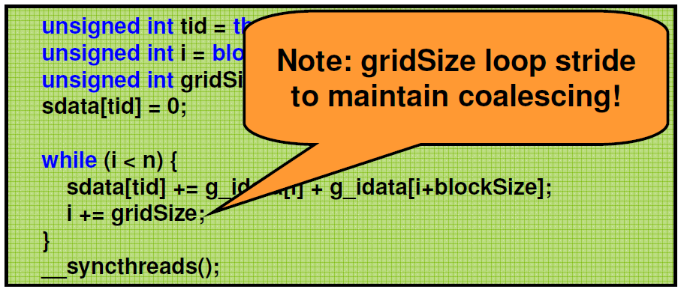

Reduction #7: Multiple Adds / Thread
Replace load and add of two elements:
unsigned int tid = threadIdx.x;
unsigned int i = blockIdx.x*(blockDim.x*2) + threadIdx.x; sdata[tid] = g_idata[i] + g_idata[i+blockDim.x];
syncthreads();
With a while loop to add as many as necessary:
unsigned int tid = threadIdx.x;
unsigned int i = blockI_{N}dx_{o}.x_{t}*_{e}(b:lo_{g}c_{r}k_{i}S_{d}iz_{S}e_{i}*_{z}2_{e}) +_{lo}th_{o}re_{p}ad_{s}Id_{tr}x_{i}.x_{d};_{e}
unsigned int gridSize = blockSize*2*gridDim.x;
sdata[tid] = 0;
to maintain coalescing!
while (i < n) {
sdata[tid] += g_idata[i] + g_idata[i+blockSize]; i += gridSize;
}
syncthreads();

Slide 40
Performance for 4M element reduction
Step Speedup
Cumulative Speedup
Time (2²² ints)
Bandwidth
Kernel 1:
interleaved addressing with divergent branching
Kernel 2:
interleaved addressing with bank conflicts
Kernel 3:
sequential addressing
Kernel 4:
first add during global load
Kernel 5:
unroll last warp
Kernel 6:
completely unrolled
Kernel 7:
multiple elements per thread
Kernel 7 on 32M elements: 73 GB/s!
8.054 ms | 2.083 GB/s
3.456 ms | 4.854 GB/s | 2.33x | 2.33x
1.722 ms | 9.741 GB/s | 2.01x | 4.68x
0.965 ms | 17.377 GB/s | 1.78x | 8.34x
0.536 ms | 31.289 GB/s | 1.8x | 15.01x
0.381 ms | 43.996 GB/s | 1.41x | 21.16x
0.268 ms | 62.671 GB/s | 1.42x | 30.04x

Slide 41





template <unsigned int blockSize>
global void reduce6(int *g_idata, int *g_odata, unsigned int n)
{
extern shared int sdata[];
unsigned int tid = threadIdx.x;
unsigned int i = blockIdx.x*(blockSize*2) + tid;
unsigned int gridSize = blockSize*2*gridDim.x; sdata[tid] = 0;
Final Optimized Kernel
while (i < n) { sdata[tid] += g_idata[i] + g_idata[i+blockSize]; i += gridSize; }
syncthreads();
if (blockSize >= 512) { if (tid < 256) { sdata[tid] += sdata[tid + 256]; } syncthreads(); } if (blockSize >= 256) { if (tid < 128) { sdata[tid] += sdata[tid + 128]; } syncthreads(); }
if (blockSize >= 128) { if (tid < 64) { sdata[tid] += sdata[tid +
if (tid < 32) {
if (blockSize >= 64) sdata[tid] += sdata[tid + 32]; if (blockSize >= 32) sdata[tid] += sdata[tid + 16];
if (blockSize >= 16) sdata[tid] += sdata[tid + 8];
64]; } syncthreads(); }
if (blockSize >= if (blockSize >= if (blockSize >=
8) sdata[tid] += sdata[tid + 4];
4) sdata[tid] += sdata[tid + 2];
2) sdata[tid] += sdata[tid + 1];
}
if (tid == 0) g_odata[blockIdx.x] = sdata[0];
35
}

Slide 42
Performance Comparison
10
1: Interleaved Addressing: Divergent Branches
2: Interleaved Addressing: Bank Conflicts
3: Sequential Addressing
4: First add during global load
5: Unroll last warp
6: Completely unroll
7: Multiple elements per thread (max 64 blocks)
1
Time (ms)
0.1
0.01
131072
262144
524288
1048576
2097152
4194304
8388608
16777216
33554432
# Elements

Slide 43
Types of optimization
Interesting observation:
Algorithmic optimizations
Changes to addressing, algorithm cascading 11.84x speedup, combined!
Code optimizations
Loop unrolling
2.54x speedup, combined

Slide 44
Conclusion
Understand CUDA performance characteristics
Memory coalescing Divergent branching Bank conflicts
Latency hiding
Use peak performance metrics to guide optimization Understand parallel algorithm complexity theory
Know how to identify type of bottleneck
e.g. memory, core computation, or instruction overhead
Optimize your algorithm, then unroll loops
Use template parameters to generate optimal code
Questions: mharris@nvidia.com

Slide 45
Lab – Implement them on your own!
The kernel code is already there in the slides (you probably need to fix a little). Just write a correct invocation.
Implement all seven versions and see the difference
If you have any more idea, apply them for even higher performance

Slide 46
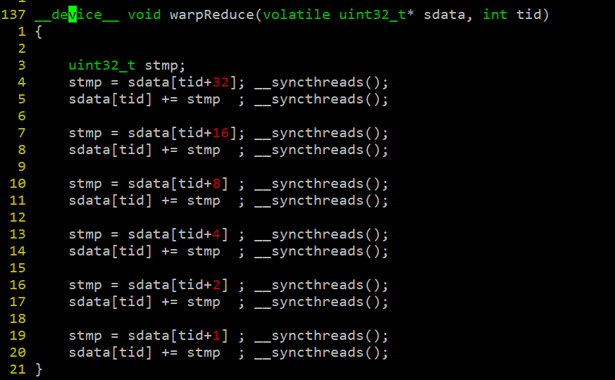
another wrong case
+= is also read+write
nope. this seems to be correct
Notes:
nope. this seems to be correct

Slide 47
Parallel Reduction: Sequential Addressing
Values (shared memory)
10 1 8 -1 0 -2 3 5 -2 -3 2 7 0 11 0 2
10 1 8 -1 0 -2 3 5 … … … …
Step 1
Stride 8
Thread IDs
0 | 1 | 2 | 3 | 4 | 5 | 6 | 7
8 | -2 | 10 | 6 | 0 | 9 | 3 | 7 | -2 | -3 | 2 | 7 | 0 | 11 | 0 | 2
0 | 1 | 2 | 3
Values
Step 2
Stride 4
Thread IDs
Values
Thread IDs
Values
Thread IDs
Values
8 | 7 | 13 | 13 | 0 | 9 | 3 | 7 | -2 | -3 | 2 | 7 | 0 | 11 | 0 | 2
Step 3
Stride 2
1
0
21 | 20 | 13 | 13 | 0 | 9 | 3 | 7 | -2 | -3 | 2 | 7 | 0 | 11 | 0 | 2
Step 4
Stride 1
0
41 | 20 | 13 | 13 | 0 | 9 | 3 | 7 | -2 | -3 | 2 | 7 | 0 | 11 | 0 | 2
Sequential addressing is conflict free
14

