Slide 1
Ensemble Learning
Bagging Explained for Beginners
What is an ensemble? What is Bagging? Any famous algorithm that uses Bagging?

Slide 2
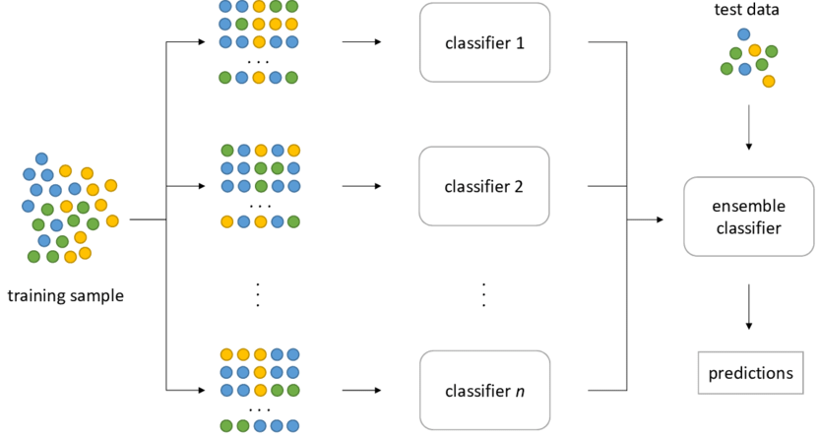
Ensemble
Courtesy: www.researchgate.net

Slide 3
Bagging
Courtesy: www.researchgate.net

Slide 4






















Bagging and Overfitting Example Regression

Slide 5
Bagging: A famous algorithm Random Forest
Multiple Decision Trees
Each trained on a random subset

Slide 6
Website : www.aisciences.net

