Slide 1

Ensemble Learning
Boosting Explained for Beginners
What is an ensemble? What is Boosting? Any famous algorithm that uses Boosting?

Slide 2
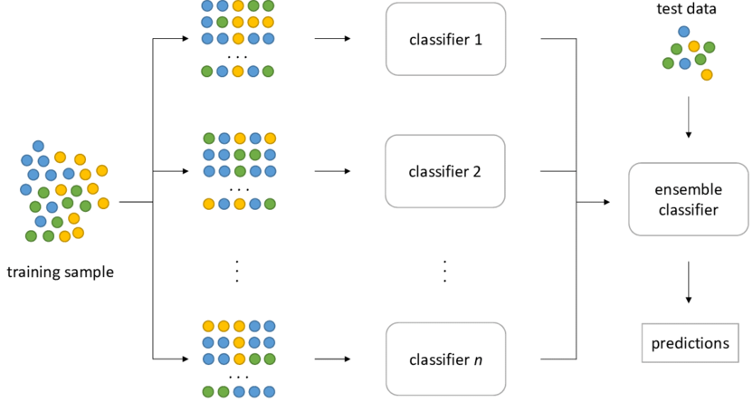
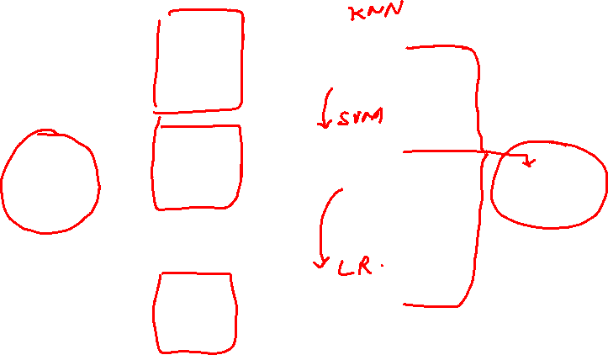
Ensemble
Courtesy: www.researchgate.net

Slide 3
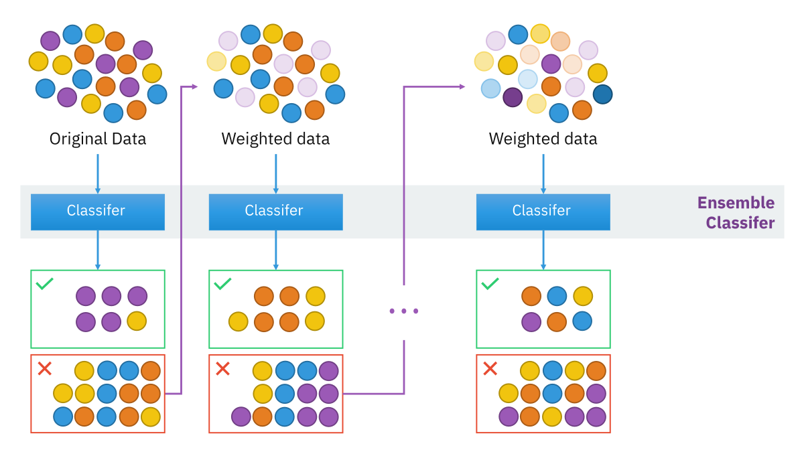
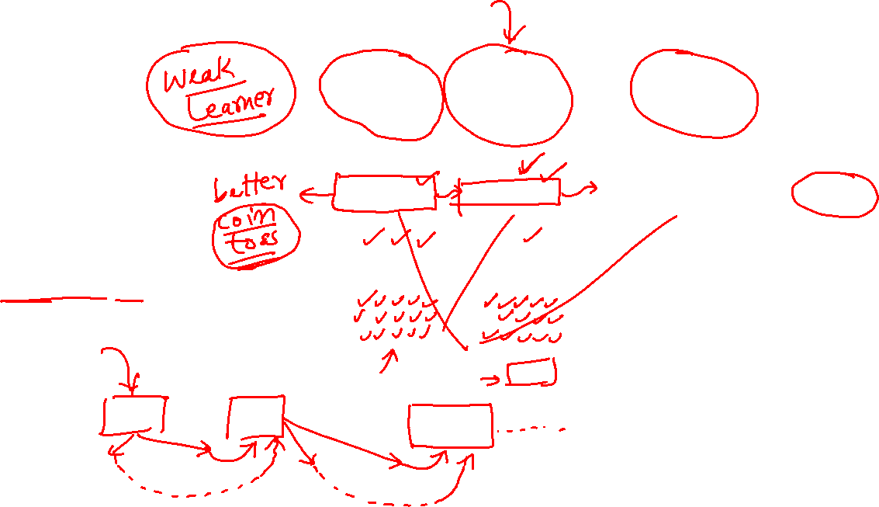
Boosting
Courtesy: commons.wikimedia.org

Slide 4
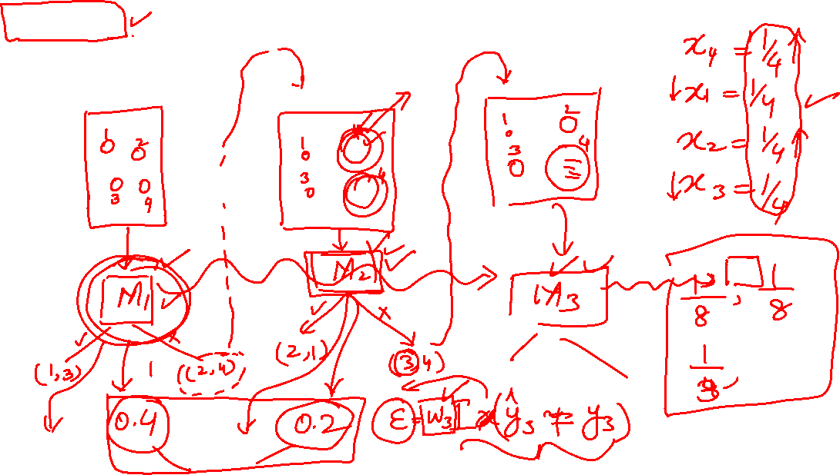
Boosting: A famous algorithm Adaboost

Slide 5
Website : www.aisciences.net

