Slide 1

Ensemble Learning
Stacking Explained for Beginners
What is an ensemble? What is Stacking? Stacking in Deep Learning!

Slide 2
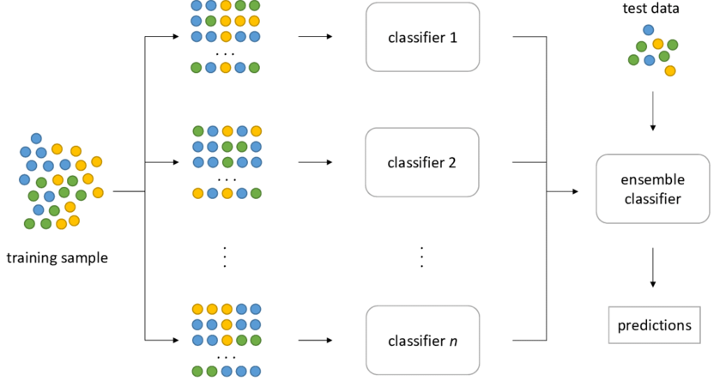
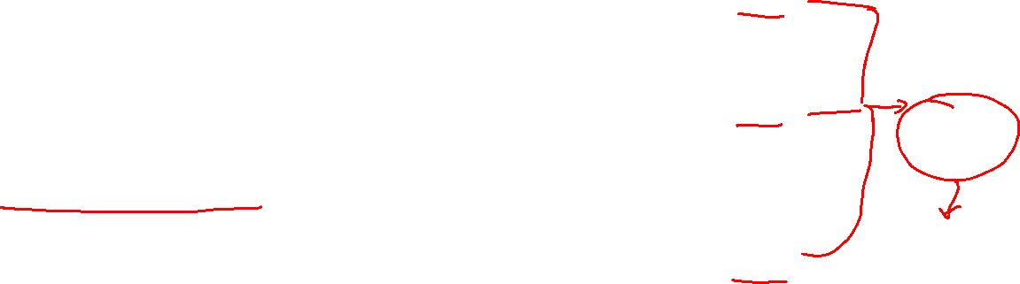
Ensemble
Courtesy: www.researchgate.net

Slide 3
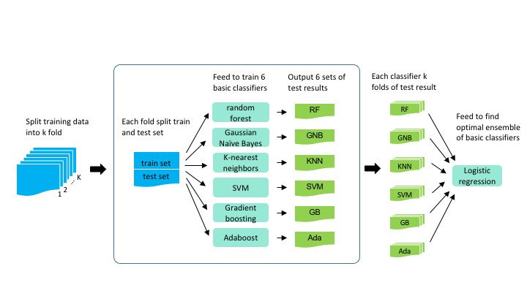
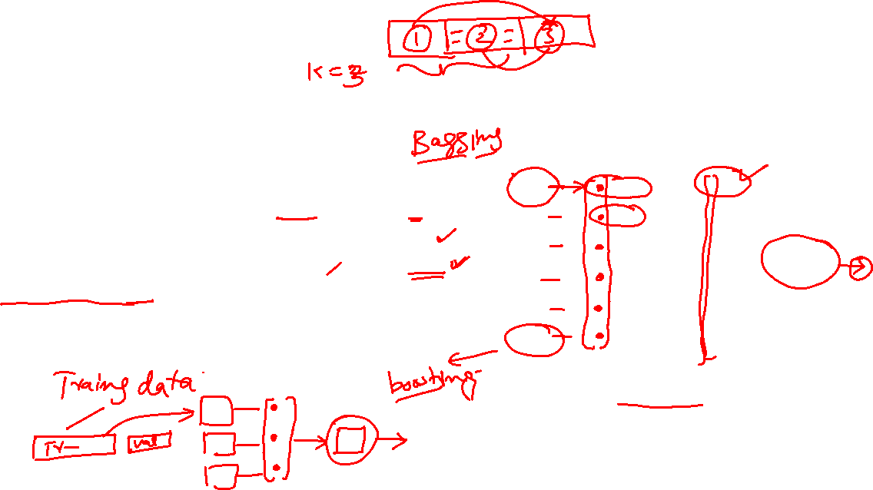
Stacking
Courtesy: www.researchgate.net

Slide 4
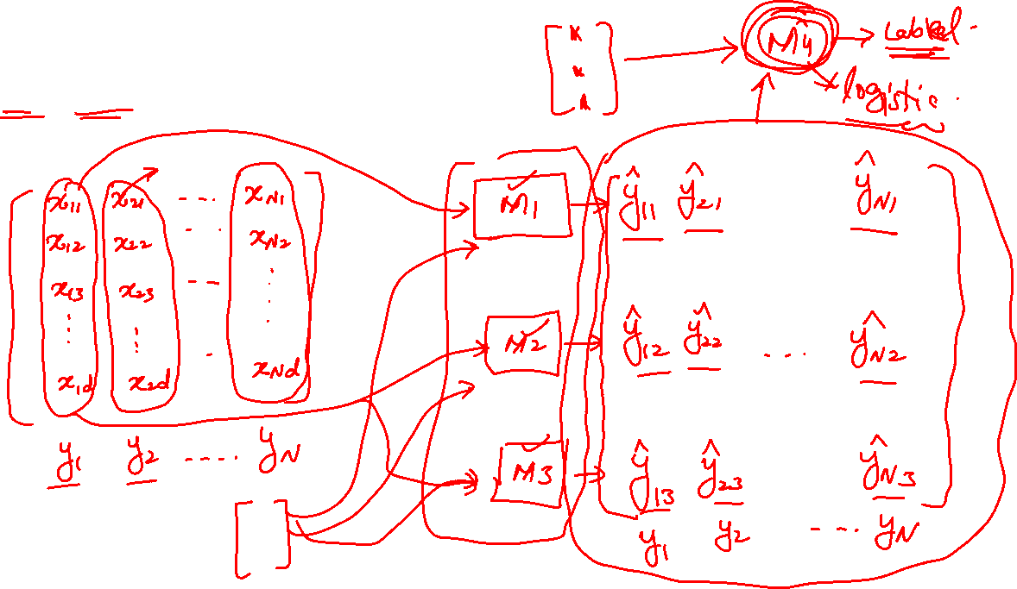
Stacking Example Single Level

Slide 5
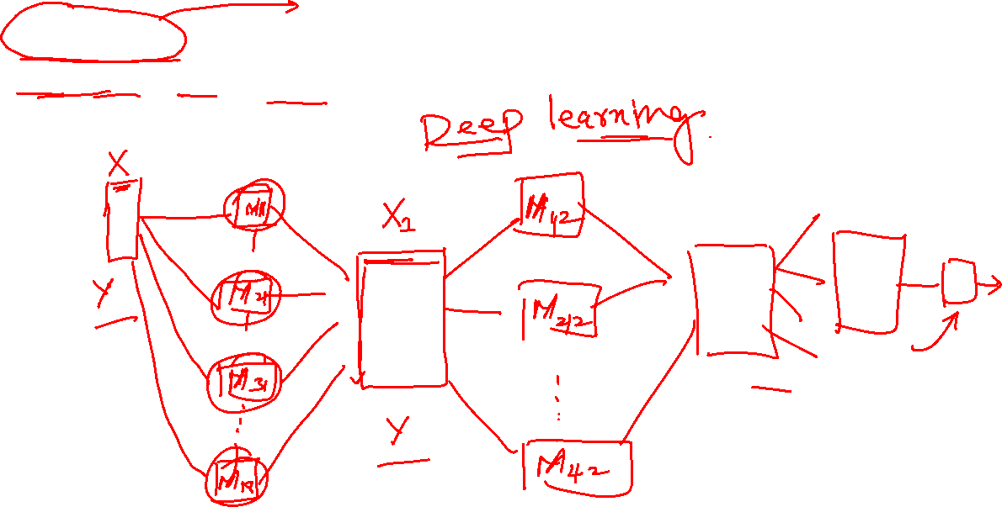
Stacking Example Multi Level ( Deep Learning )

Slide 6
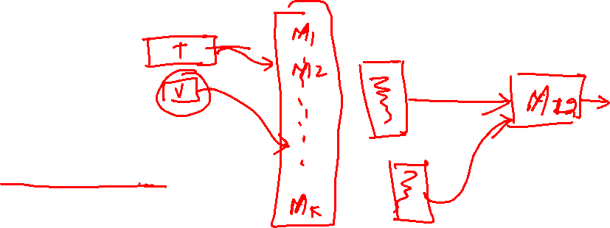
Blending

Slide 7
Website : www.aisciences.net

