Slide 1
Underfitting
Explained for beginners
Husnain Haider

Slide 2
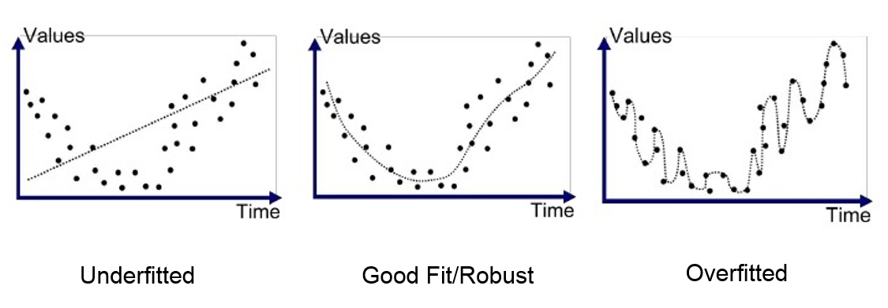
Underfitting concept?
Generalization aims that machine learning model learns general patterns from training data to perform equally good on unseen data
Underfitting is when machine learning model is not able to learn the patterns in the training data
Overfitting is when machine learning model learns specific patterns of the training data and performs bad on unseen data
Image curtsey: Google images

Slide 3
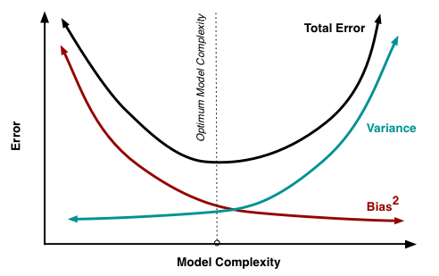
Goodness of fit
How well the model fits the training data
Model complexity should be adjusted according to the problem
Bias is the difference between our model’s prediction and ground truth which should be predicted
Variance is the model’s variability of prediction for a given data point
Image source: http://scott.fortmann-roe.com/docs/BiasVariance.html

Slide 4
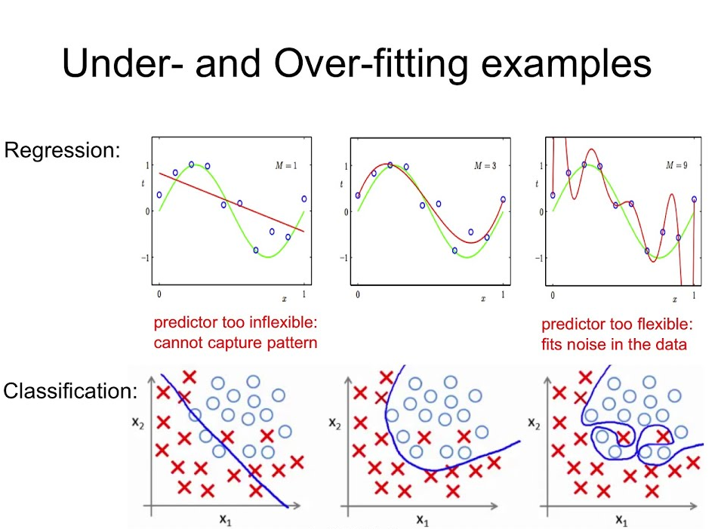
Regression and Classification
Regression and classification are two sub-problems of supervised learning

Slide 5
Diagnosis of underfitting
Results on training data as well as on testing data are very bad
For example, a model gives 30.9% accuracy on training data and 27% accuracy reported on test set, we call this underfitting

Slide 6
Why underfitting happens?
High bias, low variance
Less number of parameters
Less training
Insufficient training data
Insufficient complexity of model

Slide 7






Thank you
Please visit us on:
www.youtube.com/channel/UC8kFF39hsRrFfHM6-7A6APQ
www.aisciences.net
www.instagram.com/aisciences/
www.linkedin.com/company/aiscienceslearn
www.facebook.com/AISciencesLearn
www.twitter.com/AISciencesLearn

