Slide 1
Overfitting
Husnain Haider

Slide 2
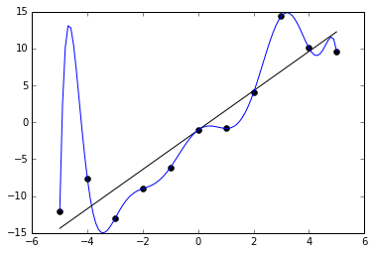
What is overfitting? Definition & Basics
In statistics, overfitting is "the production of an analysis that corresponds too closely or exactly to a particular set of data and may therefore fail to fit additional data or predict future observations reliably“
Signal and Noise
Curtsey: Wikipedia

Slide 3
Learning
Human learn from real world
Machine learn from data

Slide 4
Machine Learning (ML) Definition
Machine learning is the study of computer algorithms that improve automatically through experience (Wikipedia)
Machine learning is an application of artificial intelligence (AI) that provides systems the ability to automatically learn and improve from experience without being explicitly programmed

Slide 5
Generalization, Overfitting and Underfitting
Generalization aims that machine learning model learns general patterns from training data to perform equally good on unseen data
Overfitting is when machine learning model learns specific patterns of the training data and performs bad on unseen data
Underfitting is when machine learning model is not able to learn the patterns in training data.

Slide 6
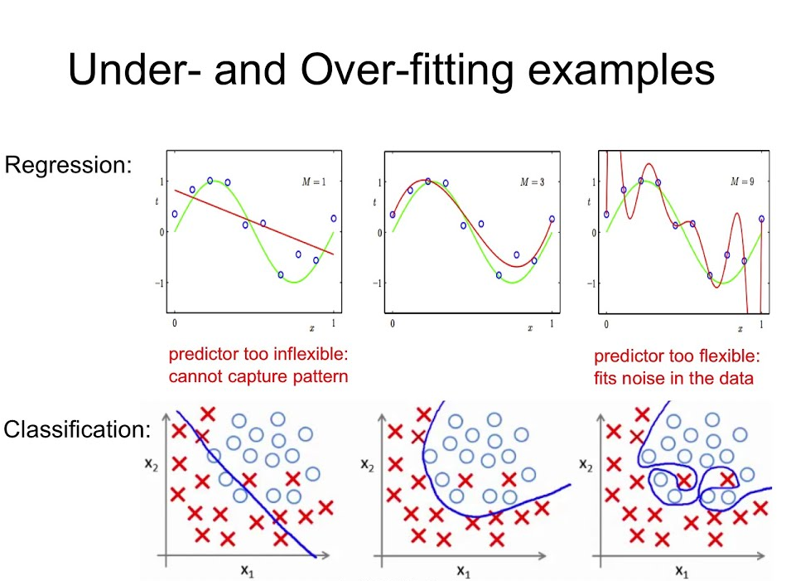
Regression and Classification
These are two sub-problems of supervised learning

Slide 7
Diagnosis of overfitting
Results on training data are way different from testing data
For example, a model gives 99.9% accuracy on training data but only 50% accuracy reported on test set, we call this overfitting

Slide 8
How to avoid overfitting
Validation set
Increase data
Less parameters
Regularization
Early stopping

