Slide 1
Backpropagation
Explained for Beginners
Neural Networks? Forward pass? Gradient Descent?

Slide 2










ANN

Slide 3
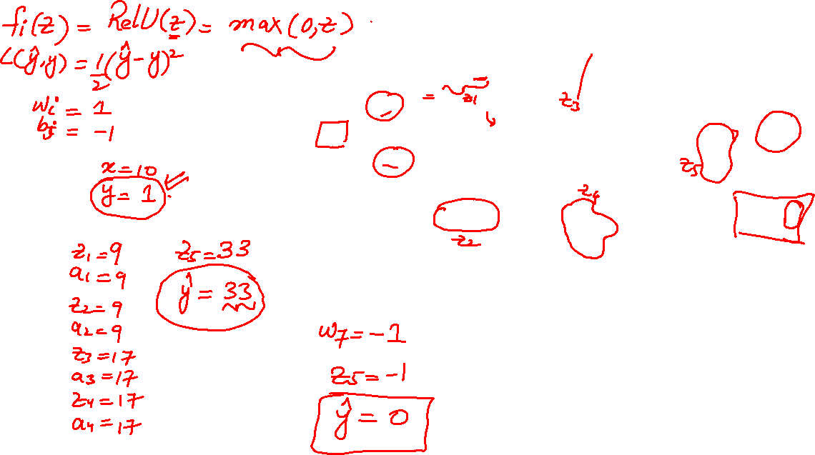
FP

Slide 4
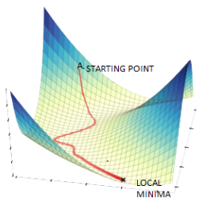
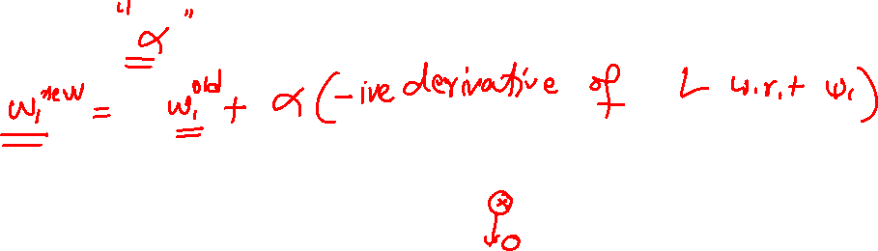
Gradient Descent
www.datasciencecentral.com

Slide 5
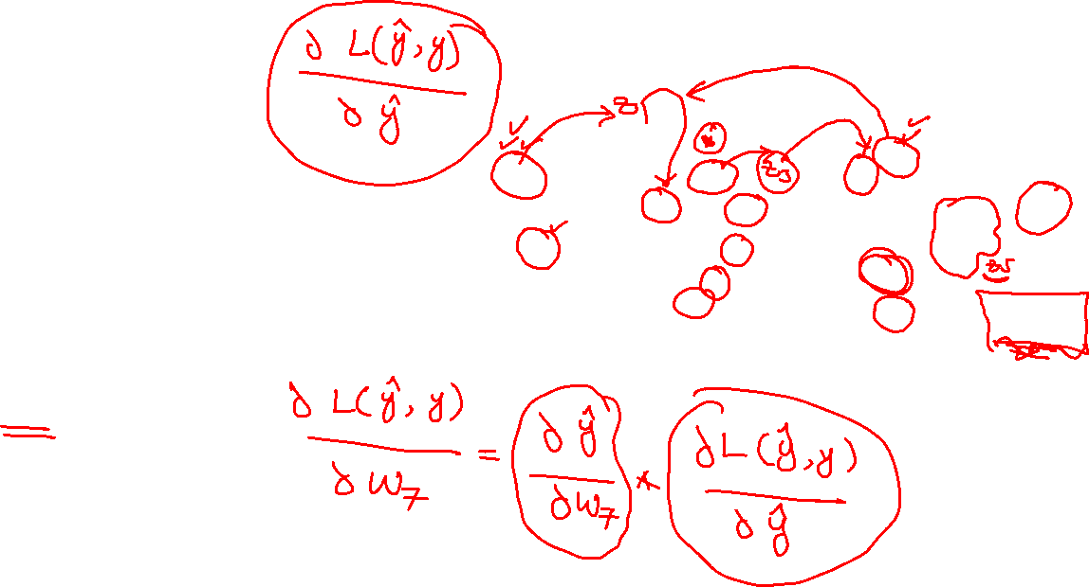
BP

Slide 6
Website : www.aisciences.io

