Slide 1
Naïve Bayes Classifier
Explained for beginners
Bayes Rule.
Curse of Dimensionality.
Naïve Bayes Assumption.
Naïve Bayes for Regression.
Hands-on in Python.

Slide 2
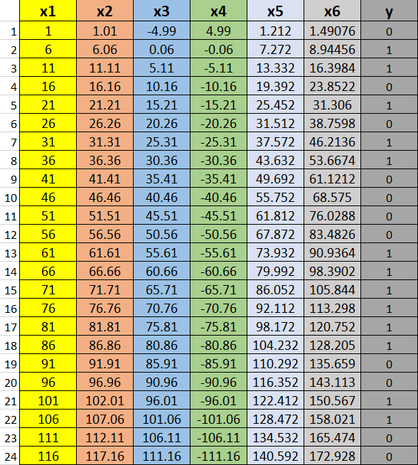
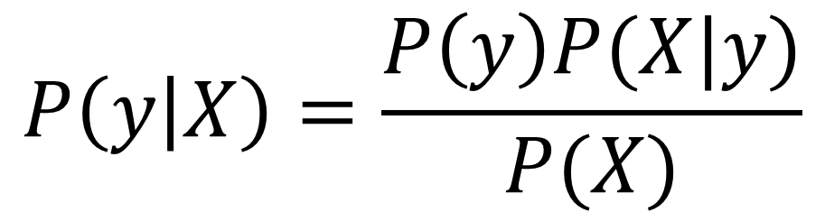
Bayes Rule
$$P\left(y | X\right)=\frac{P\left(y\right)P(X|y)}{P(X)}$$

Slide 3
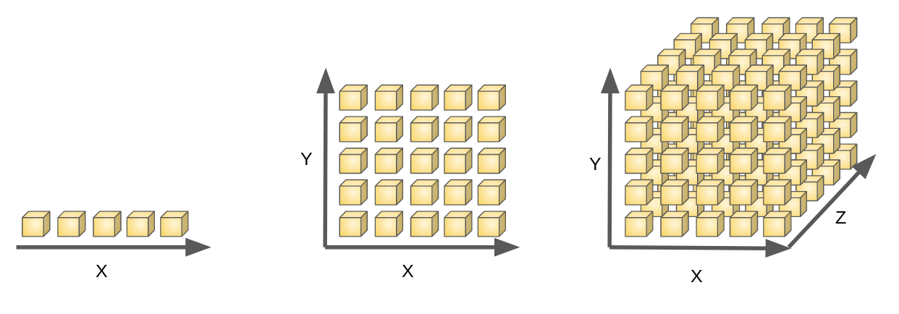
Curse of Dimensionality

Slide 4
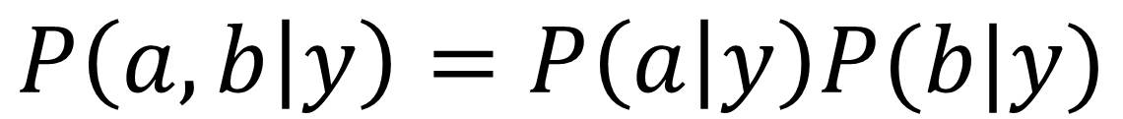
Naïve Bayes Assumption
$$P\left(a,b | y\right)=P\left(a | y\right)P(b|y)$$

Slide 5
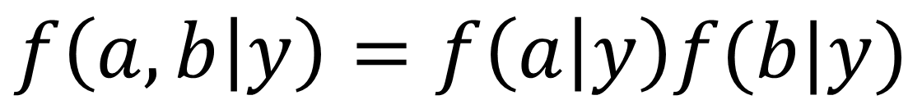
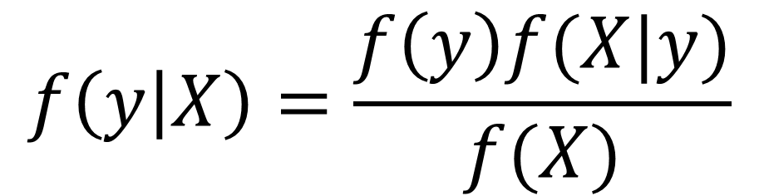
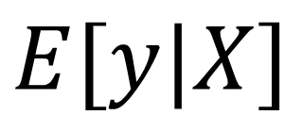
Naïve Bayes for Regression
$$f\left(y | X\right)=\frac{f\left(y\right)f(X|y)}{f(X)}$$
$$f\left(a,b | y\right)=f\left(a | y\right)f(b|y)$$
$$E[y|X]$$

Slide 6
Website : www.aisciences.io

