Slide 1
Decision Trees Explained for beginners
Binary Decision Tree.
Split.
Greedy Algorithm.
General Decision Tree.
Hands-on in Python.

Slide 2
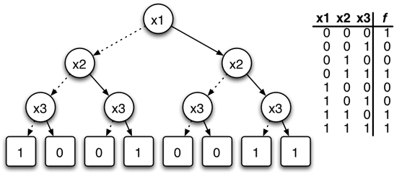
Binary Decision Tree

Slide 3
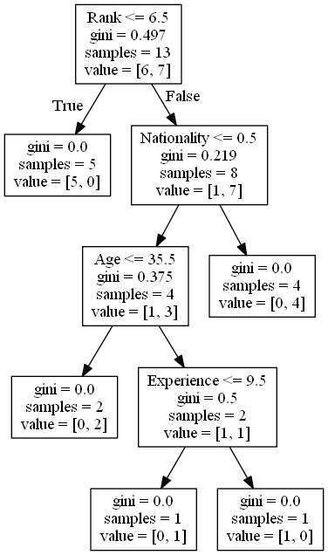
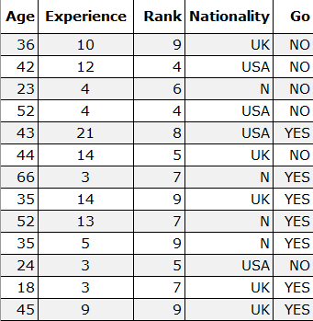
Split

Slide 4
Greedy approach

Slide 5
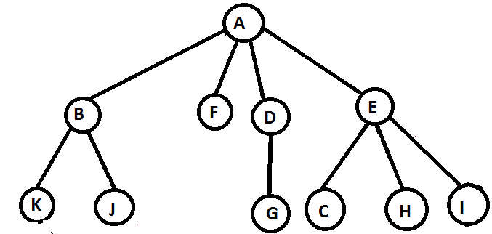
General Decision Tree

Slide 6
Website : www.aisciences.io

