Slide 1
Q Learning
Explained for Beginners
What is Q function?
What is Q Learning?
What is Deep Q Learning?

Slide 2
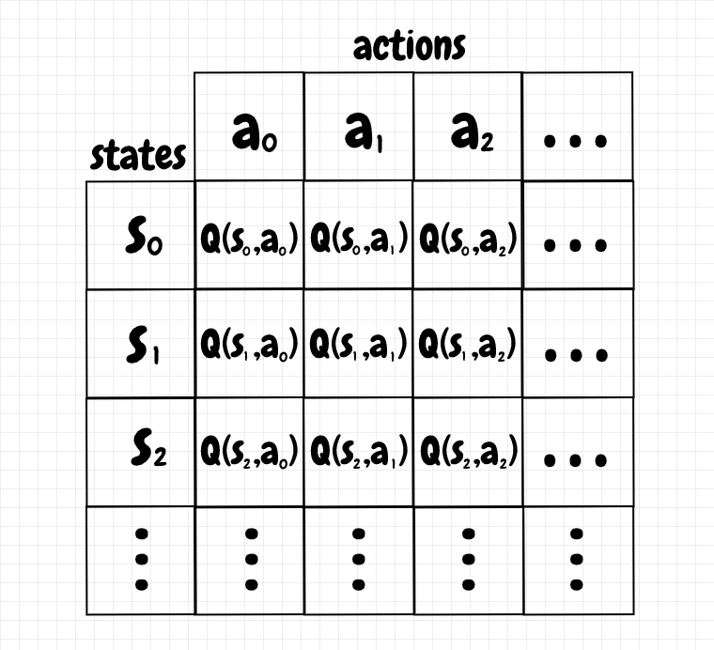
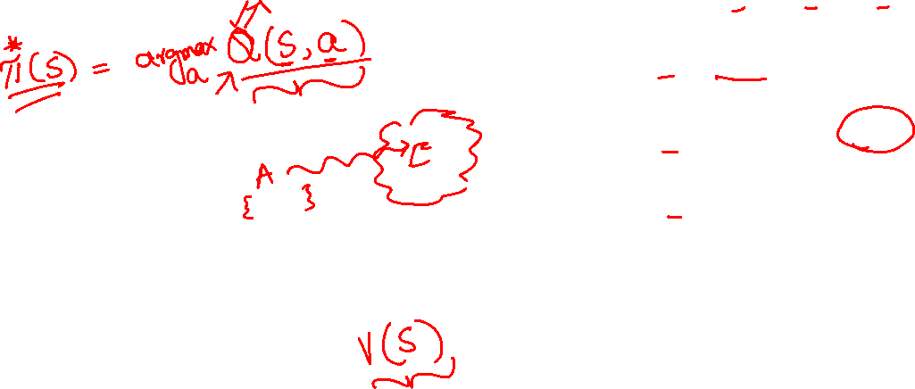
Q function
nestedsoftware.com

Slide 3
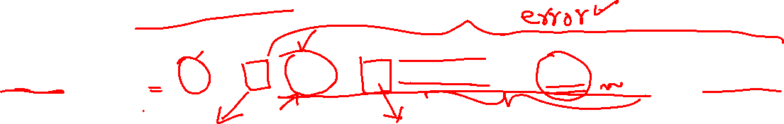
Q function
nestedsoftware.com
$Q\left(S_{t},A_{t}\right)=Q\left(S_{t},A_{t}\right)+α(\left[R_{t+1}+γ({argmax}_{a}(Q\left(S_{t+1},a \right)))\right]−Q\left(S_{t},A_{t}\right))$

Slide 4
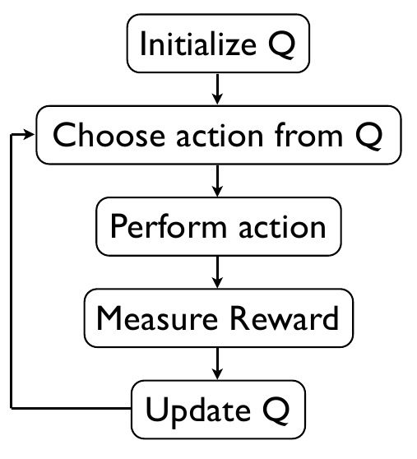
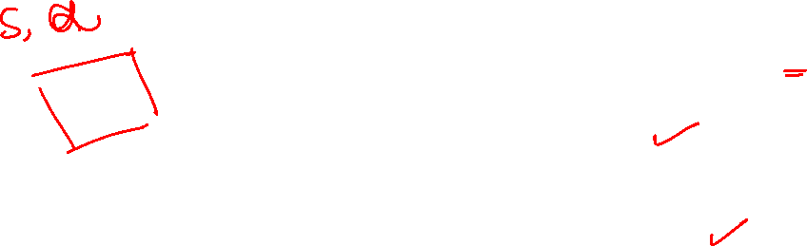
Q Learning
analyticsvidhya.com

Slide 5

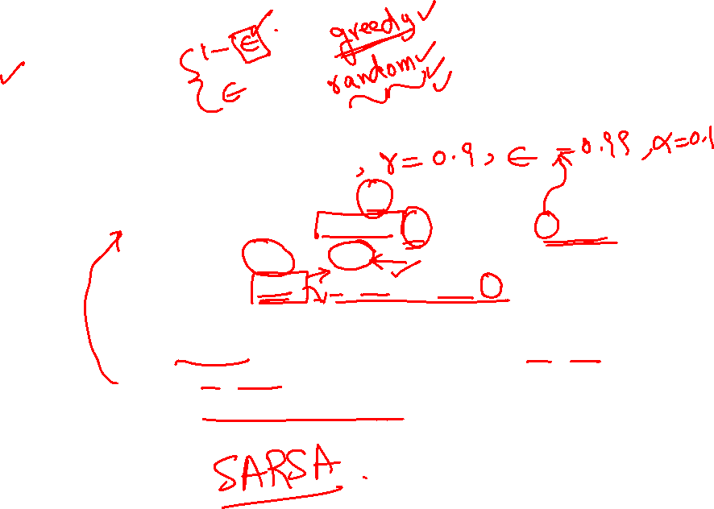
Q-Learning
Initialize $Q\left(s,a\right)=0$
Start from some state $S_{t}$ ( Random)
Sample and take an action $A_{t}$ with policy (e-greedy) for $S_{t}$
Observe $R_{t+1}$ and $S_{t+1}$
Compute $A_{t+1}={argmax}_{a}Q(S_{t+1},a)$
Update $Q\left(S_{t},A_{t}\right)$ as follows: $Q\left(S_{t},A_{t}\right)=Q\left(S_{t},A_{t}\right)+α\left(\left[R_{t+1}+γQ\left(S_{t+1},A_{t+1}\right)\right]−Q\left(S_{t},A_{t}\right)\right)$
Set $t=t+1$
If Terminal state reached, Go to step 2 otherwise Go to step 3.

Slide 6
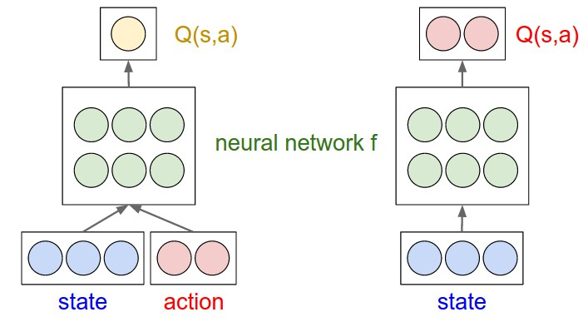
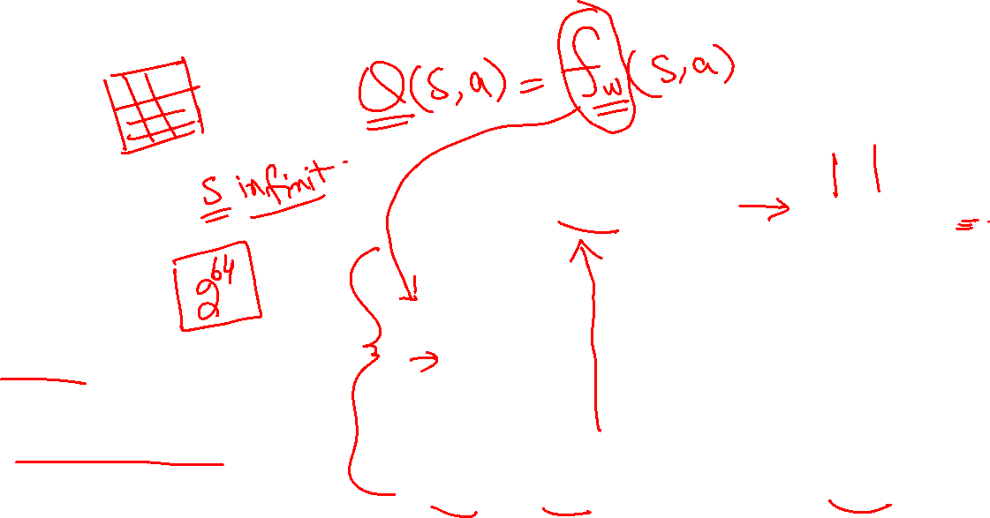
Deep Q Learning
cs.stanford.edu

Slide 7
Website : www.aisciences.io

