Slide 1
Python Date\Time Object Explained for beginners
What is Date\Time Object ?
Why it’s important ?
Date\Time Object Manipulation
Let’s do some hands-on in Python
Sajjad Mustafa

Slide 2
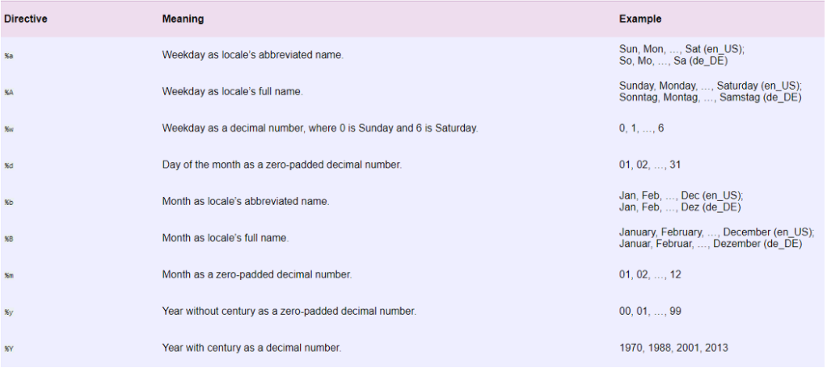
Date\Time Object

Slide 3
Website : www.aisciences.io

