Slide 1
Factorization based Word Embeddings in Python: Explained for beginners
Term-document-matrix.
Term-context-matrix.
Latent Semantic Analysis: SVD
Hands-on in Python.

Slide 2
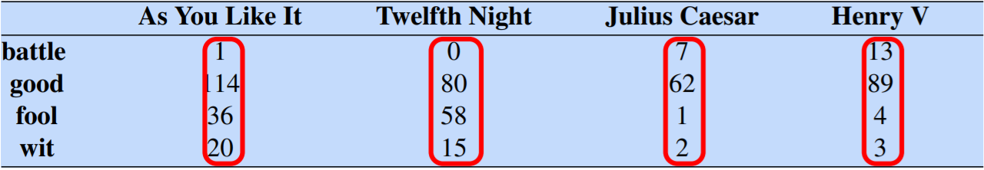
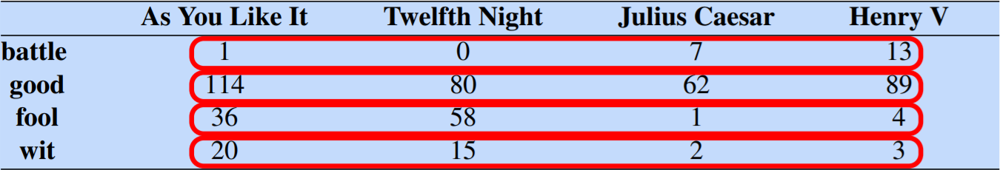
Term document matrix

Slide 3
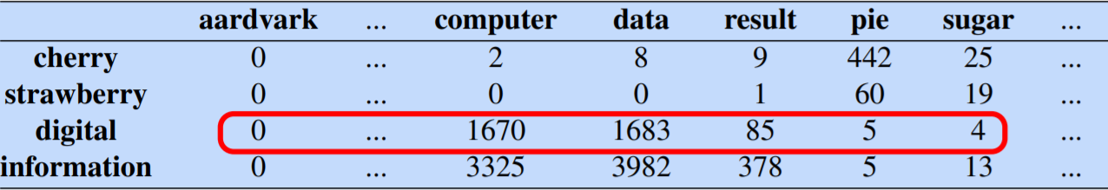
Term context matrix

Slide 4
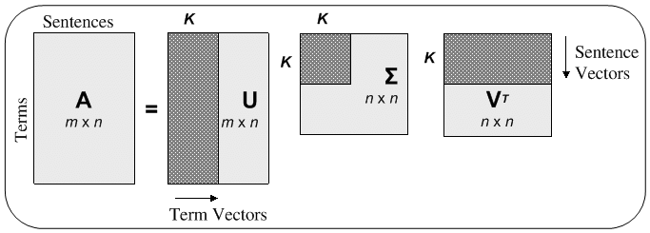
Latent Semantic Analysis

Slide 5
Website : www.aisciences.io

