Slide 1
Gaussian Basis Model
Explained for beginners
What is a Gaussian basis function?
How can it be used as a feature extractor?
K-Means with Gaussian Basis Model.
Hands-on in Python.

Slide 2
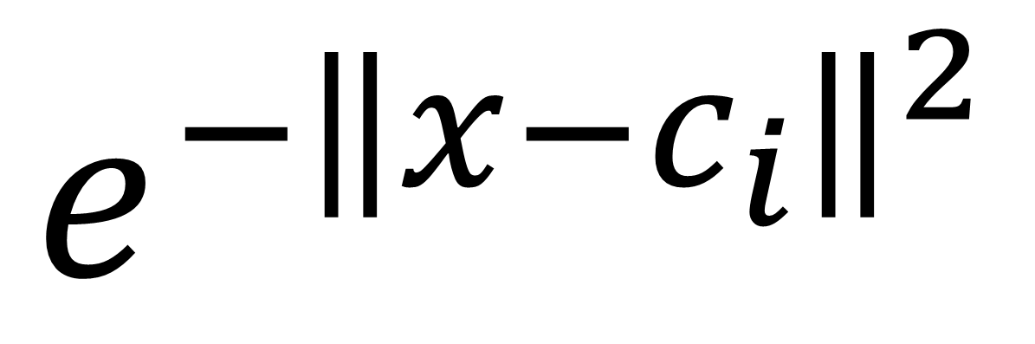
What is a Gaussian basis function
$$e^{−{\left\|x−c_{i}\right\|}^{2}}$$

Slide 3
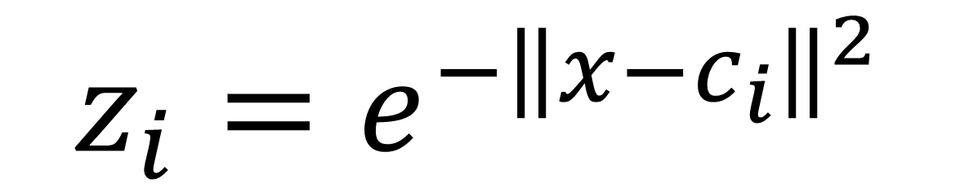
Feature Extraction
$$z_{i}{=e}^{−{\left\|x−c_{i}\right\|}^{2}}$$

Slide 4
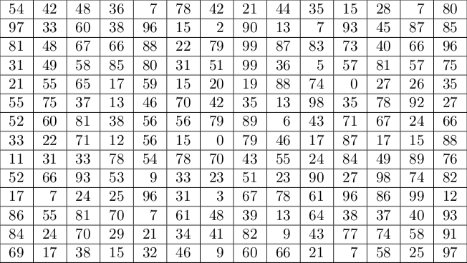
K-Means with Gaussian Basis Model

Slide 5
Website : www.aisciences.io

