Slide 1
Gensim in Python
Explained for beginners
Why Gensim?
Gensim in a nutshell.
Hands-on in Python.

Slide 2
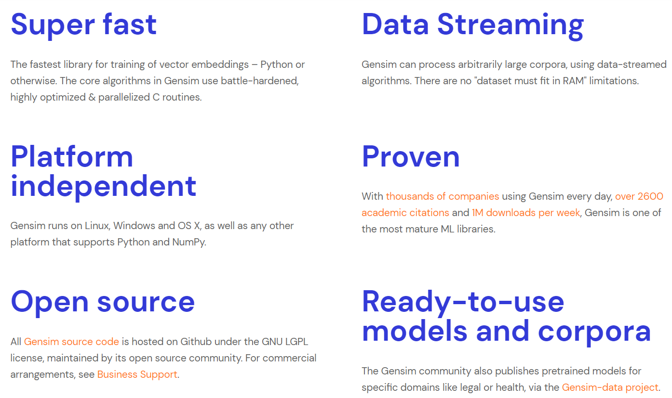
Why Gensim?
Courtesy: https://radimrehurek.com/gensim/

Slide 3
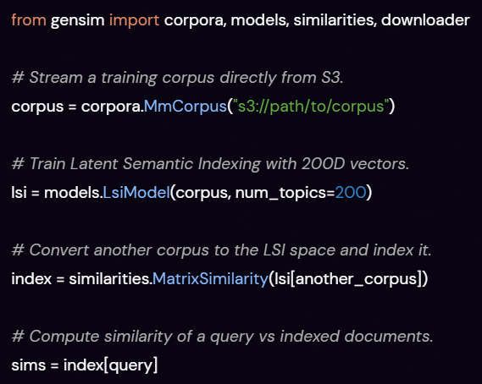
Gensim in a nutshell
Courtesy: https://radimrehurek.com/gensim/

Slide 4
Website : www.aisciences.io

