Slide 1
Gradient Boosting
Explained for Beginners Part 1
What is Boosting? What is Gradient Descent? What is Gradient Boosting?

Slide 2
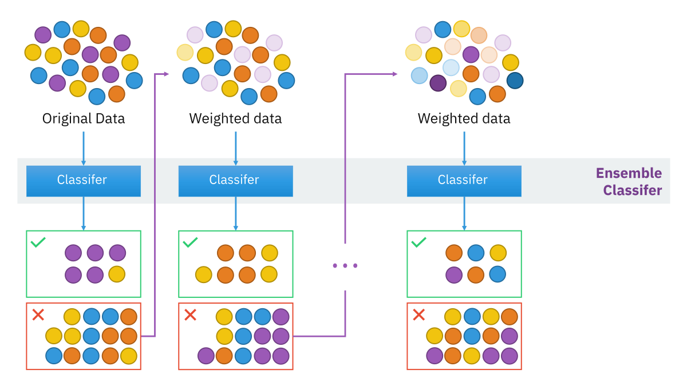
Boosting
commons.wikimedia.org

Slide 3
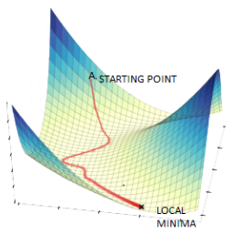
Gradient Descent
www.datasciencecentral.com

Slide 4

Gradient Boosting
Input training set $\{(x_{i},y_{i})\}$
Goal: find a mapping: $y_{i}=f\left(x_{i}\right)$
Initialize the model with a constant
For t = 1 to T iterations
Computer the gradient
Fit a base learner
Compute the best learning rate
Update the model

Slide 5
Website : www.aisciences.net

