Slide 1
Gradient Boosting
Explained for Beginners Part 2
Gradient Boosting with Squared Loss. Stochastic Gradient Boosting. Overfitting.

Slide 2
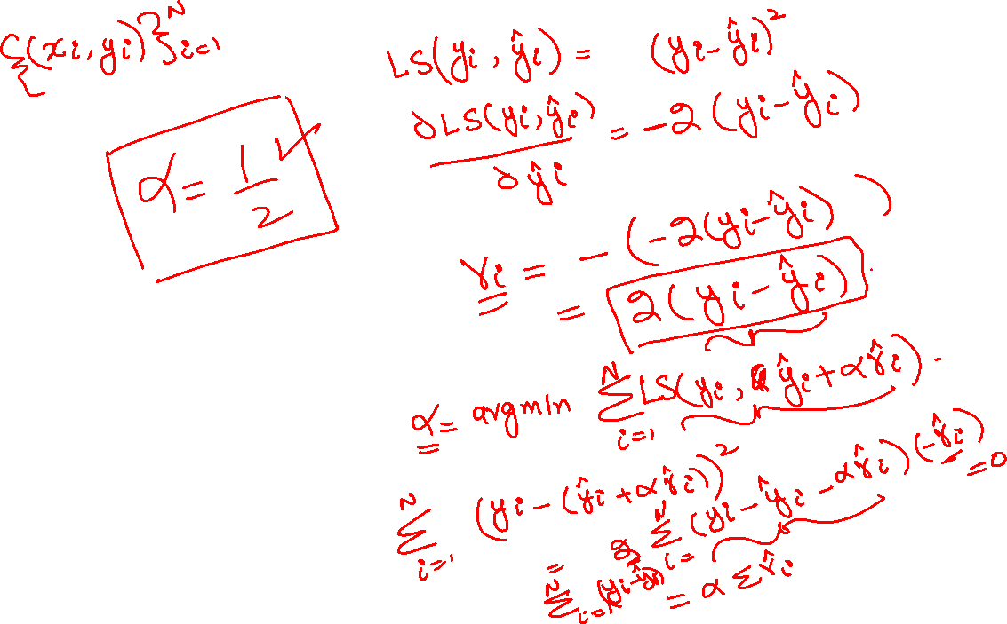
Gradient Boosting Squared Loss

Slide 3
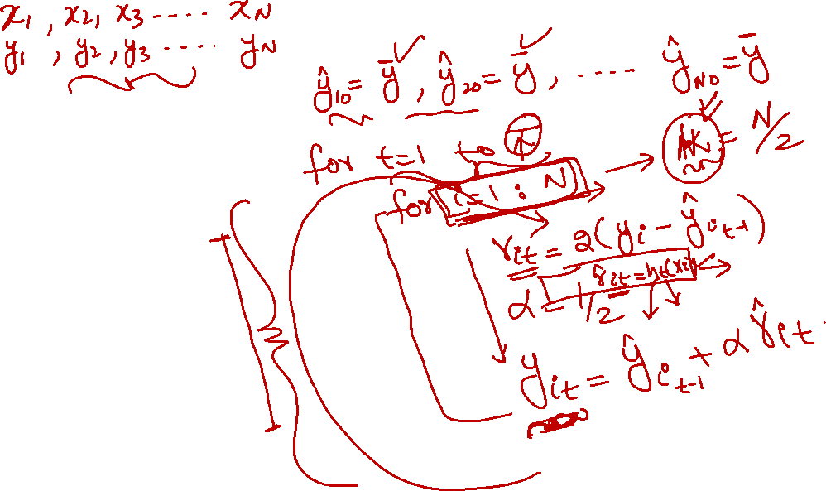
Gradient Boosting Squared Loss

Slide 4
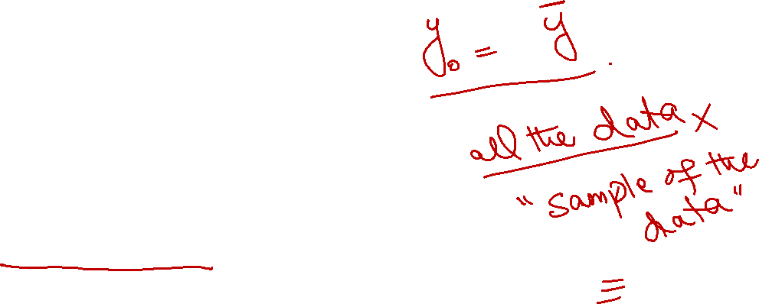
Stochastic Gradient Boosting

Slide 5
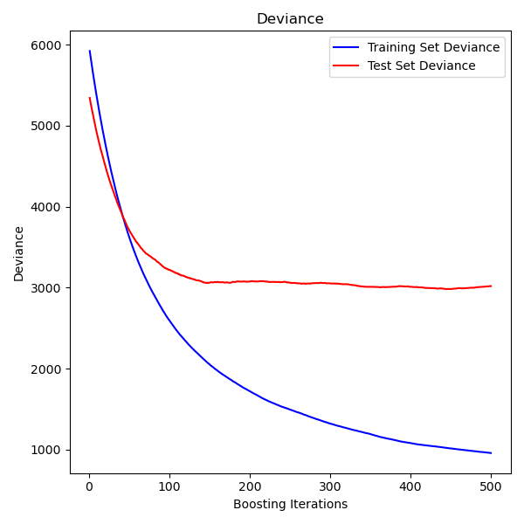
Overfitting

Slide 6
Website : www.aisciences.net

