Slide 1
K Means for Dimensionality Reduction
Explained for beginners
What does K Means do?
What is Dimensionality Reduction?
Distance Features Extraction using K Means.
Subspace Projection of Centroids.
Hands-on in Python.

Slide 2
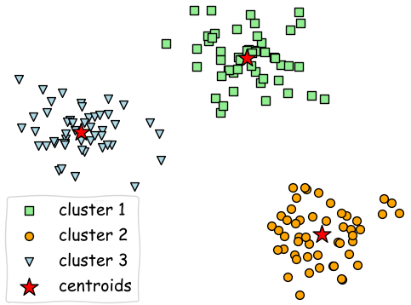
What does K Means do

Slide 3
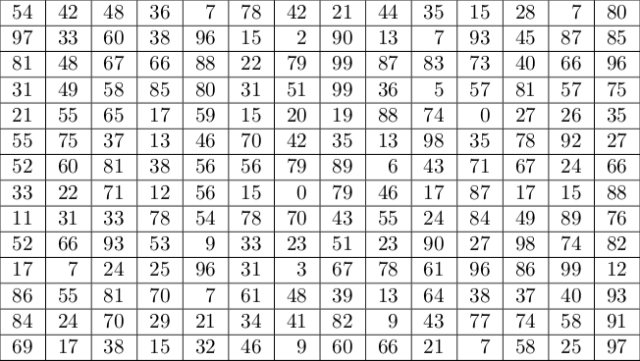
What is Dimensionality Reduction

Slide 4
Distance Features

Slide 5
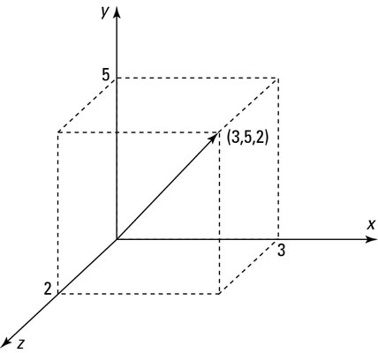
Subspace Projection

Slide 6
Conclusion
Compute centroids using K Means
Use distances from centroids as features
Or project onto the subspace spanned by centroids
The number of centroids is the new dimension

Slide 7
Website : www.aisciences.io

