Slide 1
K Means Clustering
Explained for beginners
What does KMeans do?
How does KMeans do it?
KMeans++.
Image Compression with KMeans.
Dimensionality Reduction with KMeans.
Hands-on in Python.

Slide 2
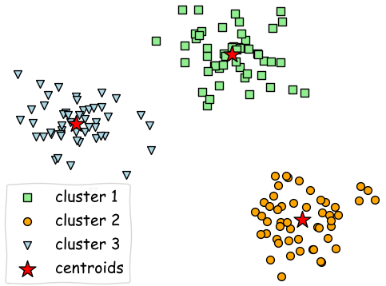
What does KMeans do

Slide 3
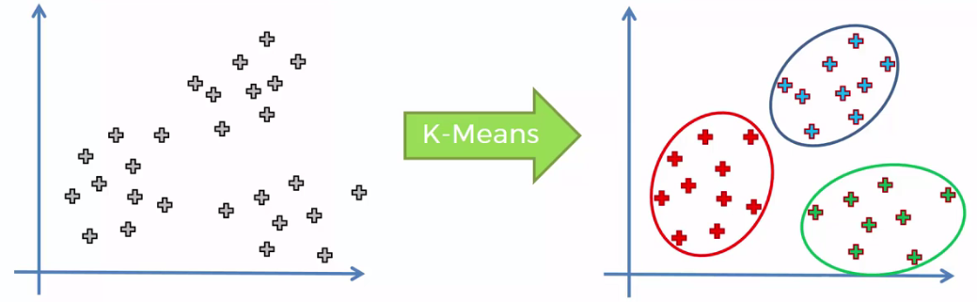
How does KMeans do it

Slide 4
KMeans++
Choose one center uniformly at random among the data points.
For each data point x not chosen yet, compute D(x), the distance between x and the nearest center that has already been chosen.
Choose one new data point at random as a new center, using a weighted probability distribution where a point x is chosen with probability proportional to D(x)².
Repeat until k centers have been chosen.

Slide 5
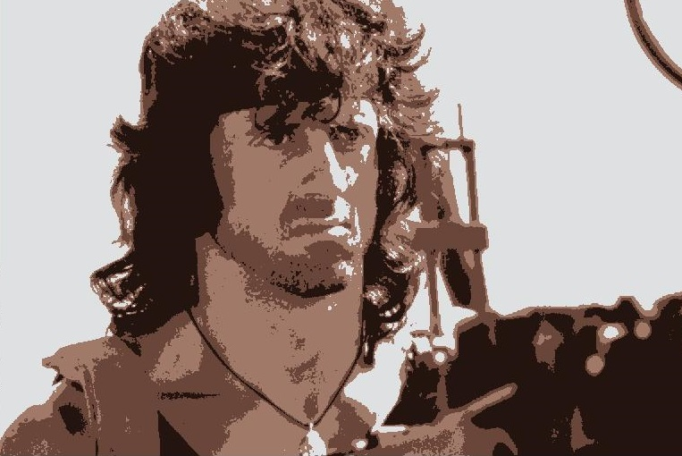
Image Compression

Slide 6
Dimensionality Reduction

Slide 7
Website : www.aisciences.io

