Slide 1
K Nearest Neighbours Classifier
Explained for beginners
Distance.
Nearest Neighbour Classification.
K Nearest Neighbours Classification.
K Nearest Neighbours Regression.
Weighted KNN.
Hands-on in Python.

Slide 2
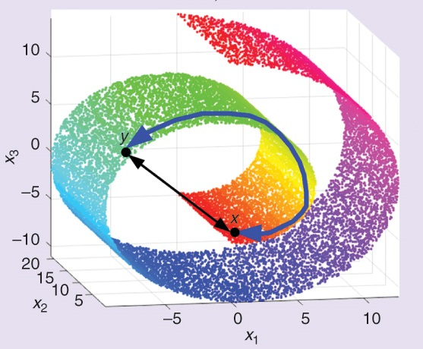
Distance

Slide 3
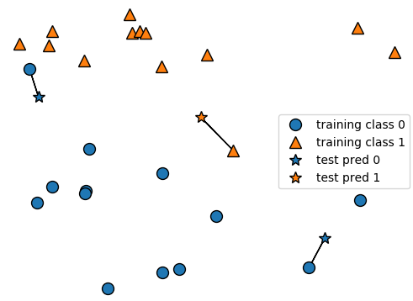
Nearest Neighbour

Slide 4
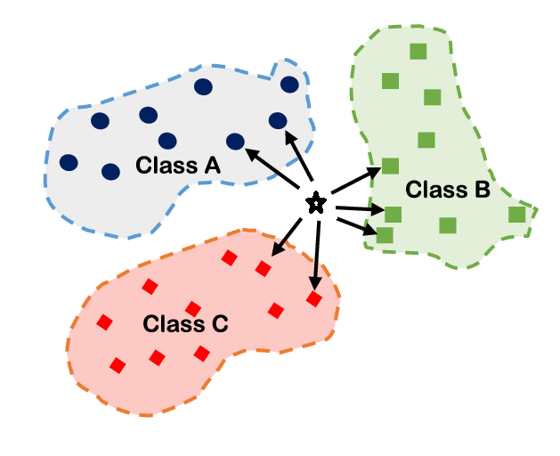
K Nearest Neighbours

Slide 5
Regression

Slide 6
Weighted KNN

Slide 7
Website : www.aisciences.io

