Slide 1
Logistic Regression Explained for beginners
Classification.
Logistic Function.
Cross Entropy Loss Function.
Gradient Descent.
Hands-on in Python.

Slide 2
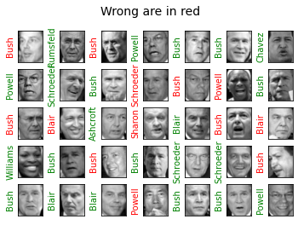
Classification

Slide 3
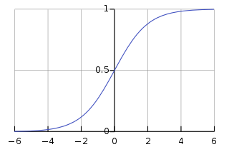
Logistic Function

Slide 4

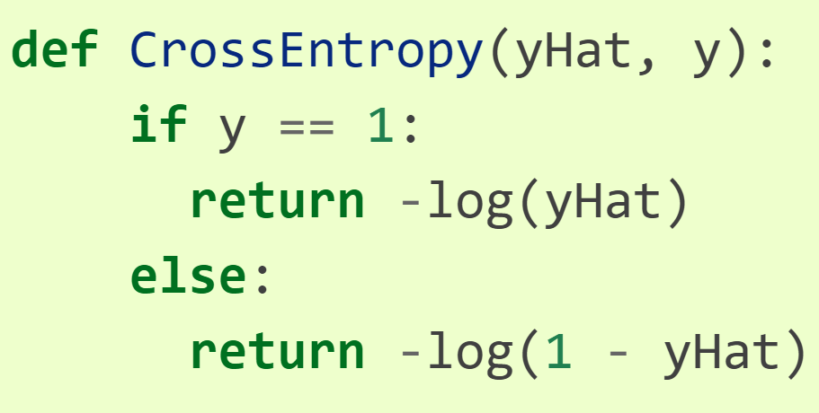
Cross Entropy Loss

Slide 5
Gradient Descent

Slide 6
Website : www.aisciences.io

