Slide 1
Random Forests Explained for beginners
Bagging.
Decision Tree.
Feature Bagging.
General Random Forests.
Hands-on in Python.

Slide 2
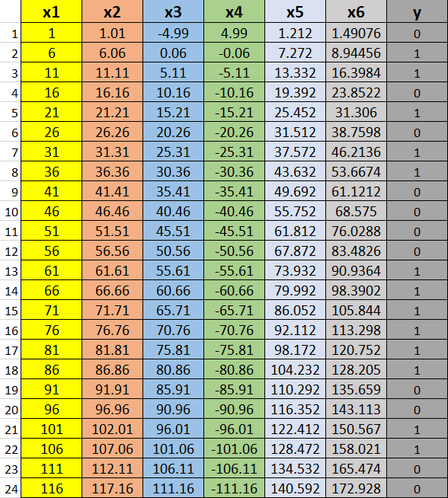
Bagging

Slide 3
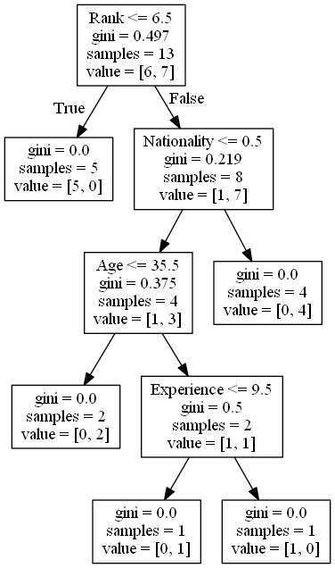
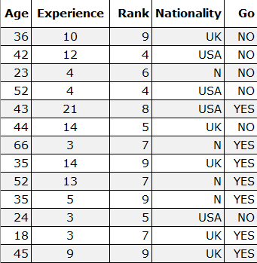
Decision Tree

Slide 4
Feature Bagging

Slide 5
General Random Forest

Slide 6
Website : www.aisciences.io

