Slide 1
Words analogies and visualizations in Python
NLP explained for beginners
Embeddings.
Cosine similarity.
Analogies.
Visualizations
Hands on in Python

Slide 2
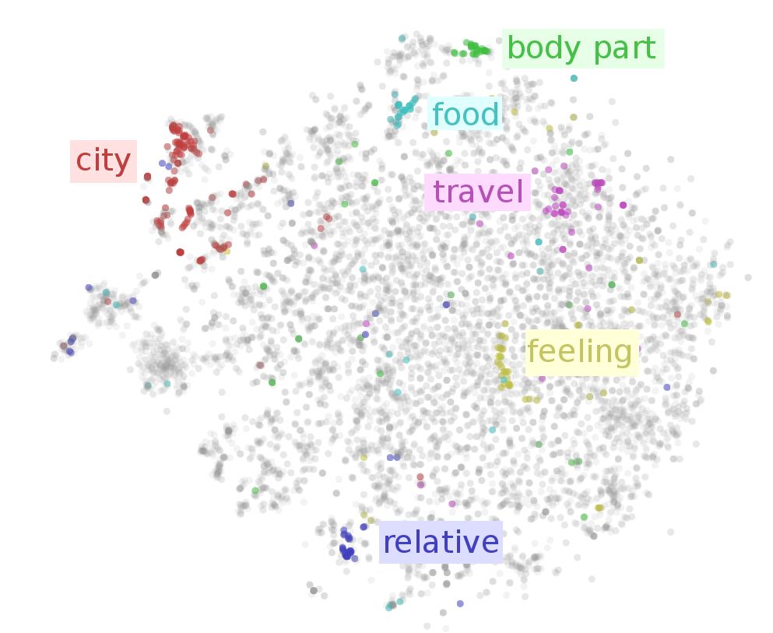
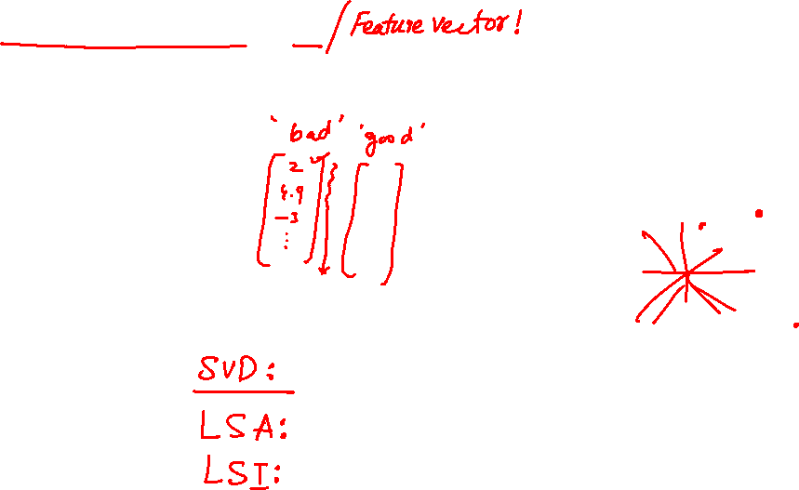
Embeddings

Slide 3
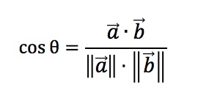
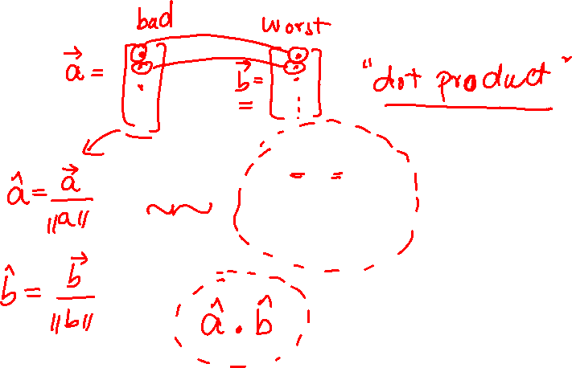
Cosine Similarity

Slide 4
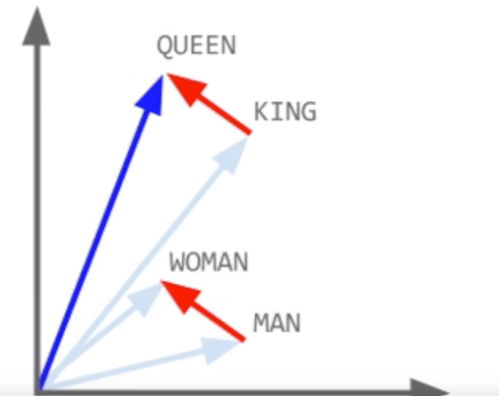
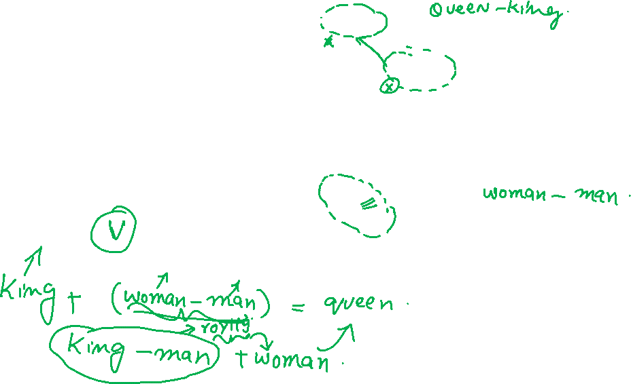
Analogy

Slide 5
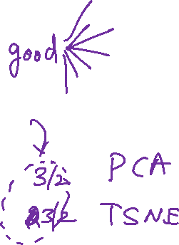
Visualizations

Slide 6
Website : www.aisciences.io

