Slide 1
XGBoost in Python
Explained for beginners
Ensemble Learning Methods.
Gradient Boosting.
eXtreme Gradient Boosting: XGBoost
Hands-on in Python.

Slide 2
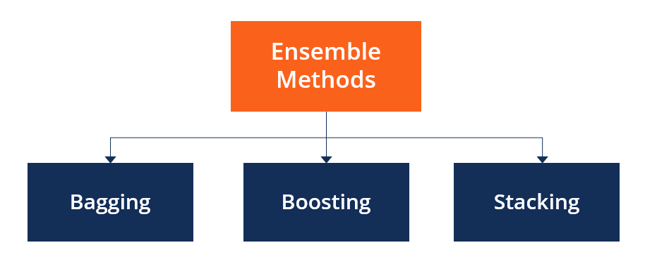
Ensemble Methods

Slide 3
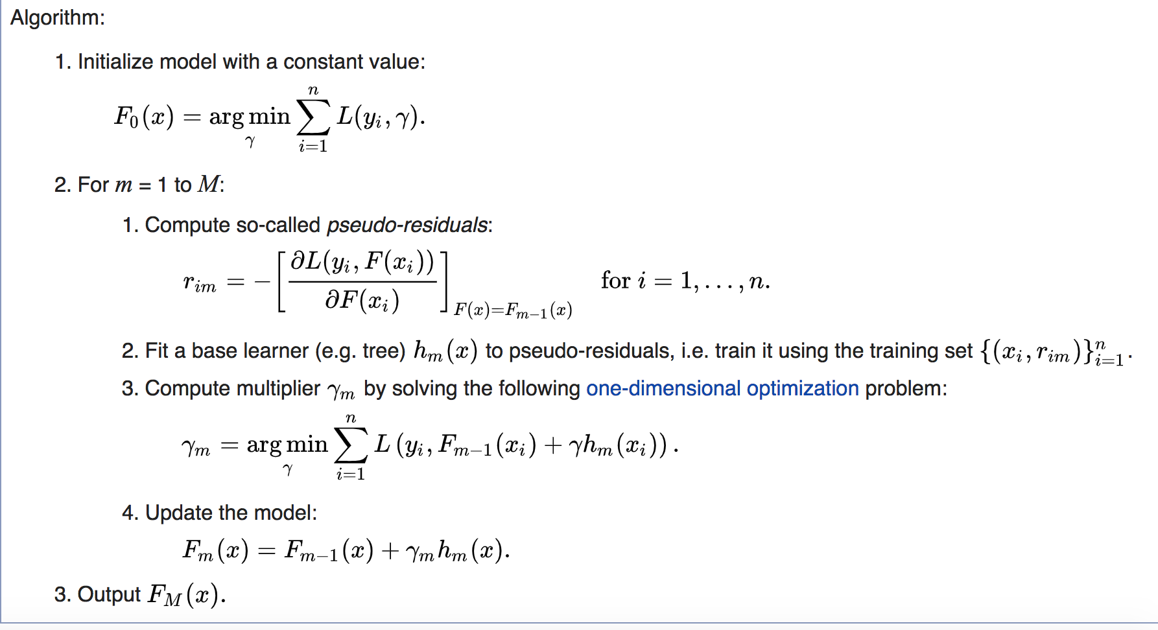
Gradient Boosting

Slide 4
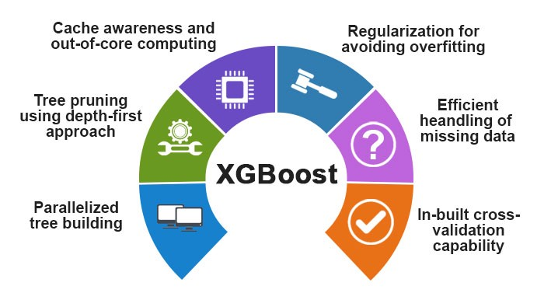
XGBoost

Slide 5
Website : www.aisciences.io

