Slide 1


AZURE Projects for Data Engineering
INSTRUCTOR: MAHNOOR KHALID
WWW.AISCIENCES.IO

Slide 2
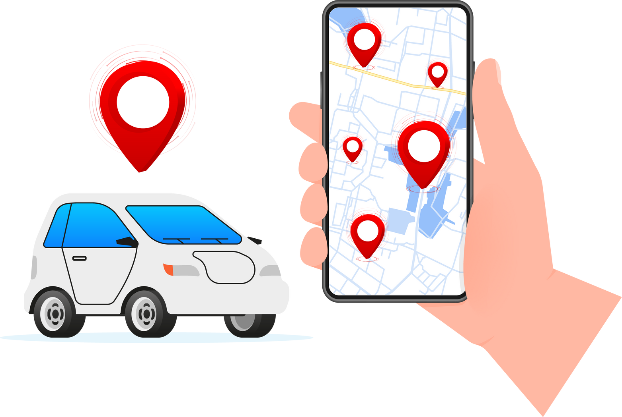
UBER TAXI DATASET ANALYSIS
Data Source:
NYC Yellow Taxi Data

Slide 3

UBER TAXI DATASET ANALYSIS
Steps to fetch data from the NYC TLC site to upload it to the storage account:
Create a linked service for HTTP request
Create a container on the storage account
Create dataset for both source and sink to copy parquet file on blob

Slide 4

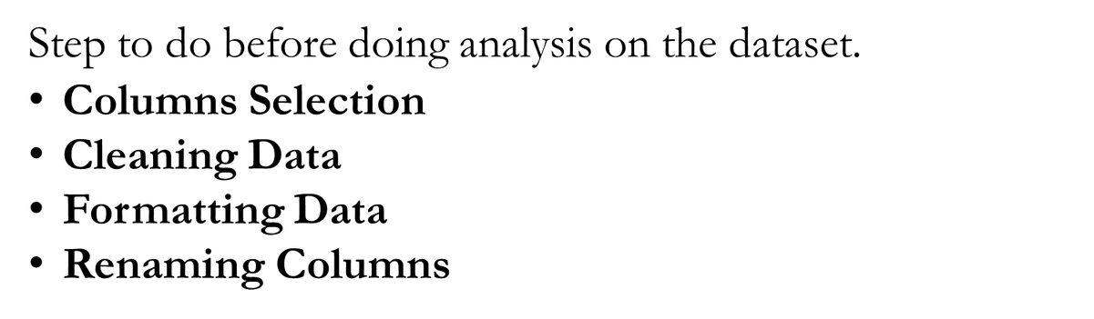
UBER TAXI DATASET ANALYSIS
PRE-PROCESSING

Slide 5
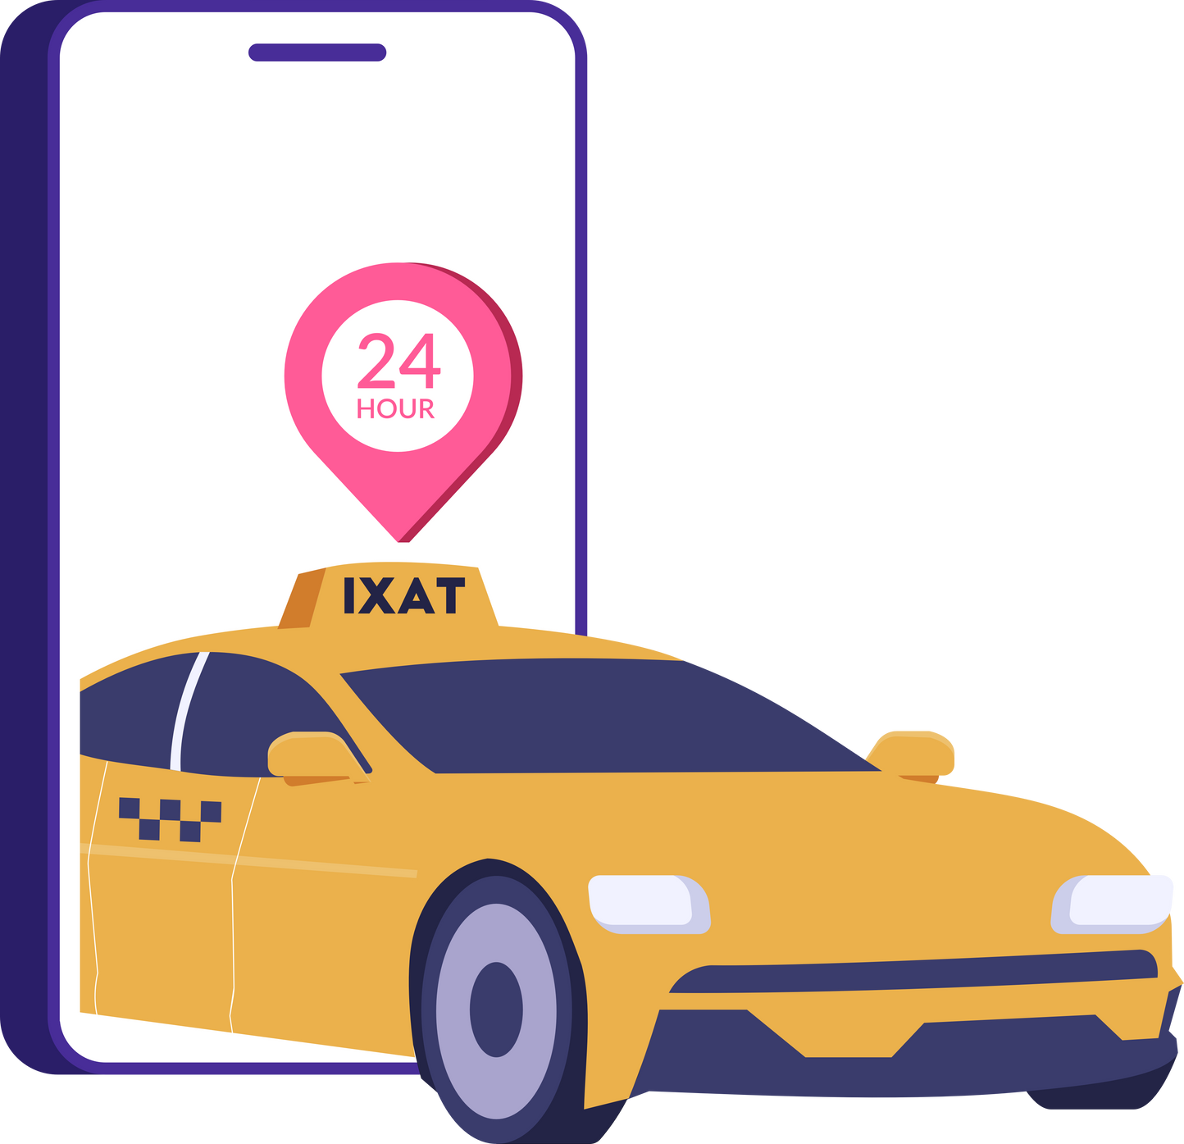
UBER TAXI DATASET ANALYSIS
Taxi Demand Analysis:
What is the overall demand for Uber rides during different time-periods (days of the week, hours of the day, etc.)?
How does the passenger count vary during peak and off-peak hours?

Slide 6
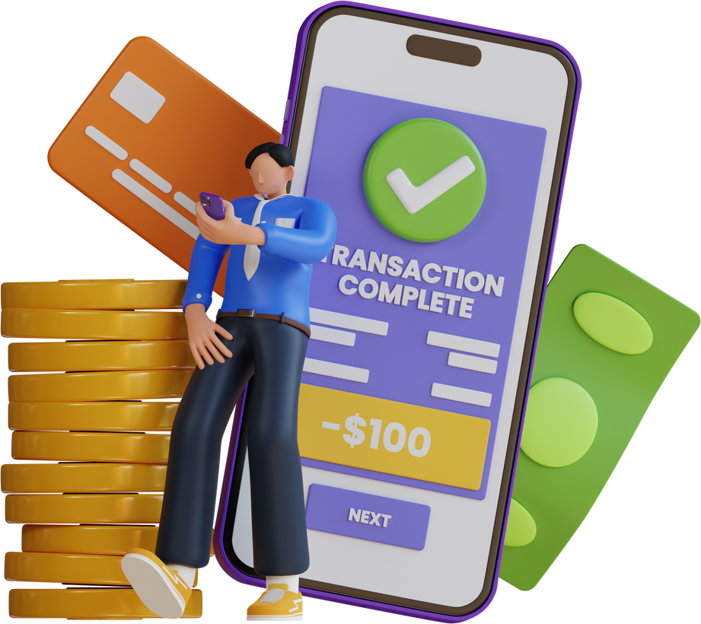
UBER TAXI DATASET ANALYSIS
Payment Analysis:
What is the distribution of payment types (cash, credit card, etc.)?
Is there any correlation between payment types and trip distance?

Slide 7
CONTACT US
contact@aisciences.io
www.aisciences.io
@AISciencesLearn

