Slide 1
PySpark & AWS: Master Big Data With PySpark and AWS
Hands on Big Data course including in demand industry skills
Muhammad Ahmad

Slide 2
BIG DATA

Slide 3
Prerequisites

Slide 4
Website: www.aisciences.io

Slide 5
Applications of Spark

Slide 6
Applications of Spark
Streaming Data

Slide 7
Applications of Spark
Streaming Data
Machine Learning

Slide 8
Applications of Spark
Streaming Data
Machine Learning
Batch Data

Slide 9
Applications of Spark
Streaming Data
Machine Learning
Batch Data
ETL Pipelines

Slide 10
Applications of Spark
Streaming Data
Machine Learning
Batch Data
ETL Pipelines
Full load and Replication on going

Slide 11

Your Instructor
MUHAMMAD AHMAD
(Cloud and Big Data Engineer)

Slide 12
What’s Inside?

Slide 13
Methodology

Slide 14
Projects

Slide 15
Student Data Analysis

Slide 16
Employee Data Analysis

Slide 17
Collaborative Filtering

Slide 18
Spark Streaming

Slide 19
ETL Pipeline

Slide 20
Full Load and Replication on Going

Slide 21
Spark

Slide 22
Why Spark?
Speed
Distributed
Advanced Analytics
Real Time
Powerful Caching
Fault Tolerant
Deployment

Slide 23
HADOOP

Slide 24
HADOOP
Map Reduce
SPARK
YARN
HDFS

Slide 25
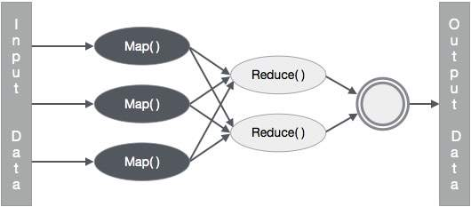

Slide 26
Spark Architecture

Slide 27
Spark Architecture
Workers
Driver Node
Spark Context
Cluster Manager
Workers

Slide 28
Spark Ecosystem

Slide 29
Spark Ecosystem
SPARK SQL
SPARK STREAMING
SPARK MLlib
SPARK GRAPHX
SPARK CORE API
JAVA
SCALA
PYTHON
R

Slide 30
DataBricks

Slide 31
Spark Local Setup

Slide 32
Spark RDDs

Slide 33
Spark RDDs
RDD is the spark’s core abstraction which stands for Resilient Distributed Dataset
RDD is the immutable distributed collection of objects
Internally spark distributes the data in RDD, to different nodes across the cluster to achieve parallelization.

Slide 34
Transformations and Actions

Slide 35
Transformations and Actions
Transformations create a new RDD from an existing one.
Actions return a value to the driver program after running a computation on the RDD
All transformations in Spark are lazy
Spark only triggers the data flow when there’s a action

Slide 36
Creating Spark RDD

Slide 37
Running Code Locally

Slide 38
map()
Map is used as a maper of data from one state to other
It will create a new RDD
rdd.map(lambda x: x.split())

Slide 39
QUIZ

Slide 40
QUIZ
For the quiz you’ll be using this input file
Hi how are you?
Hope you are doing
great
Read this file in the RDD
Write a mapper that will provide the length of each word in the following format
[ [2, 3, 3, 4], [4, 3, 3, 5], [5] ]

Slide 41
QUIZ SOLUTION

Slide 42
flatMap()
Flat Map is used as a maper of data and explodes data before final output
It will create a new RDD
rdd.flatMap(lambda x: x.split())

Slide 43
filter()
Filter is used to remove the elements from the RDD
It will create a new RDD
rdd.filter(lambda x: x != 123)

Slide 44
QUIZ

Slide 45
QUIZ
For the quiz you’ll be using this input file
this mango company animal
cat dog ant mic laptop
chair switch mobile am charger cover
amanda any alarm ant
Read this file in the RDD
Write a filter that will remove all the words that are either starting from a or c from the rdd

Slide 46
QUIZ SOLUTION

Slide 47
distinct()
Distinct is used to get the distinct elements in RDD
It will create a new RDD
rdd.distinct()

Slide 48
groupByKey()
GroupByKey is used to create groups based on Keys in RDD
For groupByKey to work properly the data must be in the format of (k,v), (k,v), (k2,v), (k2,v2)
Example: (“Apple”,1), (“Ball”,1), (“Apple”,1)
It will create a new RDD
rdd.groupByKey()
mapValues(list) are usually used to get the group data

Slide 49
reduceByKey()
ReduceByKey is used to combined data based on Keys in RDD
For reduceByKey to work properly the data must be in the format of (k,v), (k,v), (k2,v), (k2,v2)
Example: (“Apple”,1), (“Ball”,1), (“Apple”,1)
It will create a new RDD
rdd.reduceByKey(lambda x, y: x + y)

Slide 50
QUIZ

Slide 51
QUIZ
For the quiz you’ll be using this input file
this mango company
cat mango ant animal laptop
chair switch mango am charger cover
animalany mango ant laptop laptop
this
Read this file in the RDD
Write a transformation flow that will return the word count of each word present in the file as (key, value) pair

Slide 52
QUIZ SOLUTION

Slide 53
count()
count returns the number of elements in RDD
count is an action
rdd.count()

Slide 54
countByValue()
CountByValue provide how many times each value occur in RDD
countByValue is an action
rdd.countByValue()

Slide 55
saveAsTextFile()
SaveAsTextFile is used to save the RDD in the file
saveAsTextFile is an action
rdd.saveAsTextFile(‘path/to/file/filename.txt’)

Slide 56
RDDs Functions

Slide 57
repartition()
Repartition is used to change the number of partitions in RDD
It will create a new RDD
rdd.repartition(number_of_partitions)

Slide 58
coalesce()
Coalesce is used to decrease the number of partitions in RDD
It will create a new RDD
rdd.coalesce(number_of_partitions)
coalesce is only used to decrease the number of partition

Slide 59
Finding Average

Slide 60
QUIZ

Slide 61
QUIZ
For the quiz you’ll be using this input file
JAN,NY,3.0
JAN,PA,1.0
JAN,NJ,2.0
JAN,CT,4.0
FEB,PA,1.0
Read this file in the RDD
Write a code to calculate the average score in each month

Slide 62
QUIZ SOLUTION

Slide 63
Finding Min and Max

Slide 64
QUIZ

Slide 65
QUIZ
For the quiz you’ll be using this input file
JAN,NY,3.0
JAN,PA,1.0
JAN,NJ,2.0
JAN,CT,4.0
FEB,PA,1.0
Read this file in the RDD
Write a code to calculate the Minimum and Maximum rating given by each city.

Slide 66
QUIZ SOLUTION

Slide 67
Mini Project

Slide 68
Mini Project
For the project you’ll be using this input file StudentData.csv that has following columns
age,gender,name,course,roll,marks,email
Read this file in the RDD

Slide 69
Mini Project

Slide 70
Mini Project
Perform the following analytics on the data
Show the number of students in the file.
Show the total marks achieved by Female and Male students
Show the total number of students that have passed and failed. 50+ marks are required to pass the course.
Show the total number of students enrolled per course
Show the total marks that students have achieved per course
Show the average marks that students have achieved per course
Show the minimum and maximum marks achieved per course
Show the average age of male and female students

Slide 71
Spark DataFrames

Slide 72
DataFrame
DataFrame is a wrapper on the RDD
A DataFrame is a Dataset organized into named columns
It is conceptually equivalent to a table in a relational database or a data frame in R/Python
DataFrames can be constructed from a wide array of sources such as
Structured data files
Unstructured data files
External databases
Existing RDDs

Slide 73
Creating Dataframe

Slide 74
Schema of Dataframe

Slide 75
Providing Schema of Dataframe

Slide 76
Creating DataFrame from RDD

Slide 77
Select DataFrame Columns

Slide 78
withColumn in DataFrame

Slide 79
withColumnRenamed in DataFrame

Slide 80
filter/where in DataFrame

Slide 81
QUIZ

Slide 82
QUIZ
For the quiz you’ll be using StudentData.csv
Read this file in the DF
Create a new column in the DF for total marks and let the total marks be 120
Create a new column average to calculate the average marks of the student.
(marks / total marks) * 100
Filter out all those students who have achieved more than 80% marks in OOP course and save it in a new DF.
Filter out all those students who have achieved more than 60% marks in Cloud course and save it in a new DF.
Print the names and marks of all the students from the above DFs

Slide 83
QUIZ SOLUTION

Slide 84
Count, Distinct, DropDuplicates
in DataFrame

Slide 85
QUIZ

Slide 86
QUIZ
For the quiz you’ll be using StudentData.csv
Read this file in the DF
Write a code to display all the unique rows for age, gender and course column.

Slide 87
QUIZ SOLUTION

Slide 88
sort/orderBy in DataFrame

Slide 89
QUIZ

Slide 90
QUIZ
For the quiz you’ll be using OfficeData.csv
Read this file in the DF
Create a DF, sorted on bonus in ascending order and show it.
Create a DF, sorted on age and salary in descending and ascending order respectively and show it.
Create a DF sorted on age, bonus and salary in descending, descending and ascending order respectively and show it

Slide 91
QUIZ SOLUTION

Slide 92
groupBy in DataFrame

Slide 93
QUIZ

Slide 94
QUIZ
For the quiz you’ll be using StudentData.csv
Read this file in the DF
Display the total numbers of students enrolled in each course
Display the total number of male and female students enrolled in each course
Display the total marks achieved by each gender in each course
Display the minimum, maximum and average marks achieved in each course by each age group.

Slide 95
QUIZ SOLUTION

Slide 96
QUIZ

Slide 97
QUIZ
For the quiz you’ll be using WordData.txt
Read this file in the DF
Calculate and show the count of each word present in the file

Slide 98
QUIZ SOLUTION

Slide 99
UDFs in DataFrame

Slide 100
QUIZ

Slide 101
QUIZ
For the quiz you’ll be using OfficeData.csv
Read this file in the DF
Create a new column increment and provide the increment to the employees on the following criteria
If the employee is in NY state, his increment would be 10% of salary plus 5% of bonus
If the employee is in CA state, his increment would be 12% of salary plus 3% of bonus

Slide 102
QUIZ SOLUTION

Slide 103
Cache and Persist

Slide 104
Cache and Persist
TRANSFORMATION 1
TRANSFORMATION 2
ACTION 1
ACTION 2
TRANSFORMATION 1
TRANSFORMATION 2
CACHE()
ACTION 1
ACTION 2

Slide 105
DF to RDD

Slide 106
Spark SQL

Slide 107
Writing DataFrame

Slide 108
Mini Project

Slide 109
Mini Project
For the project we’ll be using OfficeDataProject.csv
Read data from the file in the DF and perform following analytics on it.
Print the total number of employees in the company
Print the total number of departments in the company
Print the department names of the company
Print the total number of employees in each department
Print the total number of employees in each state
Print the total number of employees in each state in each department
Print the minimum and maximum salaries in each department and sort salaries in ascending order
Print the names of employees working in NY state under Finance department whose bonuses are greater than the average bonuses of employees in NY state
Raise the salaries $500 of all employees whose age is greater than 45
Create DF of all those employees whose age is greater than 45 and save them in a file

Slide 110
Collaborative filtering

Slide 111
Utility Matrix

Slide 112
Utility Matrix
 | Movie 1 | Movie 2 | Movie 3 | Movie 4
User 1 | 1 | 5 | 4 | N/A
User 2 | N/A | 3 | N/A | 4
User 3 | 2 | N/A | N/A | 4
User 4 | 4 | 4 | 2 | 5

Slide 113
Explicit and Implicit Ratings

Slide 114
Expected Results

Slide 115
Expected Results
UserId | MovieId | Rating
1 | 1 | 4.8
1 | 22 | 5
2 | 12 | 4
2 | 11 | 3.9

Slide 116
Hands On

Slide 117
Dataset Overview

Slide 118
Joining DFs

Slide 119
Create Train and Test Data

Slide 120
ALS model

Slide 121
Hyperparameter tuning and cross validation

Slide 122
Best model and evaluate predictions

Slide 123
Recommendations

Slide 124
Spark Streaming

Slide 125
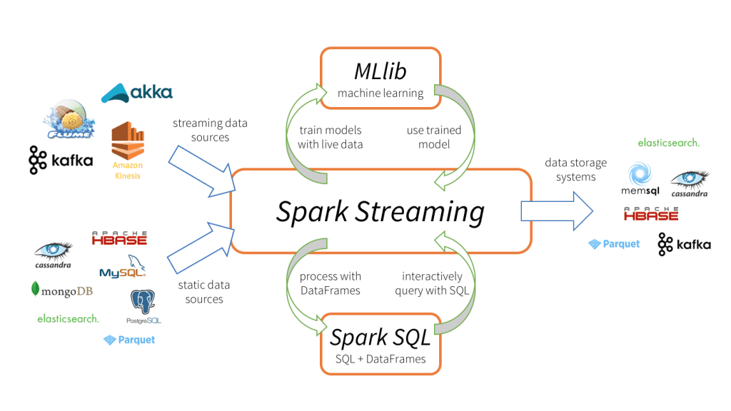

Slide 126
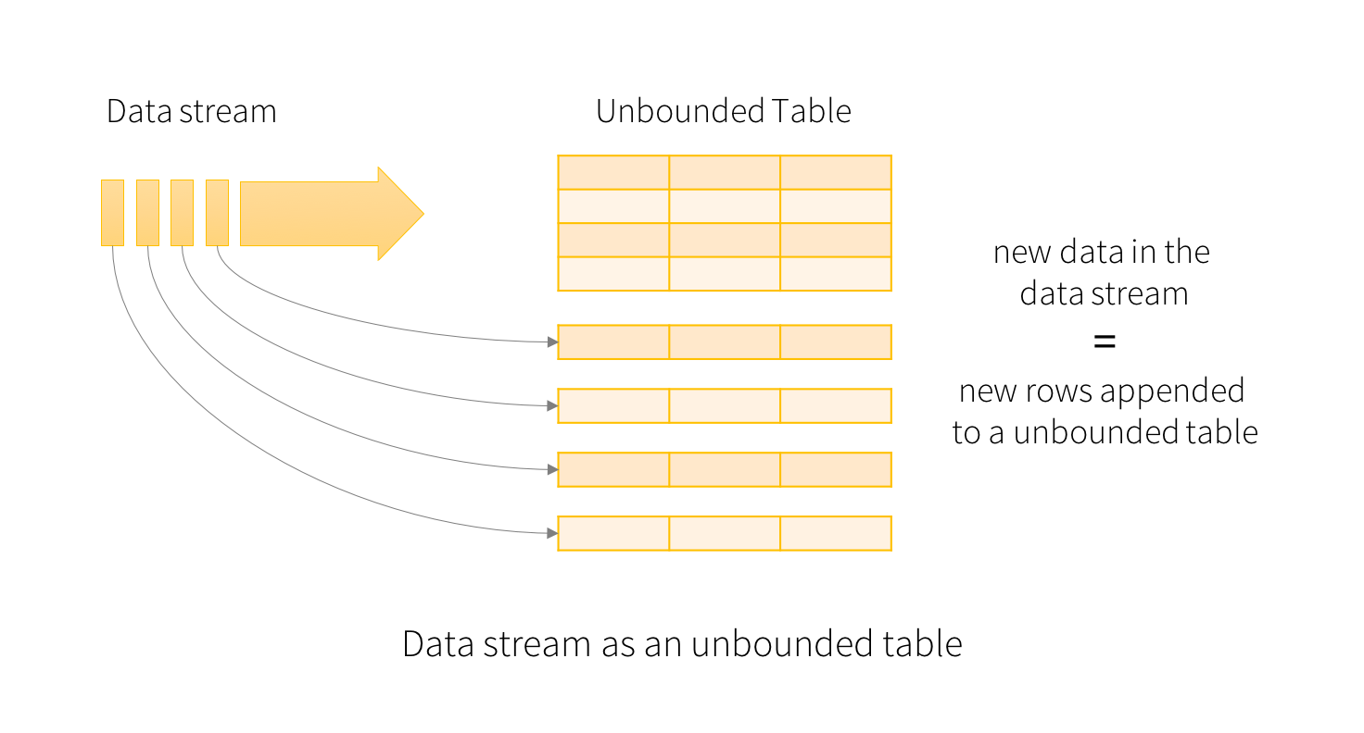

Slide 127
Spark Streaming With RDD

Slide 128
Spark Streaming With DF

Slide 129
ETL Pipeline

Slide 130

csv
Data Extraction
csv
txt
txt
ETL
jdbc
jdbc
…..
Data Load
…..

Slide 131
CSV in DBFS
PySpark on
DataBricks NoteBook
Postgres
Database in AWS RDS
EXT
LD
Transformation

Slide 132
Data Set

Slide 133
Extract

Slide 134
Transform

Slide 135
Installing Postgresql

Slide 136
Load

Slide 137
Project

Slide 138
CDC - Change Data Capture / Replication On Going

Slide 139
Project Architecture

Slide 140
Project Architecture
DMS
RDS -> MySql
Source Endpoint
Destination EndPoint
Temp
HDFS / S3
Lambda
Trigger
Invoke
READ
FINAL
HDFS / S3
READ
WRITE
Glue -> PySpark

