Slide 1
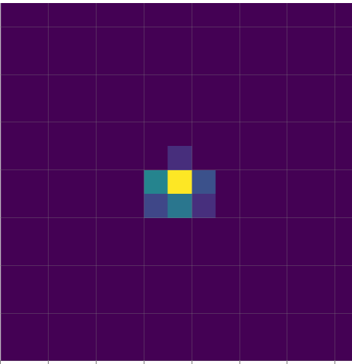
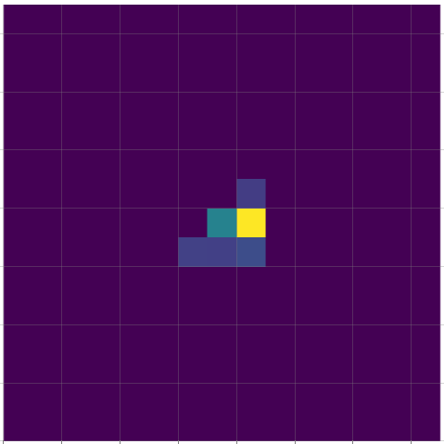
Training on baseline dataset
Baseline dataset (e.g., zero load)
Encoder Dim
Projector Dim
Predictor Dim
Train
encoder
projector
predictor
Target network
Randomly select patches
Transform
Image representation model (BYOL)
Minimize Loss
nEpochs
Train
encoder
projector
predictor
Online network
Baseline dataset (e.g., zero load)
Latent representation
K clusters
Trained encoder
Clustering
K centers
K centers
Realtime REI score
Testing dataset
Latent representation
Find each vector’s closest center and confidence score
Threshold, t
Trained encoder
REI
Testing dataset evaluation
Notes:
Training: 316, 318
411 - 414
417 - 420
423 - 426

