Slide 1
Identifying Illicit Drug Abuse Using Computer Vision
Presented by:-
Aishik Biswas :abiswas3@lakeheadu.ca

Slide 2
Introduction
Illicit drug consumptions and the abuse of drug has seen a steep rise in recent times. We can see a lot of people abusing drugs and harming their health significantly. To reduce that we need to create awareness of safe consumption of drugs and the consequences of abuse. In order to do that we need to first identify people who are abusing drugs.

Slide 3
Abstract
In this research we use concepts of image recognition to identify the people who are taking drugs. As we have researched and seen that the appearance of the person changes with prolonged period of using drugs:
So we plan on feeding the model with the pictures of people before and after drug abuse and let the model learn

Slide 4
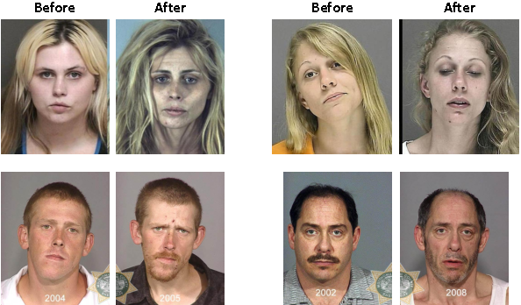
These are the types of photos of the personals that are feed into the model. The before and after results of drug abuse

Slide 5
Dataset
The dataset is curated by searching the internet for images which matches our requirements which includes the before and after results of drug abuse. The challenge of getting these datasets are:
People won’t provide their pictures themselves willingly because of the shame and the society stigma.
The fear of getting caught again for various reasons
So thanks to initiatives like “Face the Meth” a project started in 2008 by Oregon Police contains mugshot of people abusing methamphetamine and Rehab.com
Images of people without drug abuse were extracted from FERET databse.

Slide 6
Flow of the Model
So the way we go through with the model is thar first we will preprocess the all the images of the faces and two different types of feature extraction
SIFT (Scale Invariant Feature Transformation) Technique which is used by Aishik
HOG ( Histogram of Oriented Gradient) Technique which is used by Bhuwan
After the feature extraction is done we will be passing the features through KNN (K-nearest Algorithm) and SVM (Support Vector Machine). Compare the results and report them accordingly
And we learned that features like left cheek, right cheek, forehead, binocular vision and full face are the regions where the drug abuse have a distinctive effect.

Slide 7
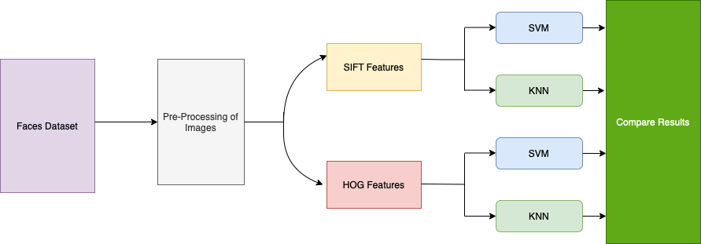
Flowchart of the Model

Slide 8
Little insight about SIFT technique
SIFT helps locate the local features in an image, commonly known as the ‘keypoints‘ of the image. These keypoints are scale & rotation invariant that can be used for various computer vision applications, like image matching, object detection, scene detection, etc.
The main advantage of of SIFT is that is doesnt depends on the size or the orientation of the image
So we find the keypoints of the image which is the unique points of the image by which i can be identified and by which we can match similar kind of image. And further eliminate keypoints that has low contrast.

Slide 9
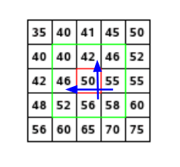
SIFT continued …..
So the next step is to differentiate each keypoints with each other. For doing so we calculate the the gradient of each pixel.
So if we have a pixel matrix like this and we want to find the gradient of the pixel in red.
For this, we will calculate the gradients in x and y directions by taking the difference
between 55 & 46 and 56 & 42.
This comes out to be Gx = 9 and Gy = 14 respectively.
Once we have the gradients, we can find the magnitude and orientation using the following formulas:
Magnitude = √[(Gx)2+(Gy)2] = 16.64
Φ = atan(Gy / Gx) = atan(1.55) = 57.17
The magnitude represents the intensity of the pixel and the orientation gives the direction for the pixel

Slide 10
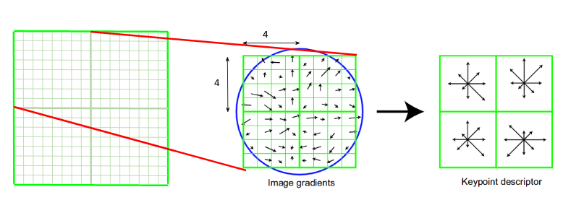
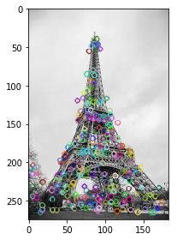
SIFT continued…..
So after differentiating the keypoints to each other which is called keypoint descriptor. It somewhat looks like the figure 1
asd
Figure 1 Figure 2
And after putting the code in it somewhat looks like the figure 2, which is the unique points with which the image can
be identified.

Slide 11
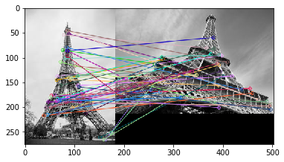
SIFT continued
So when we match two similar kind of images using the help of the keypoints and we display the matching process it somewhat looks like this

Slide 12
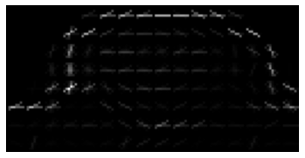
HOG
Histogram of oriented gradients (HOG) is a feature descriptor used in computer vision and image processing for the purpose of object detection. The technique counts occurrences of gradient orientation in localized portions of an image. It is better than any edge descriptor as it uses magnitude as well as angle of the gradient to compute the features.
However, we can also use HOG descriptors for quantifying and representing both shape and texture.
Below image shows a hog representation of an image from our dataset.

Slide 13
Conclusion
So to summarise all together, we intend to compare both of the algorithms with each other and see which of these two feature extraction techniques have more accuracy in classifying the images from the before and after drug abuse.
Our focus will be on the area which is highly susceptible to drug use like left cheek, right cheek, forehead, binocular vision and the full face (ROI).

Slide 14
Future Work
As earlier said we intend to help the criminal branch to identify these people who are drug abusing and hiding in open and catch them to make the environment safe for the people to live freely without fear
Raising awareness to people as well as teenagers and providing insights about what could possibly happen due to drug abuse.
Making the process faster for the police as they don’t have to go through all kind of formality or lie detectors for detecting if a person is abusing drugs or not.
Removing the stigma attached to drugs and promote safe consumption by showing the ghastly effects of drugs on a person.

Slide 15
References
[1] Rehabs.com, “Drug Rehabs - Alcohol Rehab Centers - Rehabilitation Programs,” Drug Rehab Options. https://rehabs.com.
[2]“How to Detect the Same Object in Different Images using SIFT?,” Analytics Vidhya, Oct. 09, 2019. https://www.analyticsvidhya.com/blog/2019/10/detailed-guide-powerful-sift-technique-image-matching-python/
[3]M. Tyagi, “HOG(Histogram of Oriented Gradients),” Medium, Jul. 24, 2021. https://towardsdatascience.com/hog-histogram-of-oriented-gradients-67ecd887675f.
[4] N. Dalal and B. Triggs. Histograms of oriented gradients for human detection. In IEEE Computer Society Conference on Computer Vision and Pattern Recognition, volume 1, pages 886–893, June 2005.
[5] D. Yadav, N. Kohli, P. Pandey, R. Singh, M. Vatsa, and A. Noore, “Effect of illicit drug abuse on face recognition,” 2016 IEEE Winter Conference on Applications of Computer Vision (WACV). IEEE, Mar. 2016. Doi: 10.1109/wacv.2016.7477556.
‌

