Slide 1


Predicting House Prices Using Machine Learning
Real estate is a trillion-dollar industry worldwide, and predicting housing prices is crucial to make informed investment decisions. In this presentation, we will dive deep into how machine learning plays a pivotal role in the real estate industry.

Slide 2

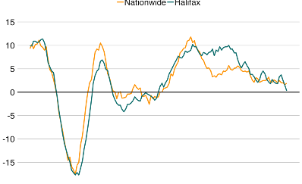

Importance of Predicting House Prices
Investing in Housing
Economic Growth
Urban Development
Real estate is a stable investment, but you need to have accurate price predictions to make informed decisions about which properties to invest in.
Accurate price predictions help economists forecast future economic growth and detect changes in the economy.
Predicting housing prices is a key component in developing urban areas and infrastructure projects while minimizing the displacement of people and communities.

Slide 3

Collecting and Preprocessing Data
1
Sources of Housing Data
Data can come from city records, online real estate databases, and online platforms. The data usually contains information about the property's location, year built, number of bedrooms, and other amenities.
2
Feature Selection and Engineering
We use feature engineering to extract important information from the data. After selecting the features, we process them to prepare them for machine learning models.
3
Handling Missing Values and Outliers
We use statistical techniques to manage missing values and remove outliers that can affect the accuracy of our models.

Slide 4
Model Selection and Training
Overview of Regression Models
Splitting Data into Training and Testing Sets
Model Training and Evaluation
We can choose from various regression models, such as linear regression, decision trees, and random forests. Each model has its strengths and weaknesses, and we evaluate their performance based on the data we have.
We train our model with the training set to improve its accuracy by minimizing the difference between expected and predicted values.
To evaluate our model, we split our data into training and testing data sets. We use the training set to help our model learn, and the testing set to check the models' accuracy and readiness to predict new data.

Slide 5

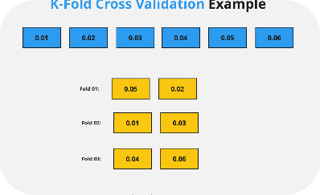

Fine-tuning and Improving the Model
Hyperparameter Tuning
Cross-validation techniques
Predicting House Prices
We use hyperparameter tuning to adjust the model parameters that affect the model's performance (e.g., number of decision trees and tree depth).
Applying the trained model to new data is the ultimate objective of this exercise. We provide predictions and offer insight into how the prediction was made.
By using cross-validation techniques, we break our data set into independent parts to evaluate the model's accuracy more effectively.

Slide 6

Interpreting the Predicted Prices
1
Location and Amenities
2
Market Forces
3
Model Accuracy
The law of supply and demand drives house prices: high demand and low supply result in higher prices.
The accuracy of the machine learning model drives the predicted prices. Accurately trained models produce better predictions, but they are only as good as the data that we feed them.
Factors like the property's location, transportation connectivity, and nearby amenities weigh heavily on the predicted prices.

Slide 7
Conclusion
Recap of the Presentation
Importance of Using Machine Learning
We presented how machine learning can help in predicting house prices. We described the importance of this, data collection, and preprocessing, model selection and training, fine-tuning the model. Finally, interpreting predicted prices.
Machine learning allows for accurate predictions and informed investment decisions which benefit consumers, real estate agents, investors, and governments alike. The real estate industry is evolving rapidly, and machine learning is becoming more important than ever.

