Slide 1
Sales Analysis Using Power BI & SQL
AISHWARYA KUMAR

Slide 2
ABSTRACT
The primary objective of this project is to transform raw sales data into actionable intelligence, enabling stakeholders to identify trends, assess performance, and uncover opportunities for growth. SQL is utilized for efficient data extraction, transformation, and loading (ETL) processes, ensuring data integrity and consistency. Complex queries are written to aggregate and filter data, making it ready for in-depth analysis. Power BI serves as the visualization tool, offering interactive dashboards and reports that present sales data in an intuitive and accessible manner. These visualizations facilitate quick comprehension of key metrics such as sales volume, revenue, profit margins, and customer behavior. The interactive nature of Power BI dashboards allows users to drill down into specifics, compare historical data, and forecast future sales trends.

Slide 3
Key FEATURES
1. Sales Performance Dashboard: A comprehensive overview of sales activities, highlighting key performance indicators (KPIs) and comparing actual performance against targets.
2. Trend Analysis: Visual representations of sales trends over time, helping to identify seasonal patterns and long-term growth trajectories.
3. Product and Customer Insights: Detailed analysis of product performance and customer demographics, aiding in targeted marketing strategies and inventory management.
4. Geographical Analysis: Mapping of sales data to visualize regional performance and identify high-performing markets.
5. Predictive Analytics: Integration of machine learning models to forecast future sales and predict potential market shifts. The implementation of this sales analysis system is expected to result in enhanced decision-making capabilities, optimized sales strategies, and improved overall business performance. By combining the data processing power of SQL with the dynamic visualization capabilities of Power BI, this project demonstrates a powerful approach to modern sales analysis.

Slide 4
OBJECTIVES
1. Transform Raw Data into Actionable Insights: - Convert large volumes of raw sales data into structured, meaningful insights that can be easily interpreted and utilized for decision-making.
2. Develop Comprehensive Dashboards: - Create interactive and visually appealing dashboards using Power BI to provide a clear and comprehensive view of key sales metrics and performance indicators.
3. Implement Efficient ETL Processes: - Utilize SQL to design and execute efficient data extraction, transformation, and loading (ETL) processes to ensure data accuracy, integrity, and consistency.
4. Analyze Sales Performance: - Assess and monitor overall sales performance by examining metrics such as sales volume, revenue, profit margins, and customer acquisition.
5. Identify Sales Trends and Patterns: - Detect and visualize trends and patterns in sales data over different time periods to help understand seasonal effects, growth trajectories, and market dynamics.
6. Evaluate Product and Customer Performance: - Analyze product-specific sales performance and customer demographics to identify best-selling products, target customer segments, and tailor marketing strategies.
7. Geographical Sales Analysis: - Map sales data geographically to evaluate regional performance, identify high-performing markets, and uncover areas with potential for growth.
8. Provide Predictive Insights: - Integrate predictive analytics to forecast future sales trends, allowing for proactive planning and strategic decision-making.
9. Enhance Data Accessibility and Usability:- Ensure that sales data and insights are easily accessible to stakeholders at all levels of the organization through user-friendly Power BI dashboards.

Slide 5
SCOPE
1. Data Collection and Integration: - Gather sales data from various sources such as databases, ERP systems, CRM systems, and spreadsheets. - Integrate and consolidate data from multiple sources to create a unified dataset for analysis.
2. ETL (Extract, Transform, Load) Processes: - Design and implement ETL processes using SQL to ensure data is clean, accurate, and consistent. - Perform data transformations to prepare the dataset for analysis, including filtering, aggregating, and normalizing data.
3. Data Modeling: - Develop a robust data model that supports efficient querying and analysis. - Define relationships between different data entities to enable comprehensive analysis.
4. Dashboard Development: - Create interactive and dynamic dashboards in Power BI to visualize key sales metrics and performance indicators. - Develop multiple views and drill-down capabilities to allow users to explore data at various levels of granularity.
5. Sales Performance Analysis: - Analyze overall sales performance, including metrics such as sales volume, revenue, profit margins, and sales growth. - Compare actual performance against targets and historical data to identify trends and deviations.

Slide 6
SCOPE
6. Product and Customer Analysis: - Perform detailed analysis of product performance to identify top-performing and underperforming products. - Analyze customer data to understand demographics, purchasing behavior, and customer segmentation.
7. Geographical Analysis: - Map sales data to geographical locations to visualize regional sales performance. - Identify high-performing regions and potential markets for expansion.
8. Trend and Pattern Analysis: - Identify and visualize sales trends and patterns over different time periods. - Detect seasonal variations, growth trajectories, and market dynamics.
9. Predictive Analytics: - Integrate machine learning models to forecast future sales trends. - Use predictive analytics to anticipate market shifts and plan strategically.
10. User Accessibility and Training: - Ensure that Power BI dashboards are user-friendly and accessible to stakeholders across the organization. - Provide training and documentation to enable users to navigate and utilize the dashboards effectively.
11. Reporting and Documentation: - Generate regular reports summarizing key insights and findings from the sales analysis. - Document the methodologies, processes, and tools used in the project for future reference.
12. Continuous Monitoring and Improvement: - Establish processes for continuous monitoring and updating of sales data and dashboards. - Implement feedback mechanisms to incorporate user suggestions and improve the system over time.
13. Security and Compliance: - Ensure that data handling and analysis processes comply with relevant data privacy and security regulations.

Slide 7
TECHNOLOGY
Data Analysis via. SQL
MICROSOFT SQL SERVER MANAGEMENT
POWER BI
SQL (Structured Query Language) is a standardized programming language used for managing and manipulating relational databases. It enables users to create, read, update, and delete database records through simple or complex queries. SQL is essential for data retrieval and analysis.
Power BI is a business analytics tool developed by Microsoft that enables users to visualize and share insights from their data. It provides interactive dashboards, reports, and data visualization tools that allow users to connect to a wide range of data sources, transform and model their data, and create compelling visual stories.
Microsoft SQL Server Management, often facilitated through SQL Server Management Studio (SSMS), is a suite of tools for configuring, managing, and administering instances of Microsoft SQL Server.

Slide 8
Problem Statement
Steven - Sales Manager:
Hi Aishwarya!
I hope you are doing well. We need to improve our internet sales reports and want to move from static reports to visual dashboards.
Essentially, we want to focus it on how much we have sold of what products, to which clients and how it has been over time.
Seeing as each salesperson works on different products and customers it would be beneficial to be able to filter them also.
We measure our numbers against budget so I added that in a spreadsheet so we can compare our values against performance.
The budget is for 2021 and we usually look 2 years back in time when we do analysis of sales.
Let me know if you need anything else!

Slide 9
BUSINESS ANALYSIS & DATA INTERPRETATION
Business Demand Overview:
Reporter: Steven – Sales Manager
Value of Change: Visual dashboards and improved Sales reporting or follow up or sales force
Necessary Systems: Power BI, CRM System
Other Relevant Info: Budgets have been delivered in Excel for 2021
No # | As a (role) | I want (request / demand) | So that I (user value) | Acceptance Criteria
1 | Sales Manager | To get a dashboard overview of internet sales | Can follow better which customers and products sells the best | A Power BI dashboard which updates data once a day
2 | Sales Representative | A detailed overview of Internet Sales per Customers | Can follow up my customers that buys the most and who we can sell ore to | A Power BI dashboard which allows me to filter data for each customer
3 | Sales Representative | A detailed overview of Internet Sales per Products | Can follow up my Products that sells the most | A Power BI dashboard which allows me to filter data for each Product
4 | Sales Manager | A dashboard overview of internet sales | Follow sales over time against budget | A Power Bi dashboard with graphs and KPIs comparing against budget.

Slide 10
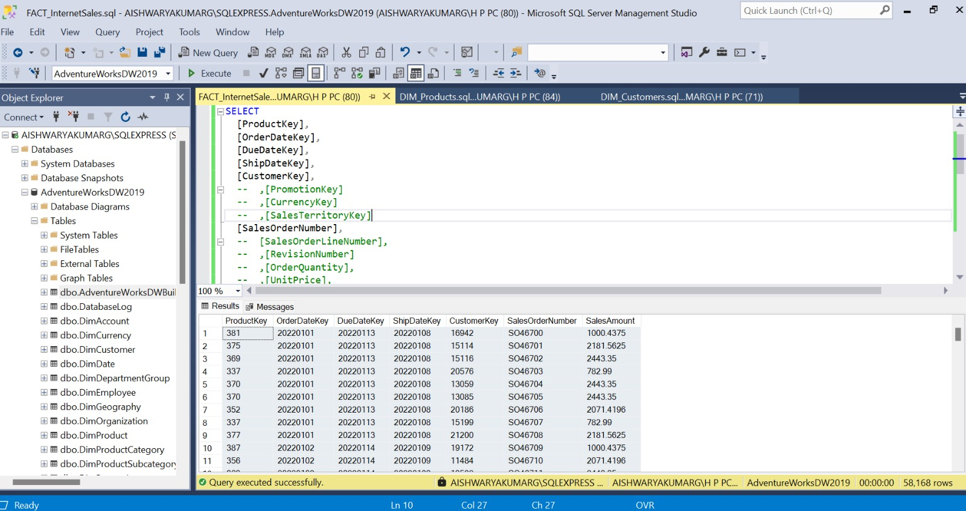

Slide 11
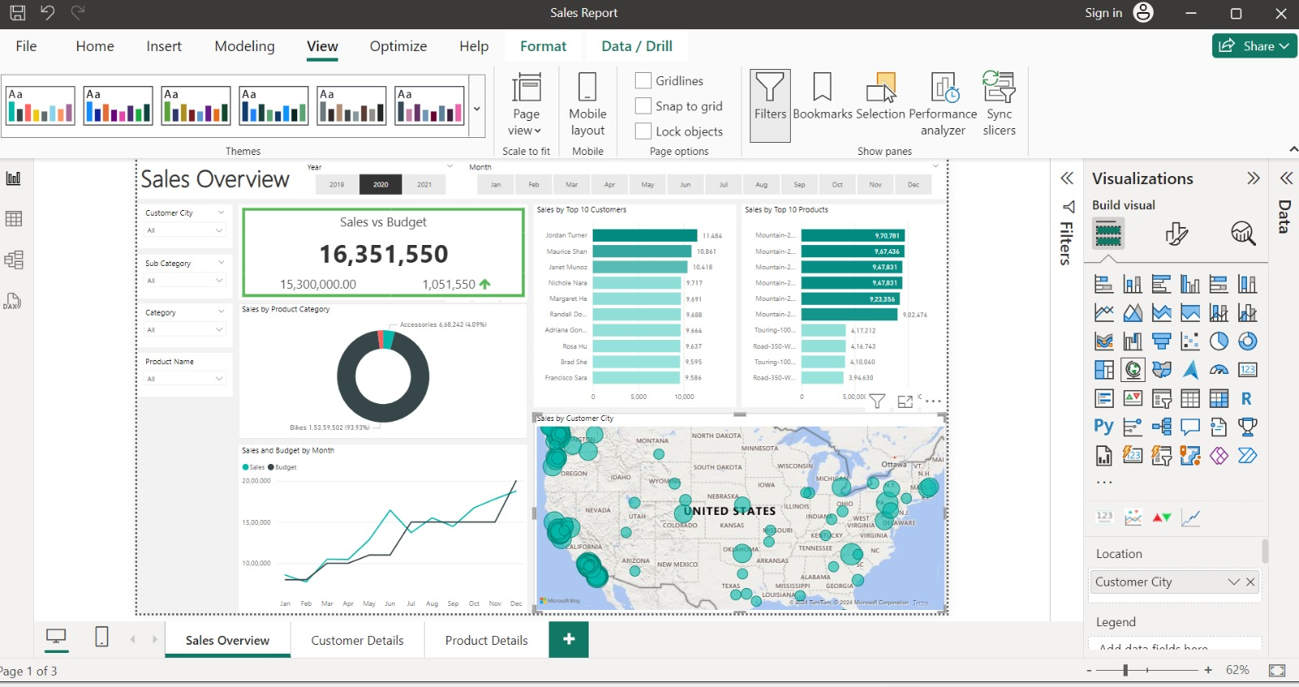

Slide 12
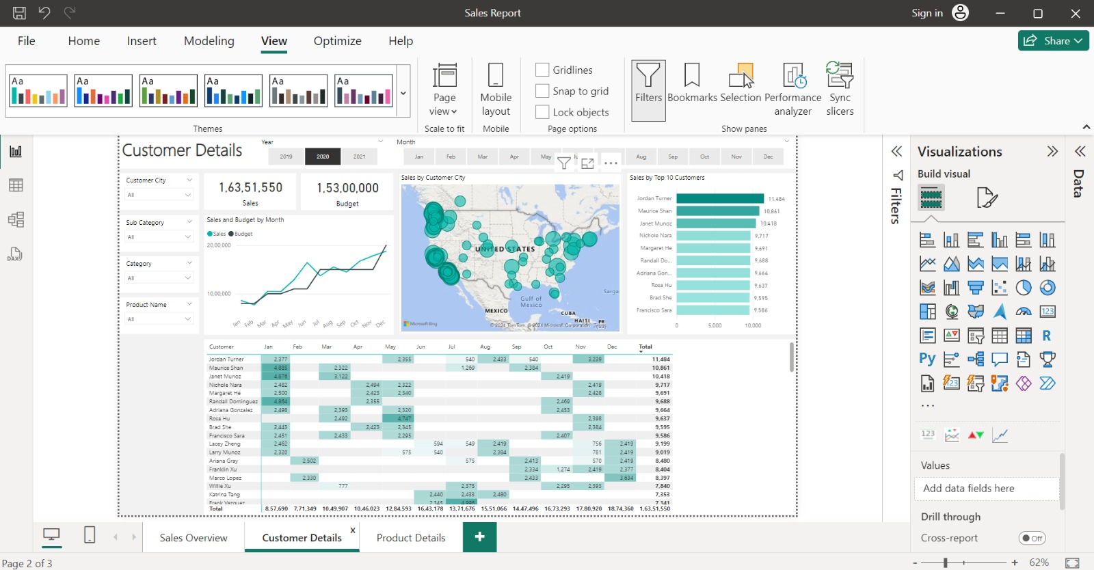

Slide 13
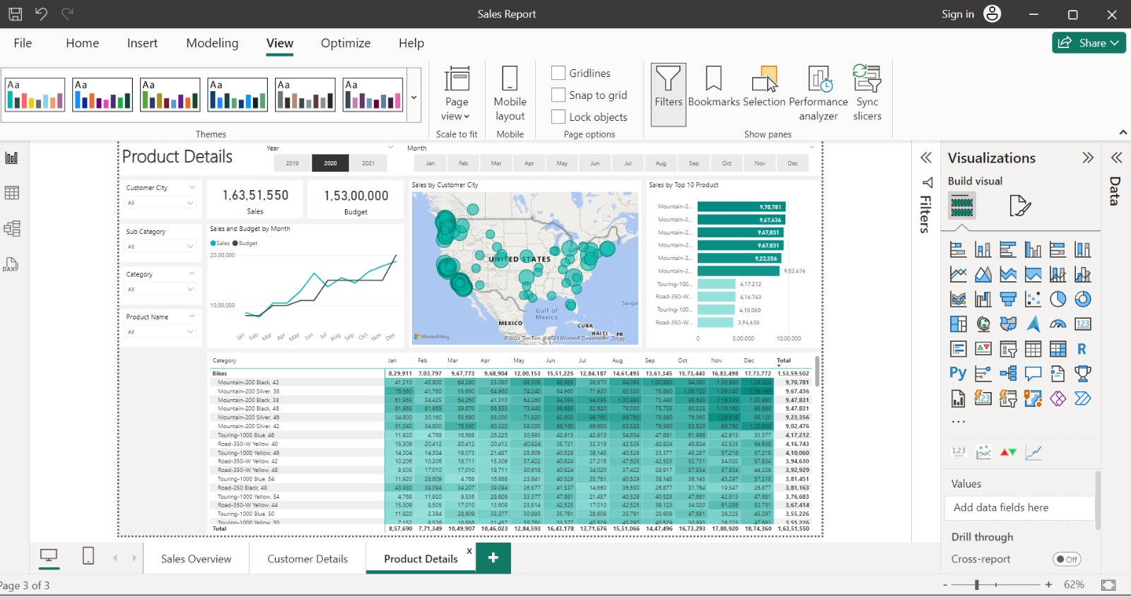
Sales Analysis Using Power BI & SQL

Slide 14
RESOURCES
Project Resources
What Customers Want
Online Tutorials and Courses: Platforms like Coursera, Udemy, and LinkedIn Learning offer courses on Power BI and SQL.
Community Forums and Support: Microsoft Power BI Community, Stack Overflow, and SQL Server forums for troubleshooting and advice.
Books and Articles
Customers want their sales to grow exponentially so that they can figure out the new regions where they can invest and expand in future.

Slide 15
GOALS FOR NEXT REVIEW
Goals for Next Review
1. Data Accuracy and Integrity
2. Enhanced Data Models
3. Comprehensive Dashboards
4. Advanced Analytics
5. User Training and Documentation
6. Performance Optimization
7. Regular Updates and Maintenance
8. Integration with Other Tools
9. Feedback and Iteration
10. Security and Compliance
Action Plan Review

Slide 16
Thank You
AISHWARYA KUMAR
+91-8299691531
gupta.aishwar05@gmail.com
www.linkedin.com/in/aishwarya-kumar-gupta

