Slide 1


Stock Price Prediction Using RNN
Notes:
1

Slide 2
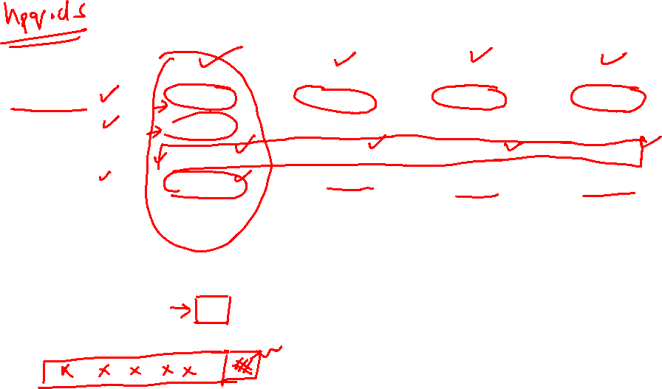
Data
Date | Open | High | Low | Close
0 | 1970-01-02 | 0.30627 | 0.30627 | 0.30627 | 0.30627
1 | 1970-01-05 | 0.30627 | 0.31768 | 0.30627 | 0.31385
2 | 1970-01-06 | 0.31385 | 0.31385 | 0.30996 | 0.30996
3 | 1970-01-07 | 0.31385 | 0.31385 | 0.31385 | 0.31385
4 | 1970-01-08 | 0.31385 | 0.31768 | 0.31385 | 0.31385

Slide 3
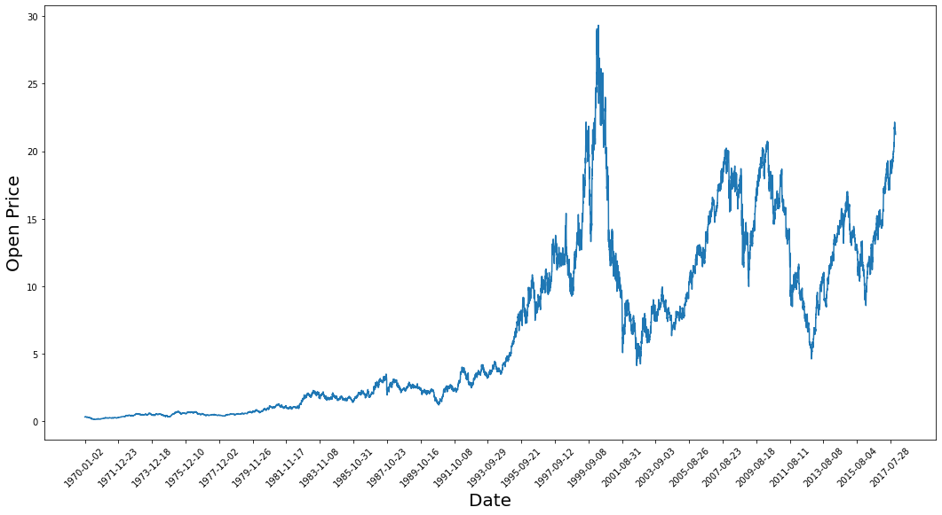
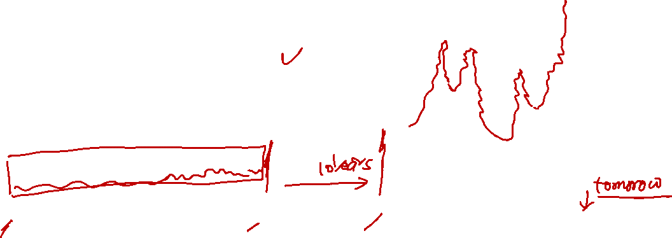
Trend of “Open”

Slide 4
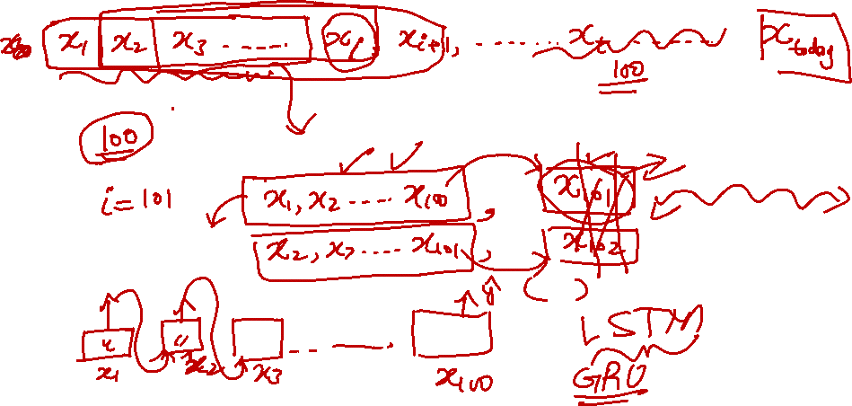
Modeling the Problem as a supervised learning problem

Slide 5
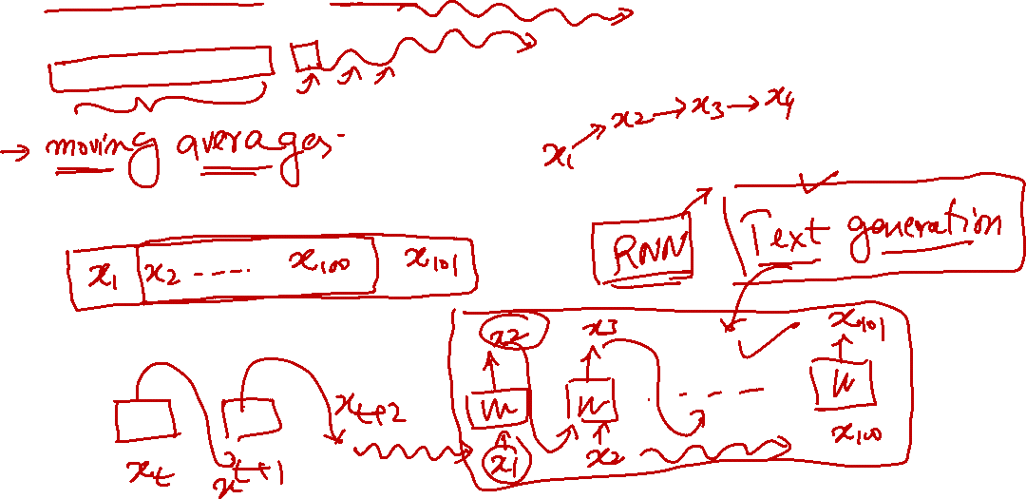
Looking Far into the future

