Slide 1
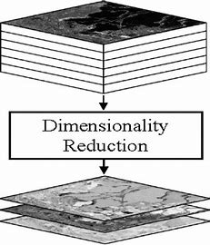
Feature Engineering, Dimensionality Reduction:
Feature Selection and Feature Extraction
Part-IV
Notes:
1

Slide 2
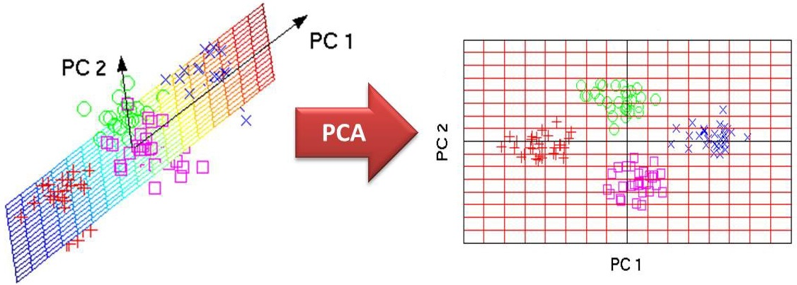
Principal Component Analysis (PCA)

Slide 3
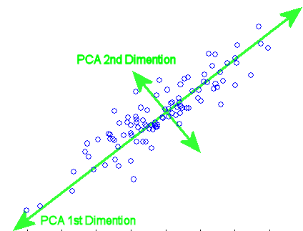
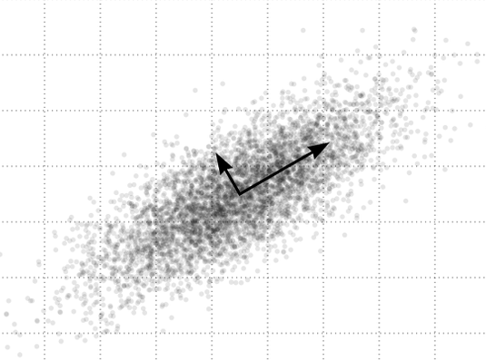
Maximum Variance Preserving Projection

Slide 4
PCA Properties
Linear Transformation

Slide 5
PCA Properties
Linear Transformation
Minimum Reconstruction Error

Slide 6
PCA Properties
Linear Transformation
Minimum Reconstruction Error
Maximum Variance Preservation

Slide 7
PCA Properties
Linear Transformation
Minimum Reconstruction Error
Maximum Variance Preservation
Preserves pairwise Euclidean distances (MDS)

Slide 8
Kernel PCA
MDS
ISOMAP
LLE
LEMAP
MVU

