Slide 1
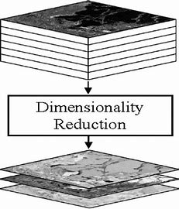
Feature Engineering, Dimensionality Reduction:
Feature Selection and Feature Extraction
Part-V
Notes:
1

Slide 2



PCA Derivation
$$X_{d,n}$$
$$W_{d,k}$$
$$Y_{k,n}$$

Slide 3
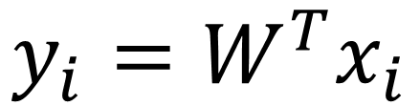
PCA Derivation
$$X_{d,n}$$
$$W_{d,k}$$
$$Y_{k,n}$$
$$y_{i}=W^{T}x_{i}$$

Slide 4

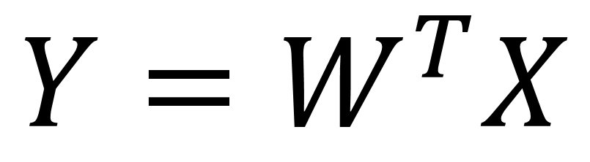
PCA Derivation
$$X_{d,n}$$
$$W_{d,k}$$
$$Y_{k,n}$$
$$y_{i}=W^{T}x_{i}$$
$$Y=W^{T}X$$
$$k≪d$$

Slide 5

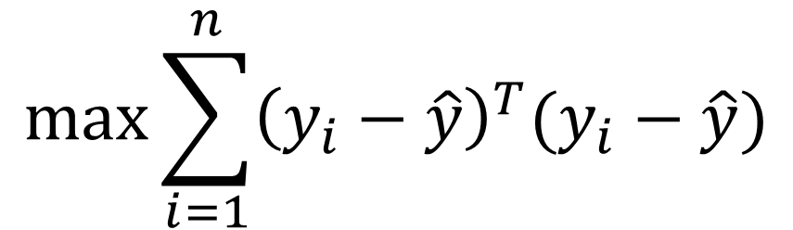
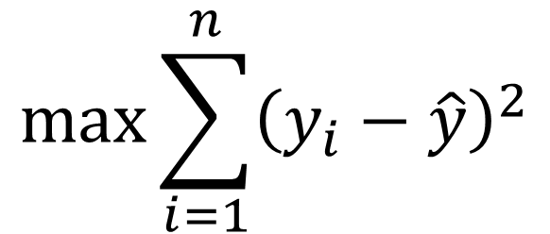


Max Variance
$$y_{i}=W^{T}x_{i}$$
$$y_{i}^{T}=x_{i}^{T}W$$
$$max⁡\sum_{i=1}^{n}{{\left(y_{i}−\hat{y}\right)}^{2}}$$
$$k=1$$
$$max⁡\sum_{i=1}^{n}{{\left(y_{i}−\hat{y}\right)}^{T}(y_{i}−\hat{y})}$$

Slide 6

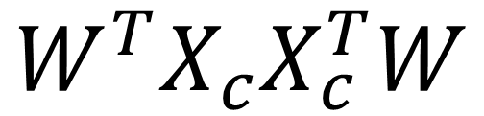
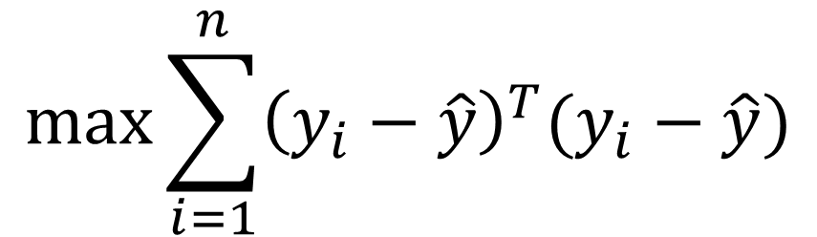
Max Variance
$$y_{i}=W^{T}x_{i}$$
$$y_{i}^{T}=x_{i}^{T}W$$
$$k=1$$
$$max⁡\sum_{i=1}^{n}{{\left(y_{i}−\hat{y}\right)}^{T}(y_{i}−\hat{y})}$$
$$W^{T}X_{c}X_{c}^{T}W$$

Slide 7

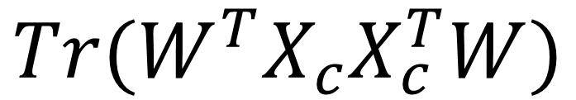
Max Variance
$${Tr(W}^{T}X_{c}X_{c}^{T}W)$$
$$k>1$$
Eigen Decomposition of the covariance matrix

