Slide 1
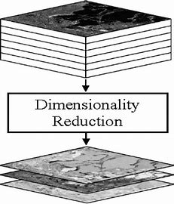
Feature Engineering, Dimensionality Reduction:
Feature Selection and Feature Extraction
Part-VI
Notes:
1

Slide 2
Principal Component Analysis
Python Implementation
From scratch
Notes:
2

