Slide 1
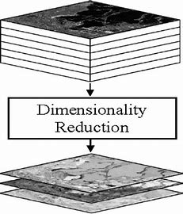
Feature Engineering, Dimensionality Reduction:
Feature Selection and Feature Extraction
Video-I/Part-I
Notes:
1

Slide 2
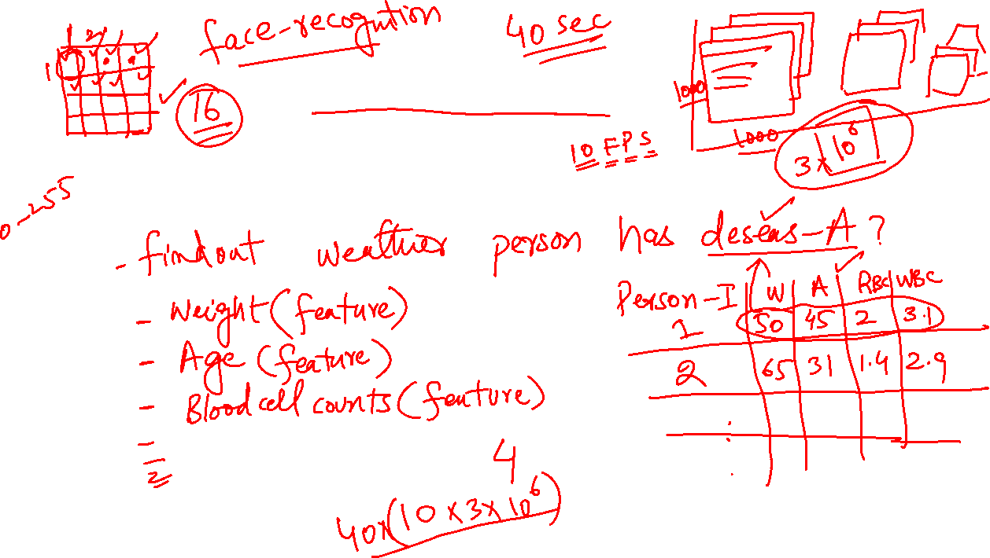
Dimensionality
What is dimensionality?
Notes:
2

Slide 3
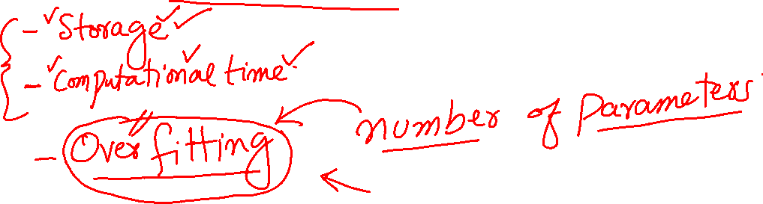
Dimensionality Reduction
Why Dimensionality Reduction?
Notes:
3

Slide 4
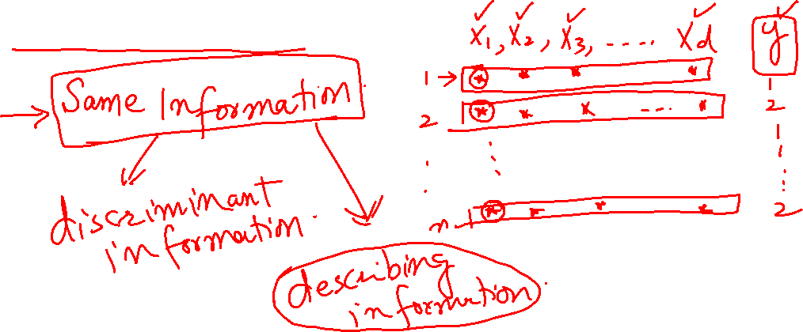
Types of Dimensionality Reduction
Feature Selection
Notes:
4

Slide 5
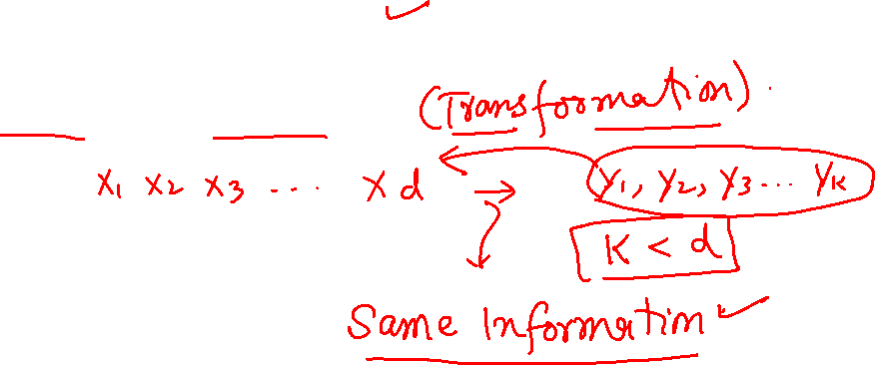
Types of Dimensionality Reduction
Feature Selection
Feature Extraction
Notes:
5

Slide 6
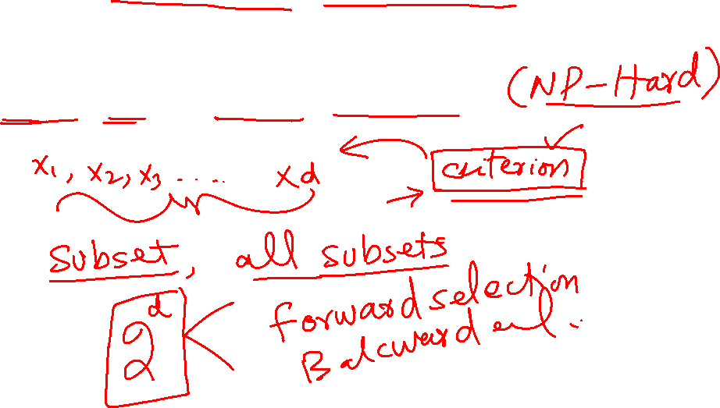
Feature Selection
Complexity of the Problem
Notes:
6

