Slide 1
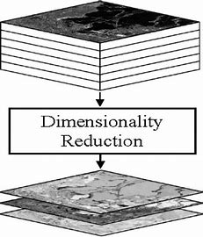
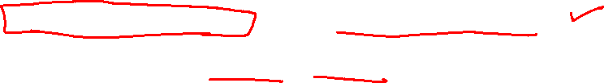
Feature Engineering, Dimensionality Reduction:
Feature Selection and Feature Extraction
Video-I/Part-II
Notes:
1

Slide 2
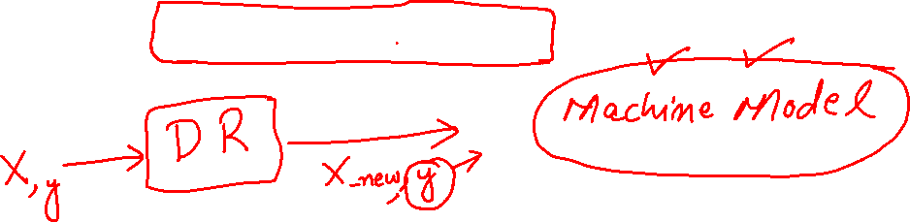
Feature Selection
Why Feature Selection?
Notes:
2

Slide 3

Feature Selection Methods
Filter Methods
Wrapper Methods
Embedded Methods
Notes:
3

Slide 4
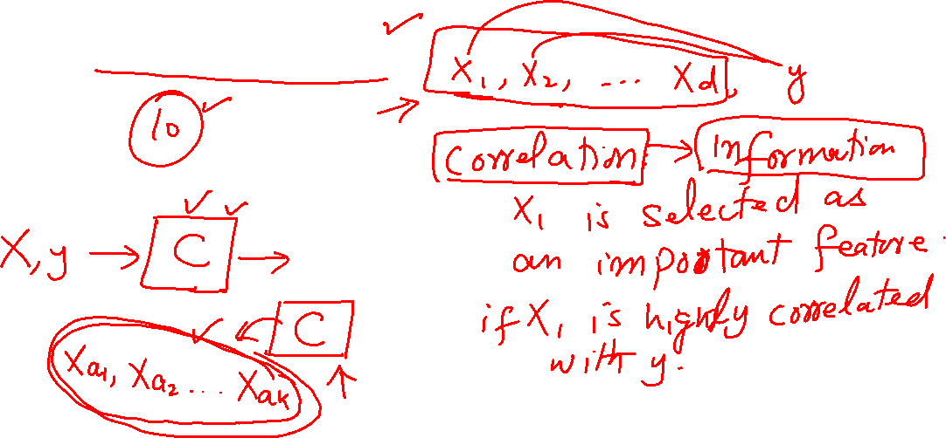
Feature Selection : Filters
Filter Methods
Notes:
4

Slide 5
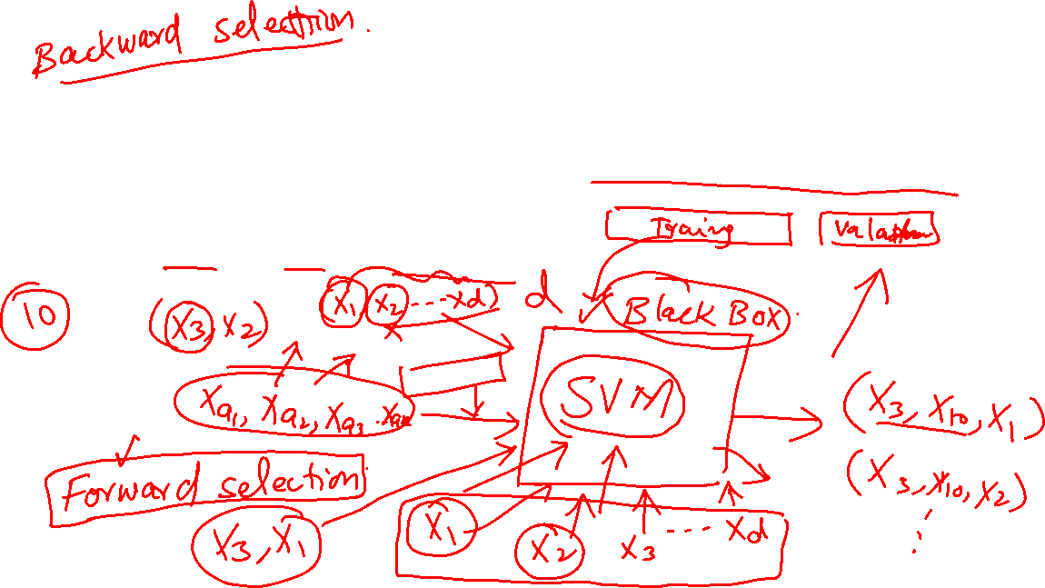
Feature Selection : Wrappers
Wrapper Methods
Notes:
5

Slide 6
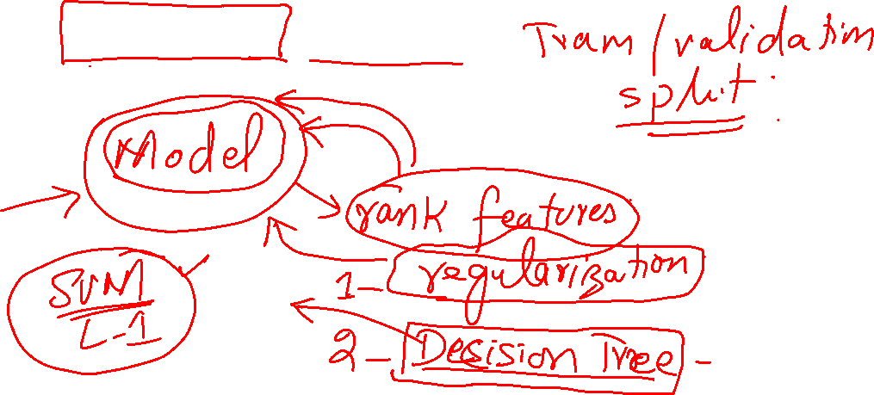
Feature Selection : Embedded
Embedded Methods
Notes:
6

