Slide 1
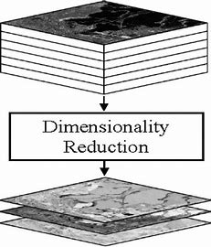
Feature Engineering, Dimensionality Reduction:
Feature Selection and Feature Extraction
Video-I/Part-III
Notes:
1

Slide 2
Feature Selection Methods
Python Implementation
Filter Methods
Wrapper Methods
Embedded Methods
Notes:
2

