Slide 1
Bidirectional Encoder Representations from Transformers
BERT
Notes:
1

Slide 2

Distinctions
Context aware embedding
Notes:
2

Slide 3
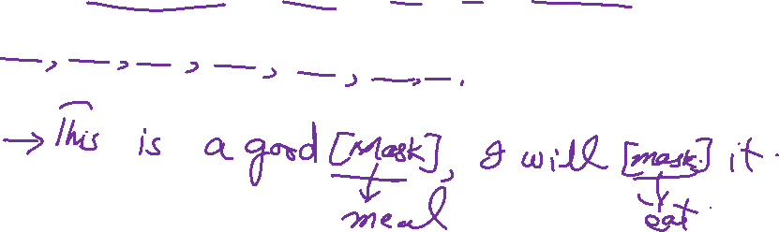
Distinctions
Context aware embedding
Masked Language Model
Notes:
3

Slide 4
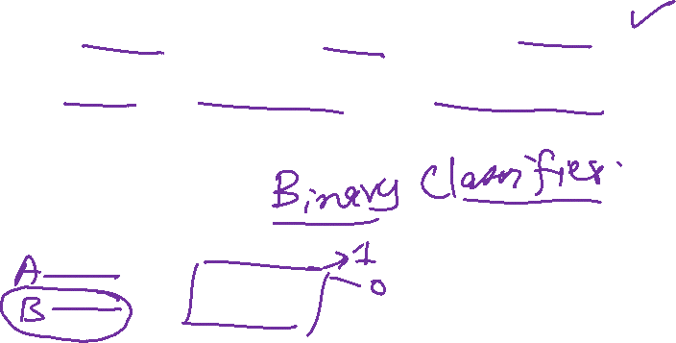
Distinctions
Context aware embedding
Masked Language Model
Next Sentence Prediction
Notes:
4

