Slide 1
Vectorization:
Loop-less coding in Python for Data Science
Part-II
Notes:
1

Slide 2
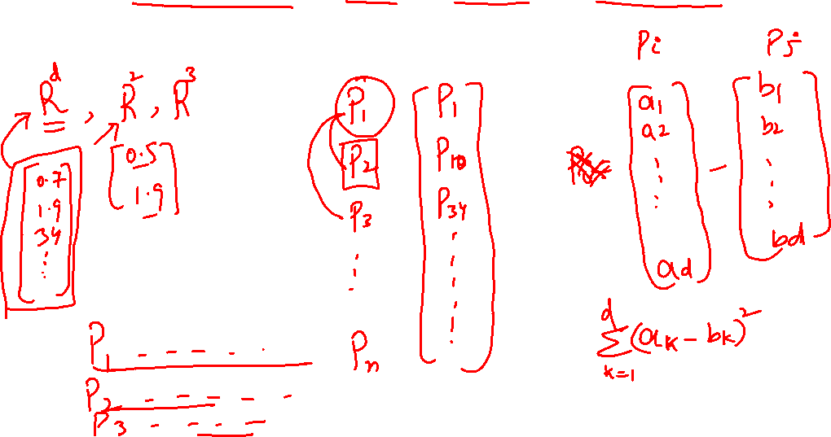
Nearest Neighbor Sorting
Notes:
2

