Slide 1
Vectorization:
Loop-less coding in Python for Data Science
Part-III
Notes:
1

Slide 2
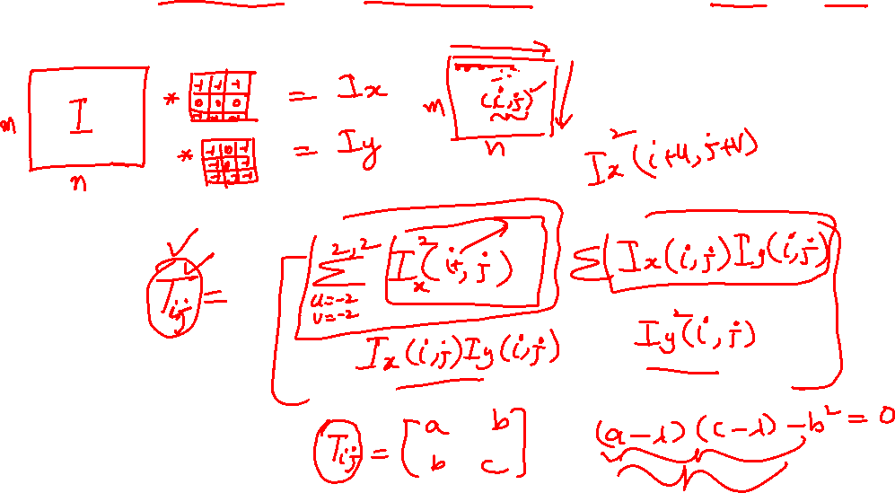
Corner Detection in Images
Notes:
2

Slide 3
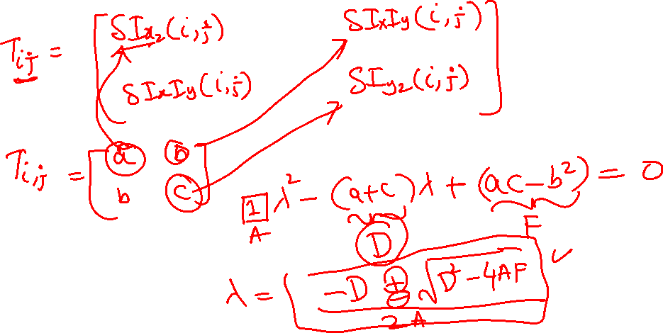
Corner Detection in Images
Notes:
3

