Slide 1
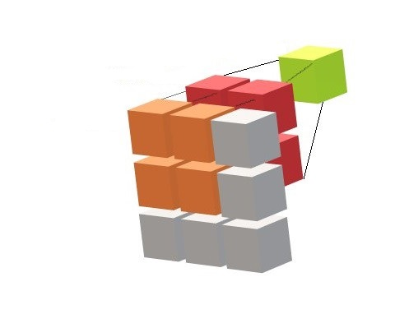
Introduction to Convolutional Neural Networks
Part-VI
Notes:
1

Slide 2
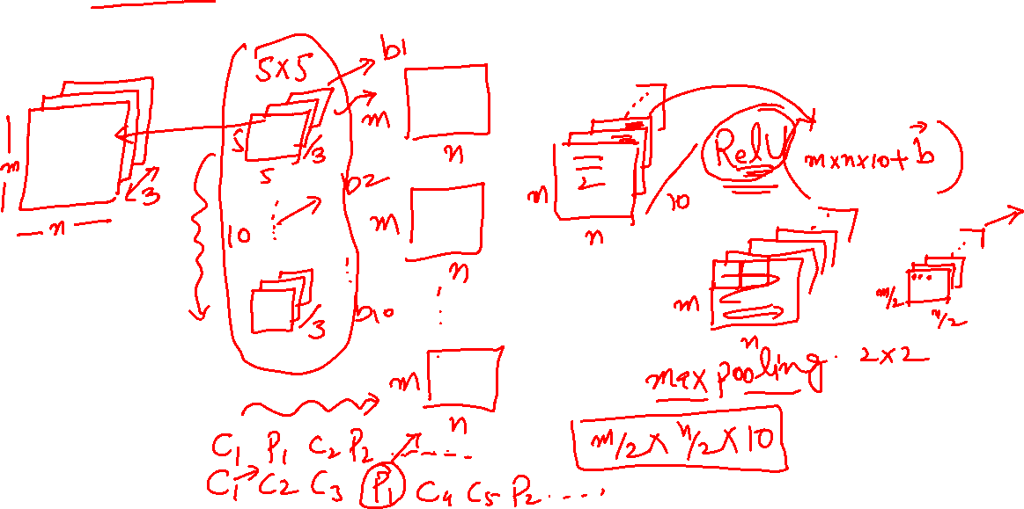
CNN: General Architecture

Slide 3

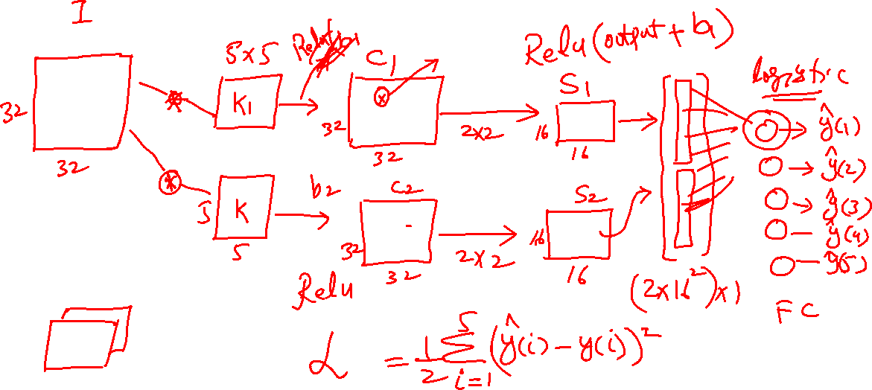
CNN: Example

Slide 4
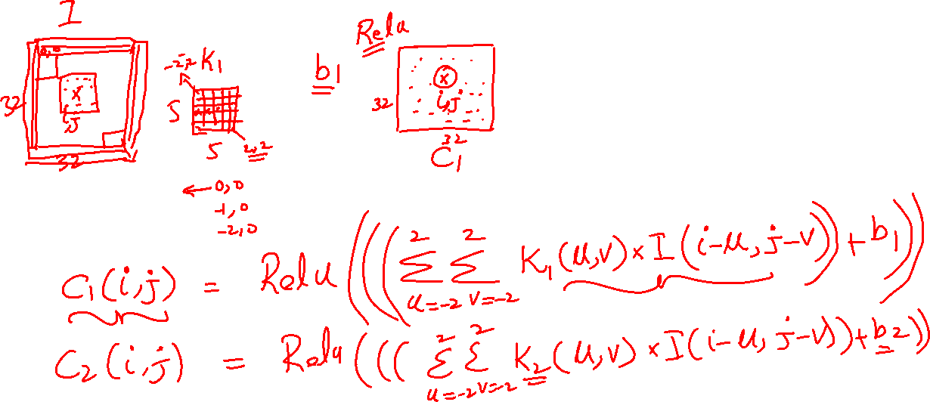
CNN: Convolution details

Slide 5
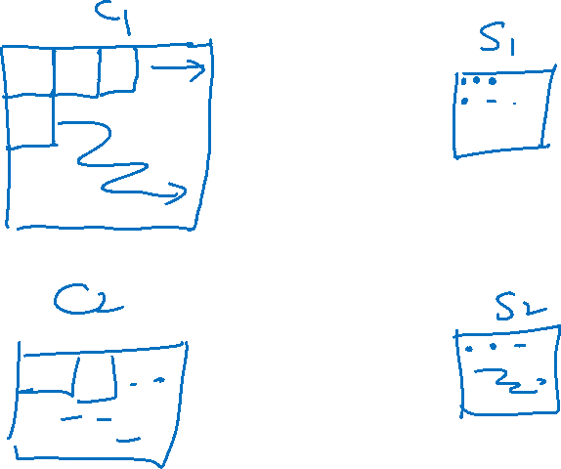
CNN: Pooling details

Slide 6
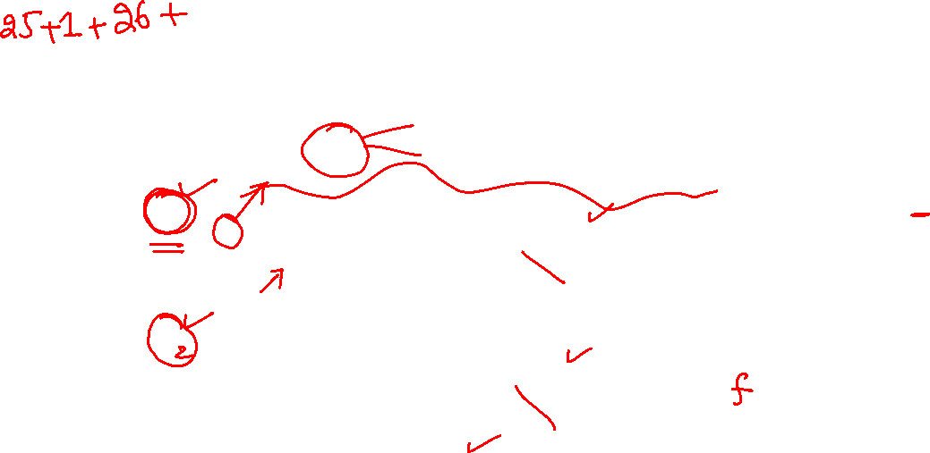
CNN: Example

Slide 7
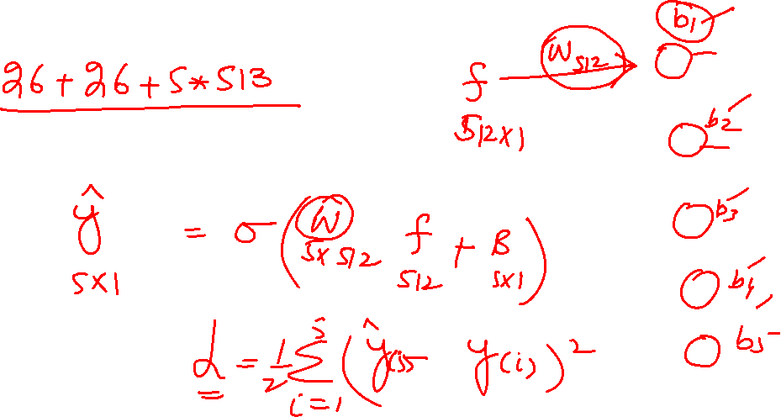
CNN: Backpropagation

Slide 8
CNN: Total Parameters

Slide 9
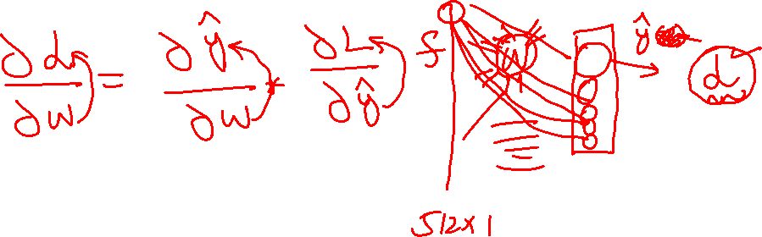
CNN: Chain Rule

Slide 10
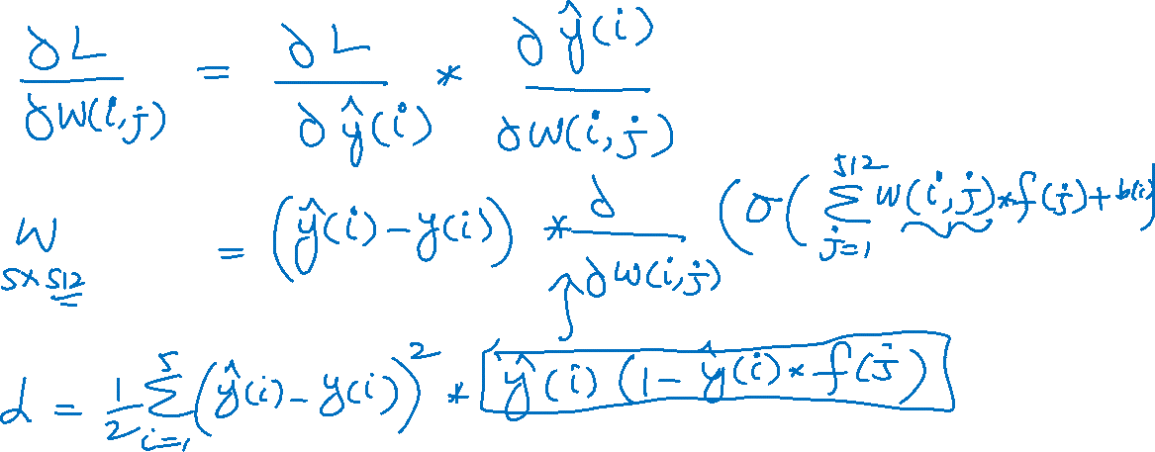
CNN: Derivatives

Slide 11
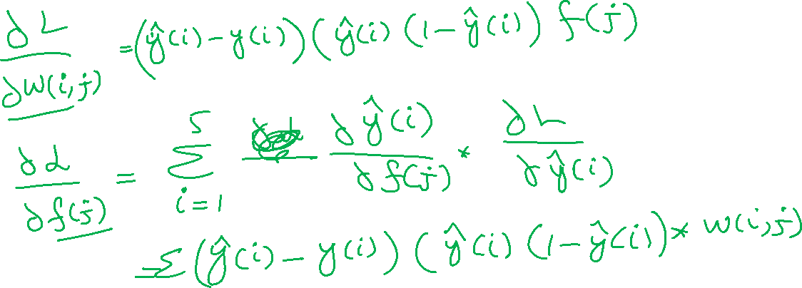
CNN: Derivatives

Slide 12
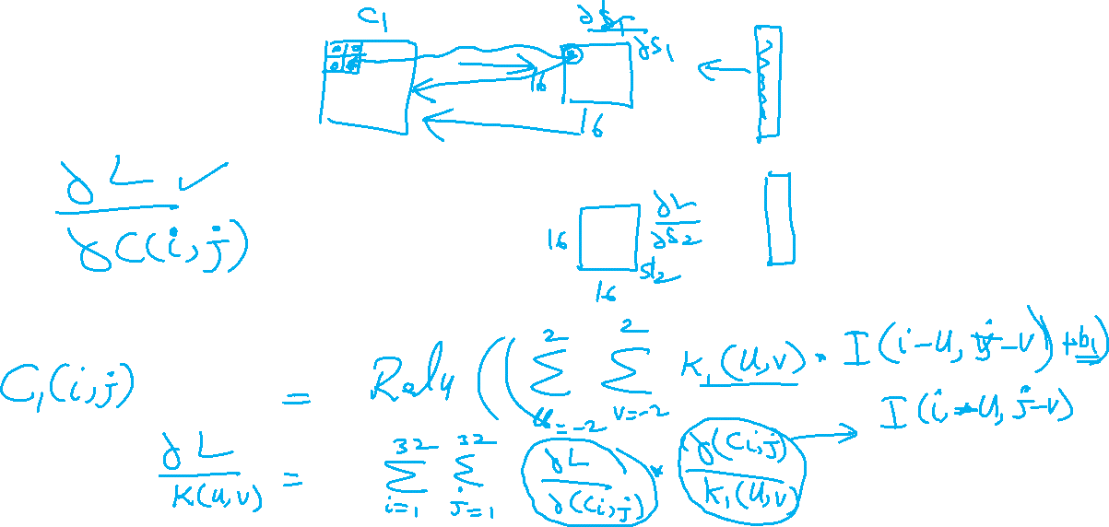
CNN: Derivatives

