Slide 1
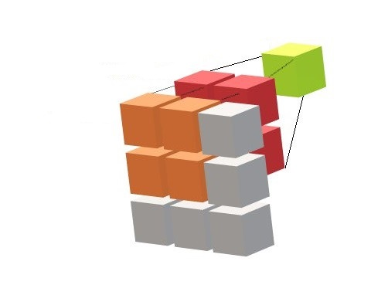
Introduction to Convolutional Neural Networks
Part-II
Notes:
1

Slide 2
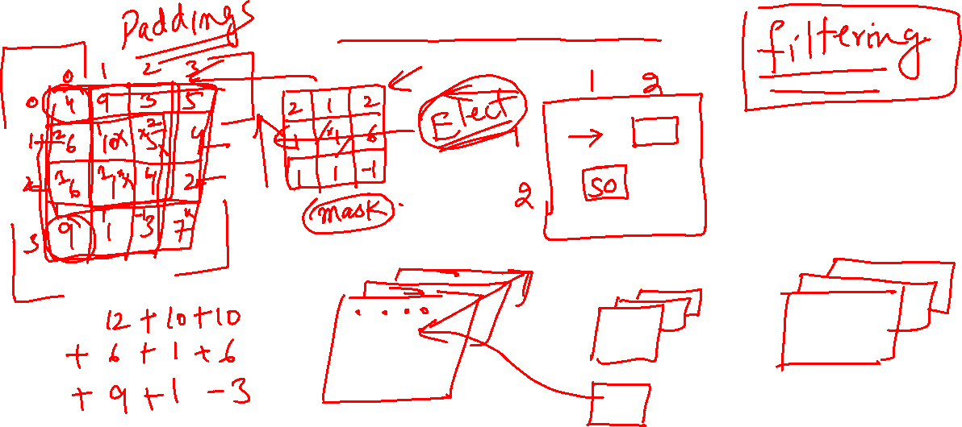
Convolution

Slide 3
2D Convolution in Python

Slide 4
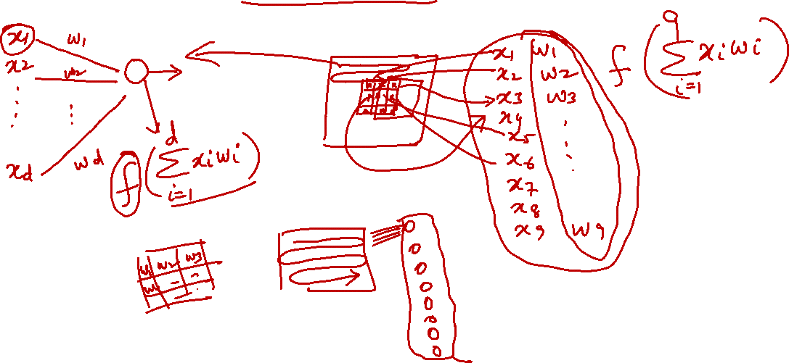
CNN: Convolution as Perceptron

Slide 5
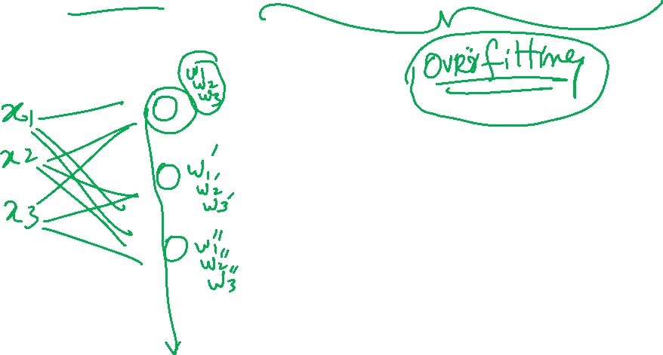
CNN: Parameter Sharing

