Slide 1
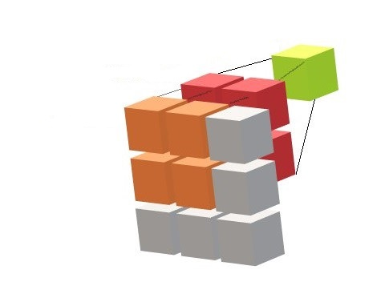
Introduction to Convolutional Neural Networks
Part-III
Notes:
1

Slide 2
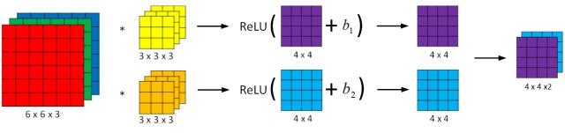
CNN: Filter bank
Image Courtesy: programmersought.com

Slide 3
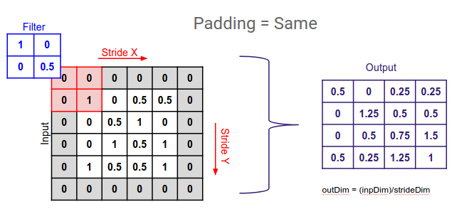
CNN: Padding
Image Courtesy: medium.com

Slide 4
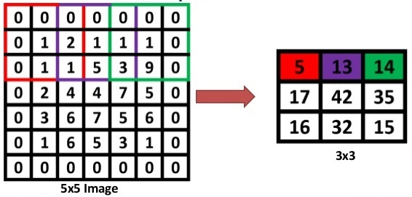
CNN: Stride
Image Courtesy: slideshare.net

Slide 5
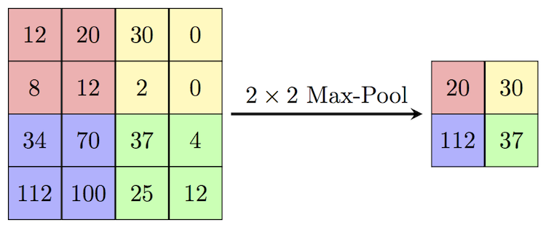
CNN: Pooling
Image Courtesy: computersciencewiki.org

Slide 6

CNN: Tensors and Volumes
Image Courtesy: towardsdatascience.com

Slide 7
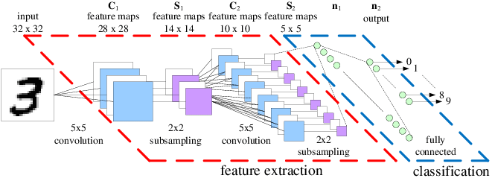
CNN: Architecture
Image Courtesy: researchgate.net

