Slide 1

Mastering Python for Data Science
https://aisciences.net/

Slide 2
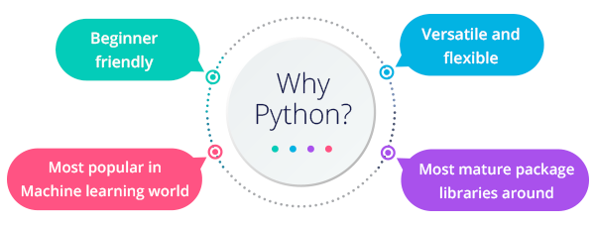
Why Python?

Slide 3
What is an IDE
Jupyter Notebook
PyCharm
Spyder
Canopy
VIM
ATOM
…..

Slide 4
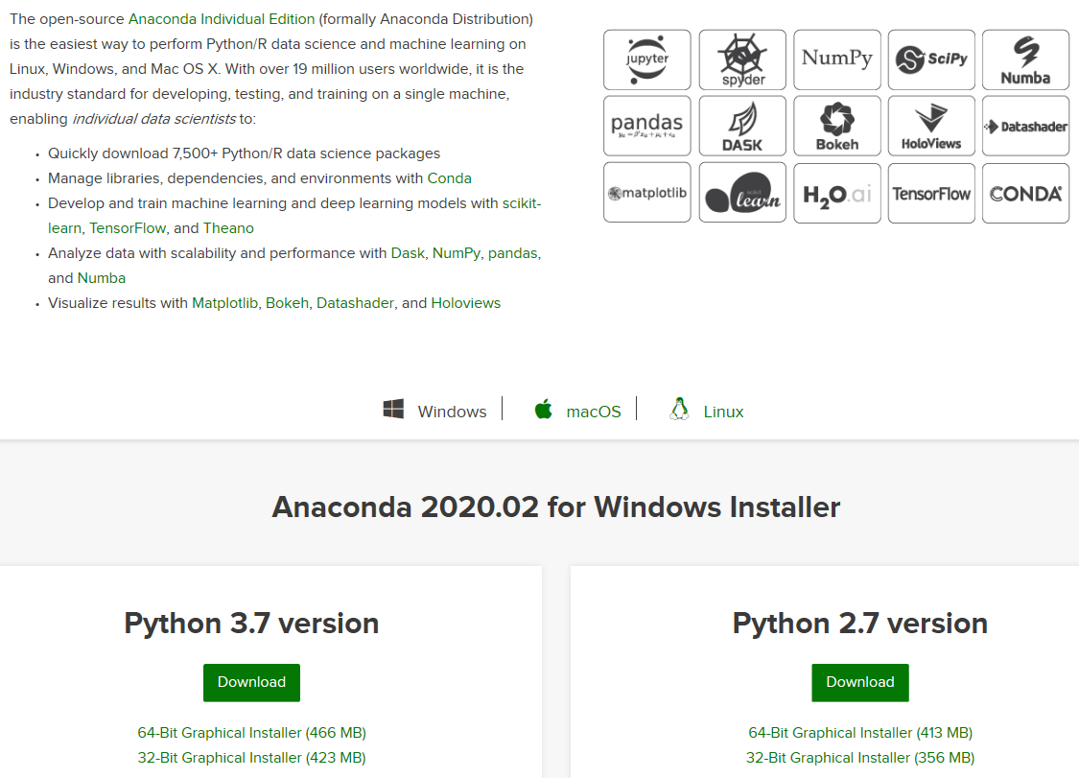
Installing Python on Windows
https://www.anaconda.com/distribution/

Slide 5
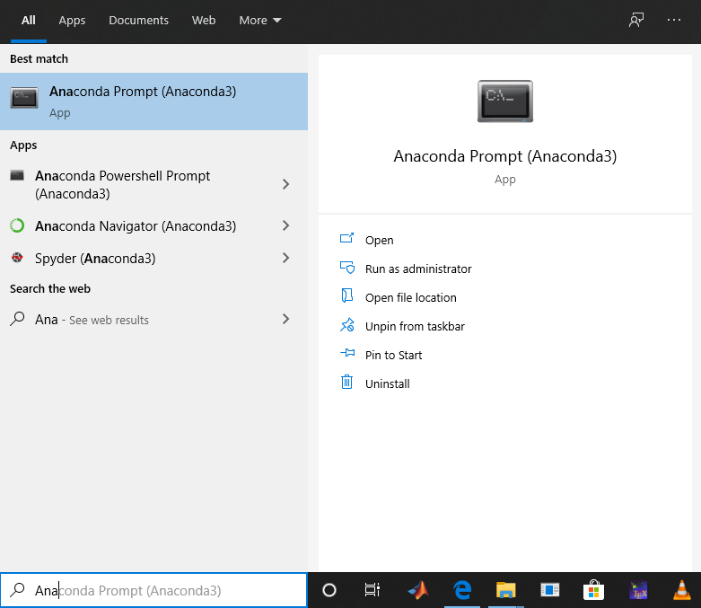
Launch Jupyter

Slide 6
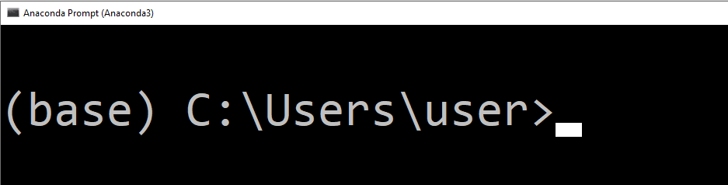
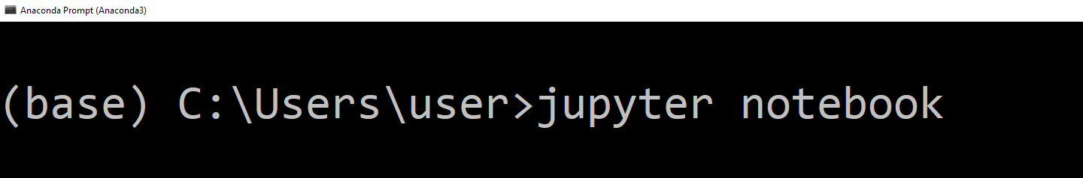
Launch Jupyter

Slide 7
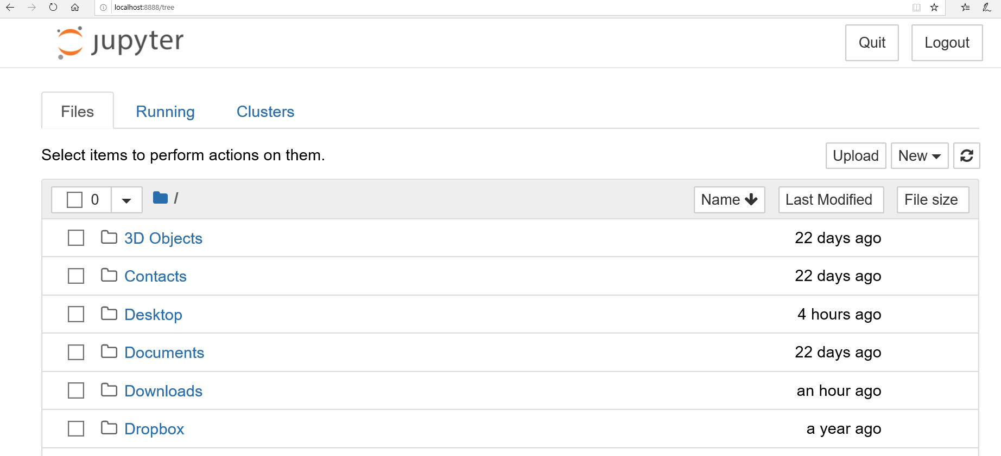
Launch Jupyter

Slide 8
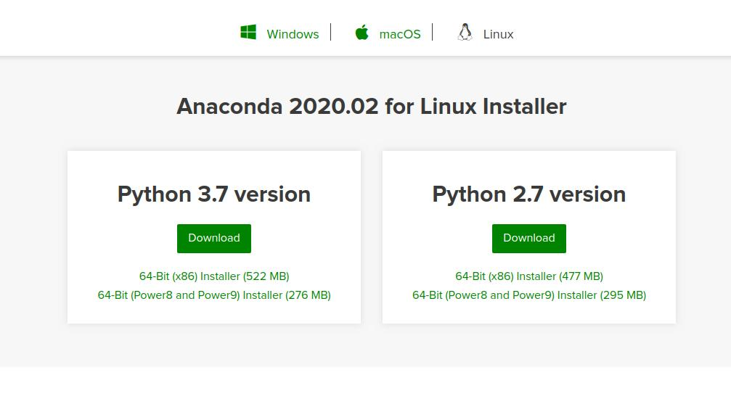
Installing Python on Ubuntu
https://www.anaconda.com/distribution/#linux

Slide 9
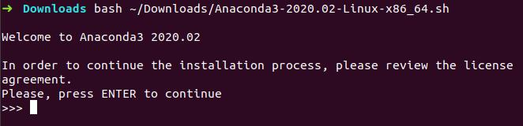
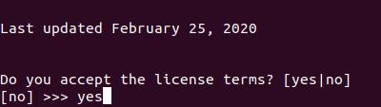
Installing Python on Ubuntu
Open a terminal and Enter the following to install Anaconda for Python 3.7:
The installer prompts “In order to continue the installation process, please review the license agreement.” Click Enter to view license terms.
Scroll to the bottom of the license terms and enter “Yes” to agree.
The installer finishes and displays “Thank you for installing Anaconda!”

Slide 10
Launch Jupyter On Ubuntu

Slide 11
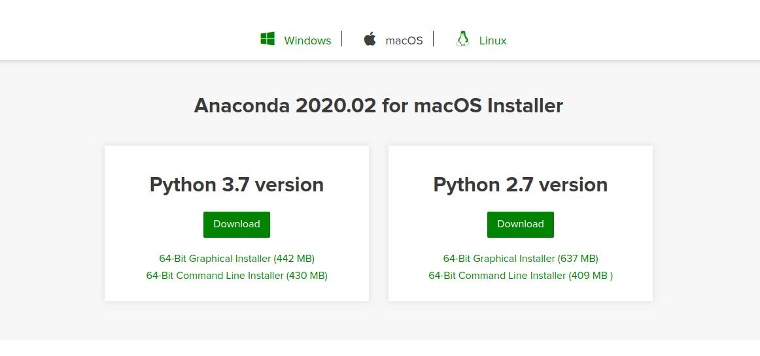
Installing Python on macOS
https://www.anaconda.com/distribution/#macos

Slide 12
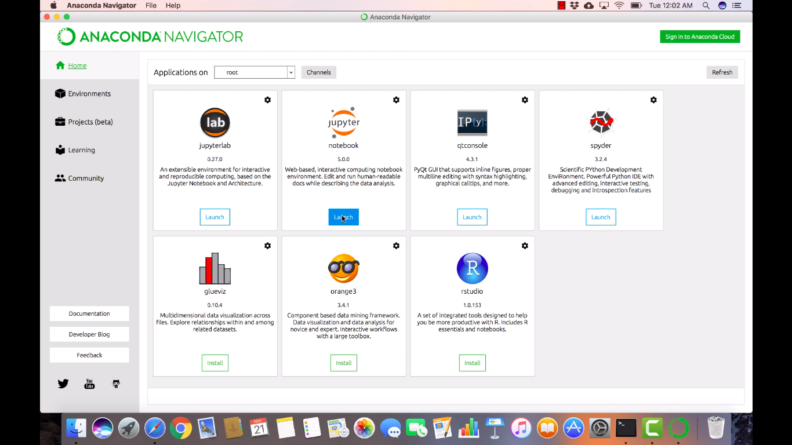
Launch Jupyter On macOS
You'll find Anaconda Navigator in Launchpad (and also in the Applications folder). Drag it to the Dock if you want to have it readily available.Then, click the Launch button below the notebook icon on the Navigator

Slide 13
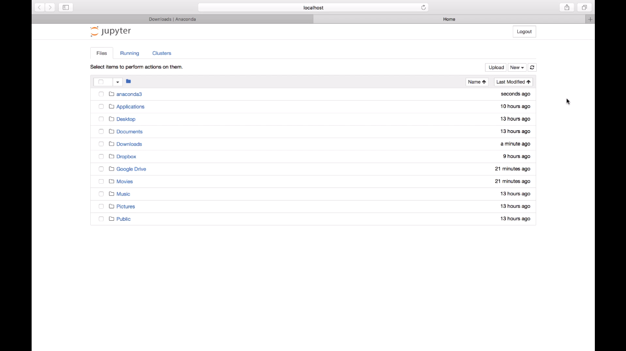
Launch Jupyter On macOS

Slide 14
Variables and operators
x = 2 # int
y = 5 # int
xy = 7.2 # float
Symbol | Task Performed
+ | Addition
- | Subtraction
/ | division
% | mod
* | multiplication
// | floor division
** | to the power of
a,b = 4,5.0 # multiple assignment
print(type(a)) # <class 'int’>
Print(type(b)) # <class ‘float'>
del x # deletes x
print(x) # error
------------------------------------------------------- NameError Traceback (most recent call last) <ipython-input-10-6fcf9dfbd479> in <module> ----> 1 x NameError: name 'x' is not defined
Variable name cannot start with a digit
https://github.com/AISPUBLISHING/mastering-python-for-data-science

Slide 15
Type bool and Comparisons
Symbol | Task Performed
== | True, if it is equal
!= | True, if not equal to
< | less than
> | greater than
<= | less than or equal to
>= | greater than or equal to
print((not(2!=3) and True) or (False and True))
https://github.com/AISPUBLISHING/mastering-python-for-data-science

Slide 16
Some Useful functions
round( ) function rounds the input value to a specified number of places or to the nearest integer.
print (round(5.6231) )
print (round(4.55842, 3))
divmod(x,y) outputs the quotient and the remainder in a tuple (We will see what a tuple is)
divmod(27,5)
isinstance( ) returns True, if the first argument is an instance of that class. Multiple classes can also be checked at once.
print(isinstance(1, int))
print(isinstance(1.0,int))
print(isinstance(1.0,(int,float)))
pow(x,y,z) x raise to the power y and remainder by z
Input() a = input("Enter something")
https://github.com/AISPUBLISHING/mastering-python-for-data-science

Slide 17
String
“python” is same as ‘python’ # be careful and don’t mix ‘python” or “python’
s = "python is the best language for data science"
t = 'in this course we are going to learn python.’
print(s + ' and, ' +t)
mulitineString = """This is the first line of the string, and here is the second line, and here is the third and final line.""“
print(multilineString)
“”” this is a multiline comment
the comment ends here”””
https://github.com/AISPUBLISHING/mastering-python-for-data-science

Slide 18
String Cont…
Indexing and Slicing
Negative index
a = “Game of programming" print(a[3:8])
print(a[-8:-3])
print(len(a))
print(len(a[3:8]))
https://github.com/AISPUBLISHING/mastering-python-for-data-science

Slide 19
String Cont…
a = " A lot OF Spaces at The beGinning and end " b = a.strip()
print(b.lower())
print(b.upper())
print(a.replace(" ", ","))
L = "game,and,no".split(",") # returns List (We will see Lists later on)
print(“at” in “asdfaatdea” )
print(“at” not in “asdfaatdea” )
"We are learning \"Strings\" here."
‘We are learning "Strings" here.’
print(“c:\drive\name” )
print(r”c:\drive\name” )
https://github.com/AISPUBLISHING/mastering-python-for-data-science

Slide 20
Data Structures
List Ordered, changeable, duplicates
Tuple Ordered, unchangeable, duplicates
Set Unordered, unchangeable(but addable), no duplicates
Dictionary Unordered, changeable, no duplicate
List | Tuple | Set | Dictionary
L= [12, "banana", 5.3] | T= (12, "banana", 5.3) | S= {12, "banana", 5.3} | D={“Val”:12,”name”:”Ban”}
L[1] | T[2] | X in S | D[“Val”]
L = L + [“game”] L[2] = “orange” | Immutable T3 = T1+T2 | S.add(“new Item”) S.update(“more”,”items”) | D[“Val”] = newValue D[“newkey”] = “newVal”
del L[1] del L | Immutable del T | S.Remove(“banana”) del S | del D[“Val”] del D
L2 = L.copy() | T2 = T | S2 = S.copy() | D2 = D.copy()
…. | …. | …. | ….
https://github.com/AISPUBLISHING/mastering-python-for-data-science

Slide 21
Control Flow (If condition)
a = 1 b = 5.9 if b > a: print("b is greater than a")
a = float(input(“Enter first number : ”)) b = float(input(“Enter second number : ”))
if b > a: print("b is greater than a") elif a == b: print("a and b are equal") else: print("a is greater than b")
a = 1 b = 5.9 if b > a: print("b is greater than a")
else: print(“b is not greater than a")
# Notice the indentation
a = 9 b = 10 print(“A") if a > b else print("=") if a == b else print("B")
https://github.com/AISPUBLISHING/mastering-python-for-data-science

Slide 22
Control Flow (Loops)
n = input(‘Max iterations :’)
i = 1 while i < n: print(i) i += 1
L = []
for i in range(n): print(i+1)
L.append(i**2)
# Notice the indentation
S = {"apple", 4.9, "cherry“} for x in S: print(x)
n = input(‘Max iterations :’)
i = 1 while i < n:
if i%2 == 0: print(i)
else
pass i += 1
D = {"apple“:44,"cherry“:”game”} for x in D: print(D[x])
https://github.com/AISPUBLISHING/mastering-python-for-data-science

Slide 23
Functions
def printSuccess(): print(“The task was successful")
def f(c2, c1, c3): print(c1,c2,c3) f(c1 = “A", c2 = “B", c3 = “C")
def printMessage(msg): print(msg)
def f(**c):
for x in c: print(c[x]) f(c1 = “A", c2 = “B", c3 = “C")
def add(x,y): return x+y
def add(*args):
sum = 0 for i in range(len(args)):
sum+=args[i]
return sum
def f(sum = 0): print(sum)
%whos
https://github.com/AISPUBLISHING/mastering-python-for-data-science

