Slide 1

Mastering Python for Data Science
https://aisciences.net/

Slide 2
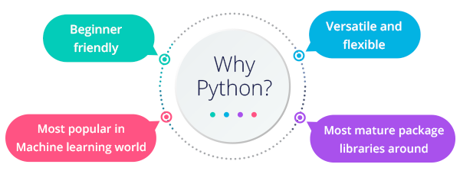

Why Python?

Slide 3
What is an IDE
Jupyter Notebook
PyCharm
Spyder
Canopy
VIM
ATOM
…..

Slide 4
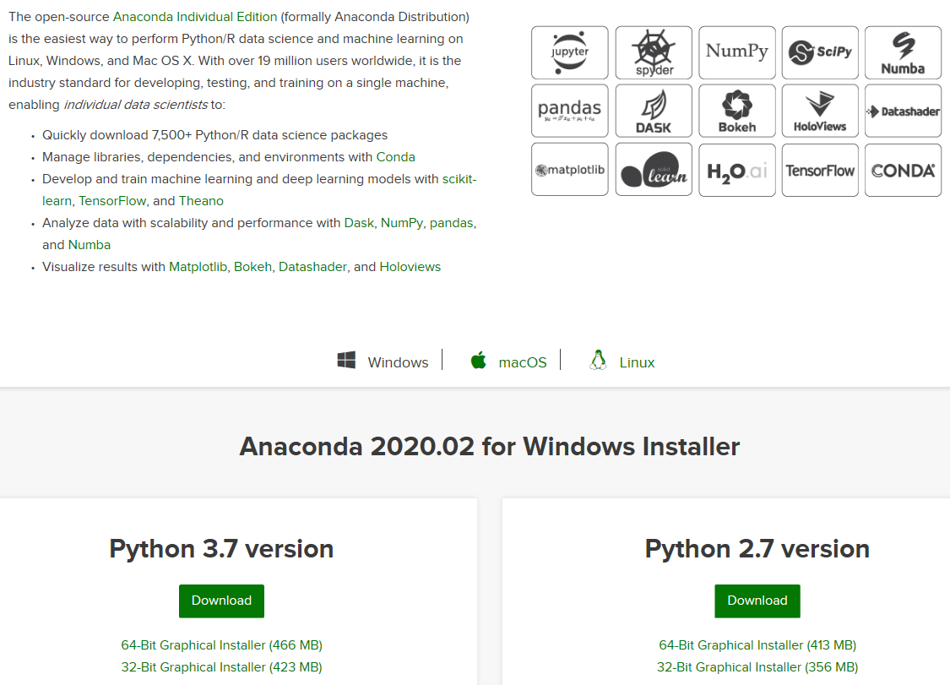
Installing Python on Windows
https://www.anaconda.com/distribution/

Slide 5
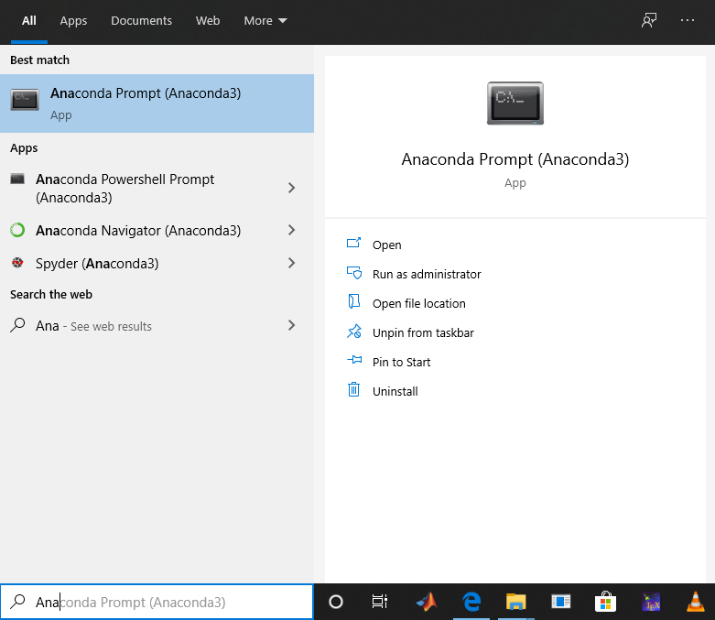
Launch Jupyter

Slide 6
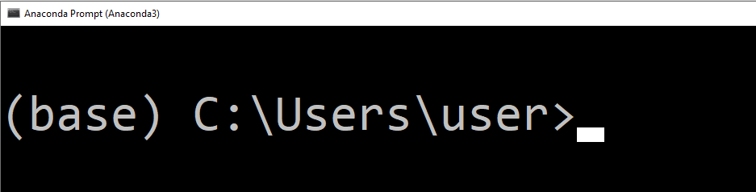
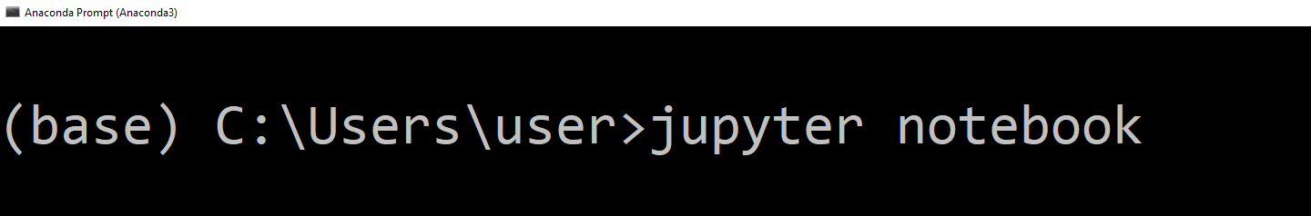
Launch Jupyter

Slide 7
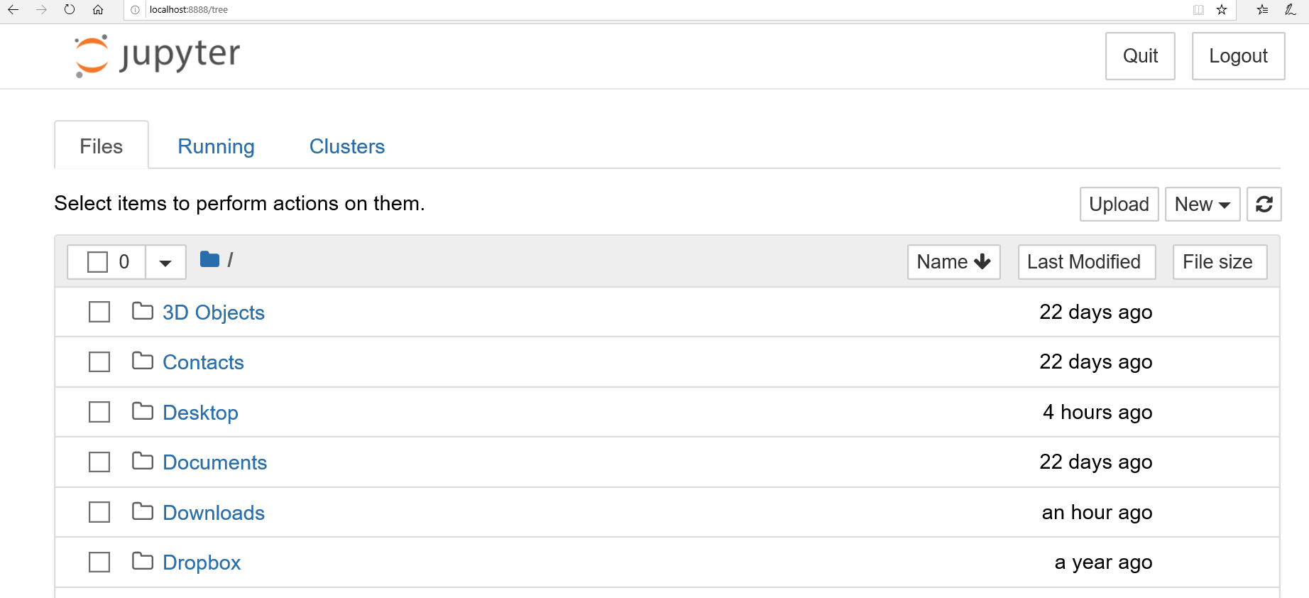
Launch Jupyter

Slide 8
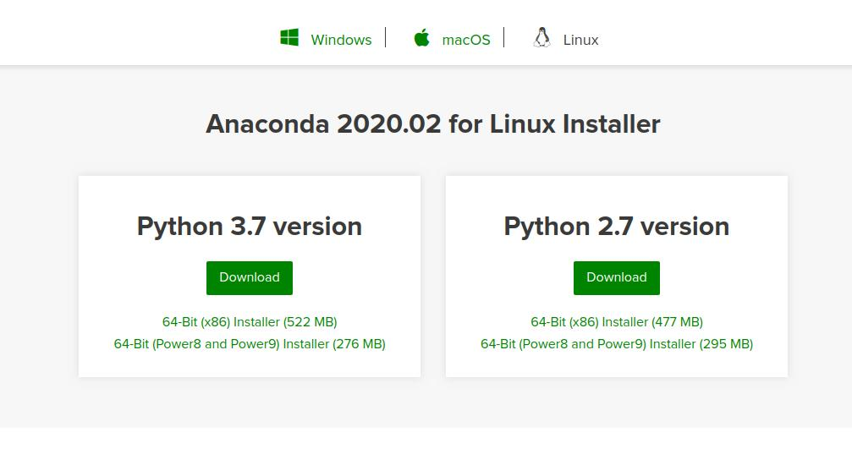
Installing Python on Ubuntu
https://www.anaconda.com/distribution/#linux

Slide 9
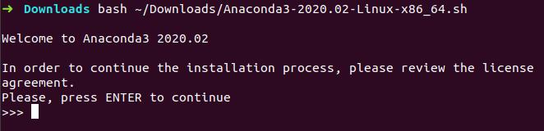
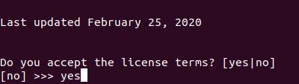
Installing Python on Ubuntu
Open a terminal and Enter the following to install Anaconda for Python 3.7:
The installer prompts “In order to continue the installation process, please review the license agreement.” Click Enter to view license terms.
Scroll to the bottom of the license terms and enter “Yes” to agree.
The installer finishes and displays “Thank you for installing Anaconda!”

Slide 10
Launch Jupyter On Ubuntu

Slide 11
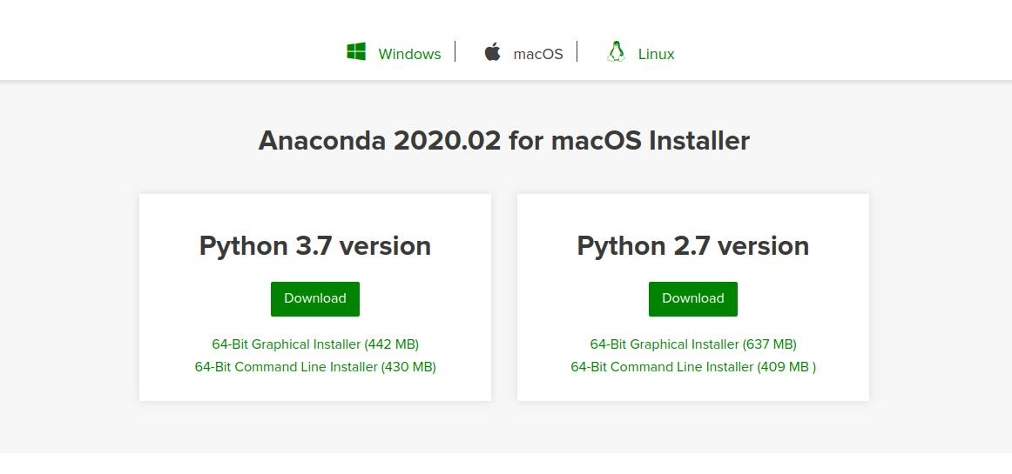
Installing Python on macOS
https://www.anaconda.com/distribution/#macos

Slide 12
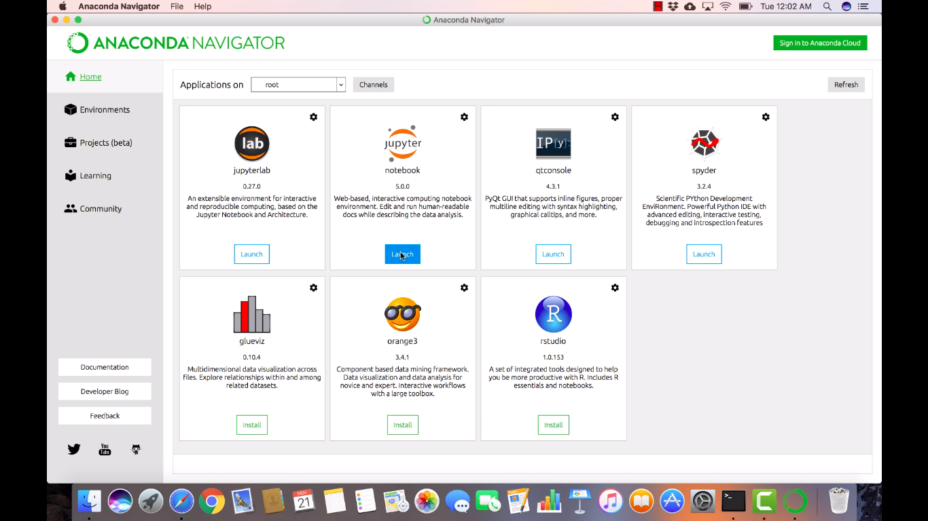
Launch Jupyter On macOS
You'll find Anaconda Navigator in Launchpad (and also in the Applications folder). Drag it to the Dock if you want to have it readily available.Then, click the Launch button below the notebook icon on the Navigator

Slide 13
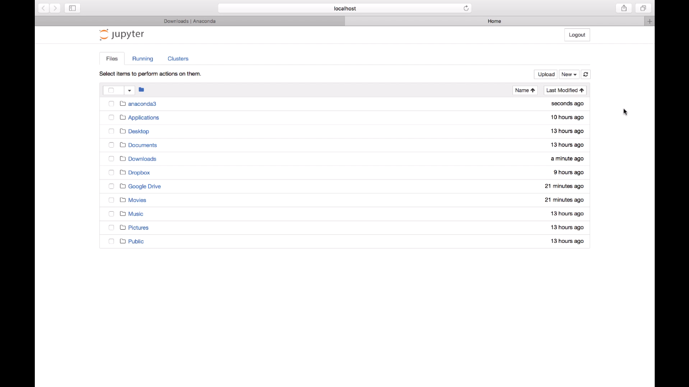
Launch Jupyter On macOS

Slide 14
Variables and operators
x = 2 # int
y = 5 # int
xy = 7.2 # float
Symbol | Task Performed
+ | Addition
- | Subtraction
/ | division
% | mod
* | multiplication
// | floor division
** | to the power of
a,b = 4,5.0 # multiple assignment
print(type(a)) # <class 'int’>
Print(type(b)) # <class ‘float'>
del x # deletes x
print(x) # error
------------------------------------------------------- NameError Traceback (most recent call last) <ipython-input-10-6fcf9dfbd479> in <module> ----> 1 x NameError: name 'x' is not defined
Variable name cannot start with a digit

Slide 15
Type bool and Comparisons
Symbol | Task Performed
== | True, if it is equal
!= | True, if not equal to
< | less than
> | greater than
<= | less than or equal to
>= | greater than or equal to
print((not(2!=3) and True) or (False and True))

Slide 16
Some Useful functions
round( ) function rounds the input value to a specified number of places or to the nearest integer.
print (round(5.6231) )
print (round(4.55842, 3))
divmod(x,y) outputs the quotient and the remainder in a tuple (We will see what a tuple is)
divmod(27,5)
isinstance( ) returns True, if the first argument is an instance of that class. Multiple classes can also be checked at once.
print(isinstance(1, int))
print(isinstance(1.0,int))
print(isinstance(1.0,(int,float)))
pow(x,y,z) x raise to the power y and remainder by z
Input() a = input("Enter something")

Slide 17
String
“python” is same as ‘python’ # be careful and don’t mix ‘python” or “python’
s = "python is the best language for data science"
t = 'in this course we are going to learn python.’
print(s + ' and, ' +t)
mulitineString = """This is the first line of the string, and here is the second line, and here is the third and final line.""“
print(multilineString)
“”” this is a multiline comment
the comment ends here”””

Slide 18
String Cont…
Indexing and Slicing
Negative index
a = “Game of programming" print(a[3:8])
print(a[-8:-3])
print(len(a))
print(len(a[3:8]))

Slide 19
String Cont…
a = " A lot OF Spaces at The beGinning and end " b = a.strip()
print(b.lower())
print(b.upper())
print(a.replace(" ", ","))
L = "game,and,no".split(",") # returns List (We will see Lists later on)
print(“at” in “asdfaatdea” )
print(“at” not in “asdfaatdea” )
"We are learning \"Strings\" here."
‘We are learning "Strings" here.’
print(“c:\drive\name” )
print(r”c:\drive\name” )

Slide 20
Data Structures
List Ordered, changeable, duplicates
Tuple Ordered, unchangeable, duplicates
Set Unordered, unchangeable(but addable), no duplicates
Dictionary Unordered, changeable, no duplicate
List | Tuple | Set | Dictionary
L= [12, "banana", 5.3] | T= (12, "banana", 5.3) | S= {12, "banana", 5.3} | D={“Val”:12,”name”:”Ban”}
L[1] | T[2] | X in S | D[“Val”]
L = L + [“game”] L[2] = “orange” | Immutable T3 = T1+T2 | S.add(“new Item”) S.update({“more”,”items”}) | D[“Val”] = newValue D[“newkey”] = “newVal”
del L[1] del L | Immutable del T | S.Remove(“banana”) del S | del D[“Val”] del D
L2 = L.copy() | T2 = T | S2 = S.copy() | D2 = D.copy()
…. | …. | …. | ….

Slide 21
Control Flow (If condition)
a = 1 b = 5.9 if b > a: print("b is greater than a")
a = float(input(“Enter first number : ”)) b = float(input(“Enter second number : ”))
if b > a: print("b is greater than a") elif a == b: print("a and b are equal") else: print("a is greater than b")
a = 1 b = 5.9 if b > a: print("b is greater than a")
else: print(“b is not greater than a")
# Notice the indentation
a = 9 b = 10 print(“A") if a > b else print("=") if a == b else print("B")

Slide 22
Set Update
S.update(“more”,”items”)
S.update({“more”,”items”})

Slide 23
Control Flow (Nested If)
x = int(input(“Enter a number : “)) if x > 10: print(“Your Number is above ten, ") if x > 20: print("and also above 20!") else: print("but not above 20.")

Slide 24
Control Flow (Indentation!)
x = int(input(“Enter a number : “)) if x > 10: print(“Your Number is above ten, ") if x > 20: print("and also above 20!") else: print("but not above 20.")
x = int(input(“Enter a number : “)) if x > 10: print(“Your Number is above ten, ") if x > 20: print("and also above 20!") else: print(“Not above 10.")

Slide 25
Control Flow (AND)
x = int(input(“Enter a number : “)) if x > 10 and x > 20: print(“Your Number is above ten, ")
print("and also above 20!") elif x > 10 and x <= 20:
print(“Your Number is above ten, ") print("but not above 20.")

Slide 26
Control Flow (Loops)
n = input(‘Max iterations :’)
i = 1 while i < n: print(i) i += 1
print(‘done’)

Slide 27
Control Flow (Loops)
n = input(‘Max iterations :’)
i = 1 while i < n:
if i%2 == 0: print(i)
else
pass i += 1
print(‘done’)

Slide 28
Control Flow (Loops: break, continue)
i = 1 while True:
if i%17 == 0: print(‘break’)
break
else
i += 1
continue
print(‘I am inside the loop’)
print(‘done’)

Slide 29
Control Flow (for Loop)
L = []
for i in range(10): print(i+1)
L.append(i**2)

Slide 30
Control Flow (else in for Loops)
S = {"apple", 4.9, "cherry“} for x in S: print(x)
else
print(‘Loop completes its iterations’)
D = {"apple“:44,"cherry“:”game”} for x in D: print(D[x])

Slide 31
Functions
def printSuccess(): print(“The task was successful")
def printSuccess():
“”” this function does nothing””” print(“The task was successful")

Slide 32
Functions
def printMessage(msg): print(msg)
def add(x,y): return x+y

Slide 33
Functions
def add(*args):
sum = 0 for i in range(len(args)):
sum+=args[i]
return sum
add(3,4,5,6,7)

Slide 34
Functions
def f(c2, c1, c3): print(c1,c2,c3) f(c1 = “A", c2 = “B", c3 = “C")
def f(**c):
for x in c: print(x,c[x]) f(c1 = “A", c2 = “B", c3 = “C")
def f(sum = 0): print(sum)

Slide 35
Modules
D:/mymodules/myfuncs.py
def printMe(msg='No message was supplied’):
print(msg)
def printList(L=[]):
for x in L:
print(x)
import sys
sys.path.append('D:/mymodules/')
import myfuncs as f
f.printMe(‘hellow’)

Slide 36
Numpy
Why Numpy?
Quick Answer: Numpy is Faster
import numpy as np a = np.array([1, 2, 3, 4, 5])
b = np.array((1, 6, 3, 4, 9)) print(a)
print(b)

Slide 37
Numpy(Dimensions)
a = np.array([[1, 2, 3], [4, 5, 6]]) print(a.ndim)
b = np.array([[[1, 2, 3], [4, 5, 6]], [[1, 2, 3], [4, 5, 6]]])
print(b.ndim)
print(b.shape[0],b.shape[1],b.shape[2])
print(b[1,0,2])

Slide 38
Numpy(Slicing)
A[start:end:step]
a[1:5] # index 1 till 5 but not 5
a[:5] # index 0 till 5 but not 5
a[:5] # index 0 till 5 but not 5
a[2:] # index 2 till end including last element
a[::-1] # from end till start (reverse the array)
a[::2] # from start till end every other element
a[::2,:] ?

Slide 39
Numpy(More Indexing)
A[index_array]
a[[1,4,6]] # index 1, 4 and 6 elements
a[[True,True,False,False,True,True,True,False]]
Assuming array has 8 elements, the above returns all
the elements corresponding to True index
a[a<8]
a[a<8 & a>4] # difference between(and,&)?
a[a<8 and a>4] ?
Copy vs View

Slide 40
Numpy(ufuncs)
b = np.random.rand(1000000)
%timeit sum(b)
%timeit np.sum(b)
%%timeit
s = 0
for x in b:
s+=x
Speed Test %timeit

Slide 41
Pandas
data = pd.Series([0.25, 0.5, 0.75, 1.0],index=['a', 'b', 'c', 'd'])
data.values
data.index
grades_dict = {‘A’: 4,‘A-’: 3.5,‘B’: 3,‘B-’: 2.5,‘B’: 2}
grades = pd.Series(grades_dict)
marks_dict = {‘A’: 85,‘A-’: 80,‘B’: 75,‘B-’: 70,‘B’: 65}
marks = pd.Series(marks_dict)
rs = pd.DataFrame({‘grades’:grades,’marks’:marks})
rs['percentage'] = rs['marks']/100
rs.index
rs.columns
rs.values[2,:]
pd.DataFrame([{'a': 1, 'b': 2}, {'b': 3, 'c': 4}])

Slide 42
Pandas (Indexing)
data = pd.Series(['a', 'b', 'c'], index=[1, 3, 5])
data[1] # explicit index , use loc instead
data[1:3] # implicit index , use iloc instead
rs.iloc[2,3]

Slide 43
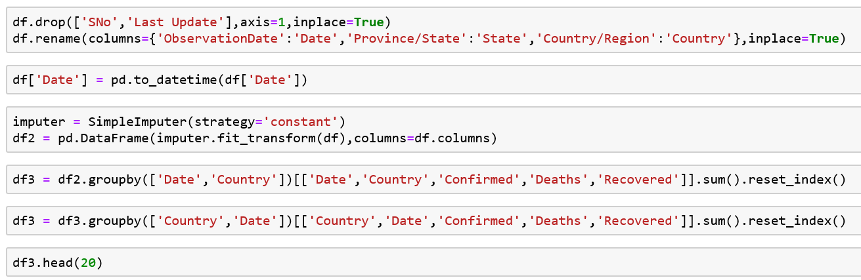
Pandas (csv files)
import pandas as pd
import numpy as np
from sklearn.impute import SimpleImputer
df = pd.read_csv('covid_19_data.csv

Slide 44
Matplotlib
import matplotlib.pyplot as plt
%matplotlib inline
fig = plt.figure()
ax = plt.axes()
x = np.linspace(0, 10, 1000)
ax.plot(x, np.sin(x));
plt.plot(x, np.sin(x - 0), color='blue’)
plt.plot(x, np.sin(x - 1), color='g’)
plt.plot(x, np.sin(x - 2), color=‘r’)
plt.plot(x, x + 0, '-g') # solid green
plt.plot(x, x + 1, '--c') # dashed cyan
plt.plot(x, x + 2, '-.k') # dashdot black
plt.plot(x, x + 3, ':r'); # dotted red

