Slide 1
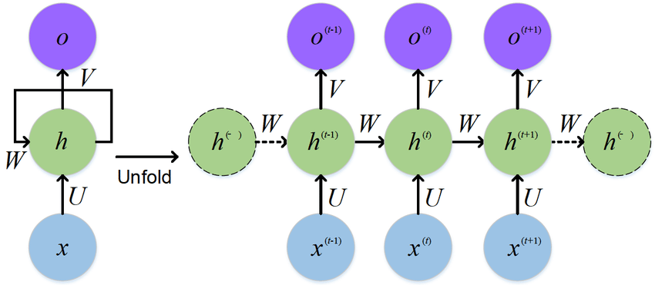
Applications of Recurrent Neural Networks
Notes:
1

