Slide 1
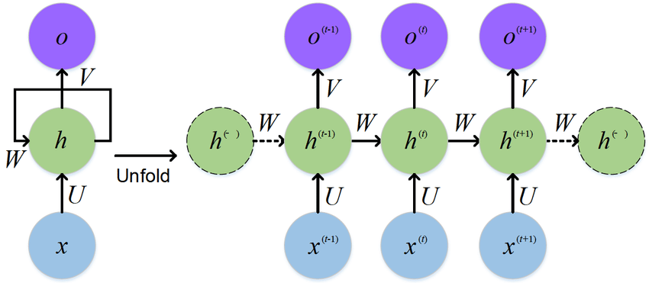
Recurrent Neural Networks in TensorFlow
Notes:
1

Slide 2
