Slide 1
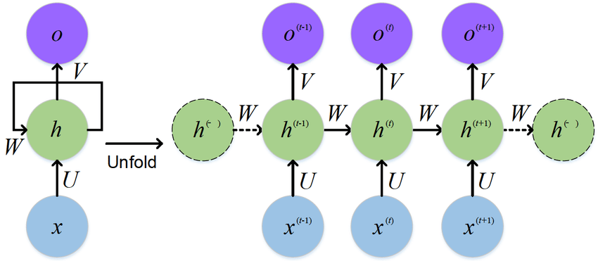
Recurrent Neural Networks Architectures
Notes:
1

