Slide 1
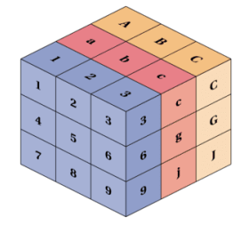
TensorFlow Tutorial for Beginners
Part-I
Notes:
1

Slide 2
What is TensorFlow?
Very powerful package Specially for Deep Learning
Notes:
2

Slide 3
How to install it?
conda create –n tf tensorflow
conda activate tf
Notes:
3

Slide 4
Use Google COLAB instead
COLAB
Notes:
4

Slide 5
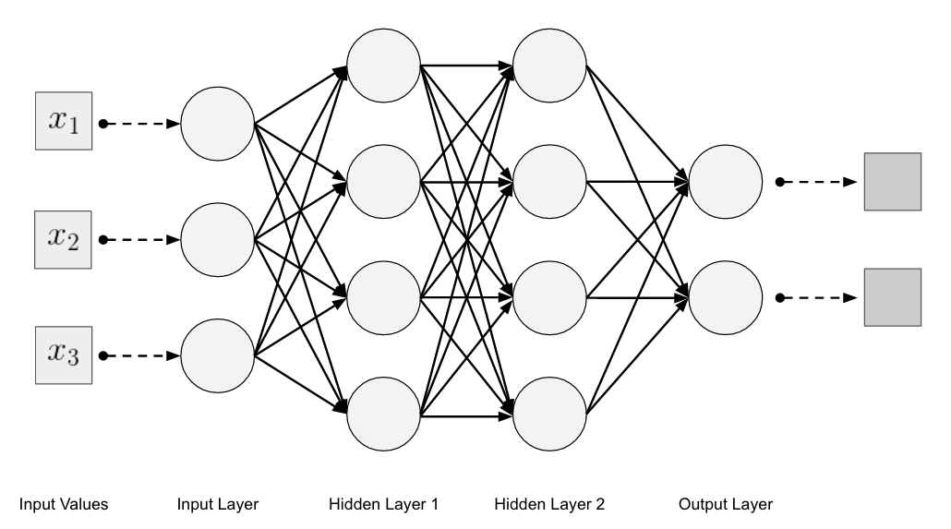
Neural Networks (Terminology)
Input Layer
Hidden Layer
Output Layer
Activation
Loss
Optimizer
Dropout
SoftMax
Notes:
5

Slide 6
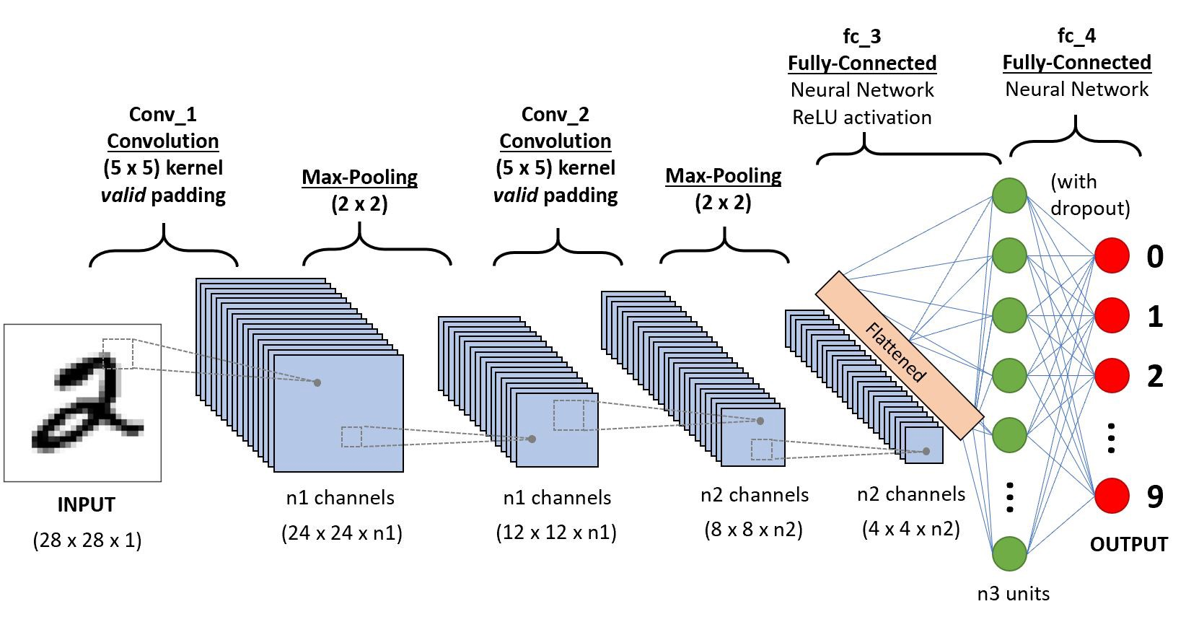
Convolutional Neural Networks
Notes:
6

