Slide 1
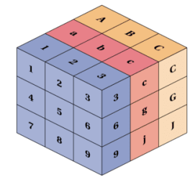
TensorFlow Tutorial for Beginners
Part-II
Notes:
1

Slide 2
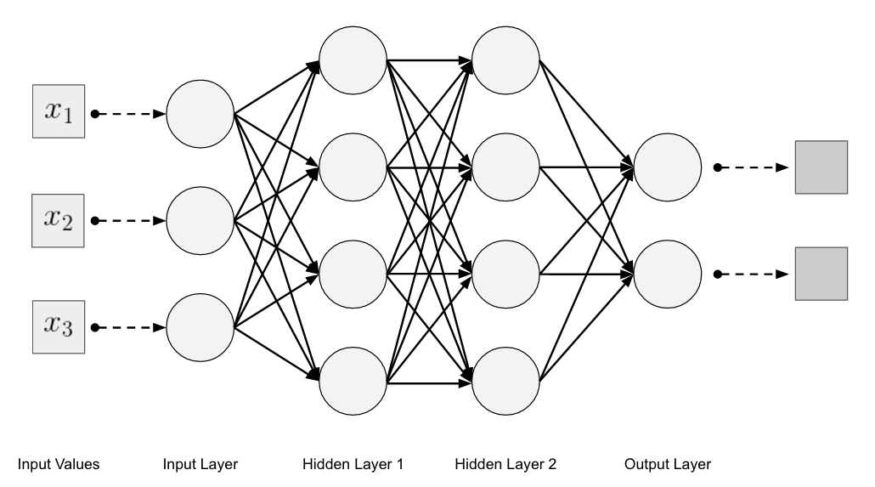
Neural Networks
Notes:
2

Slide 3
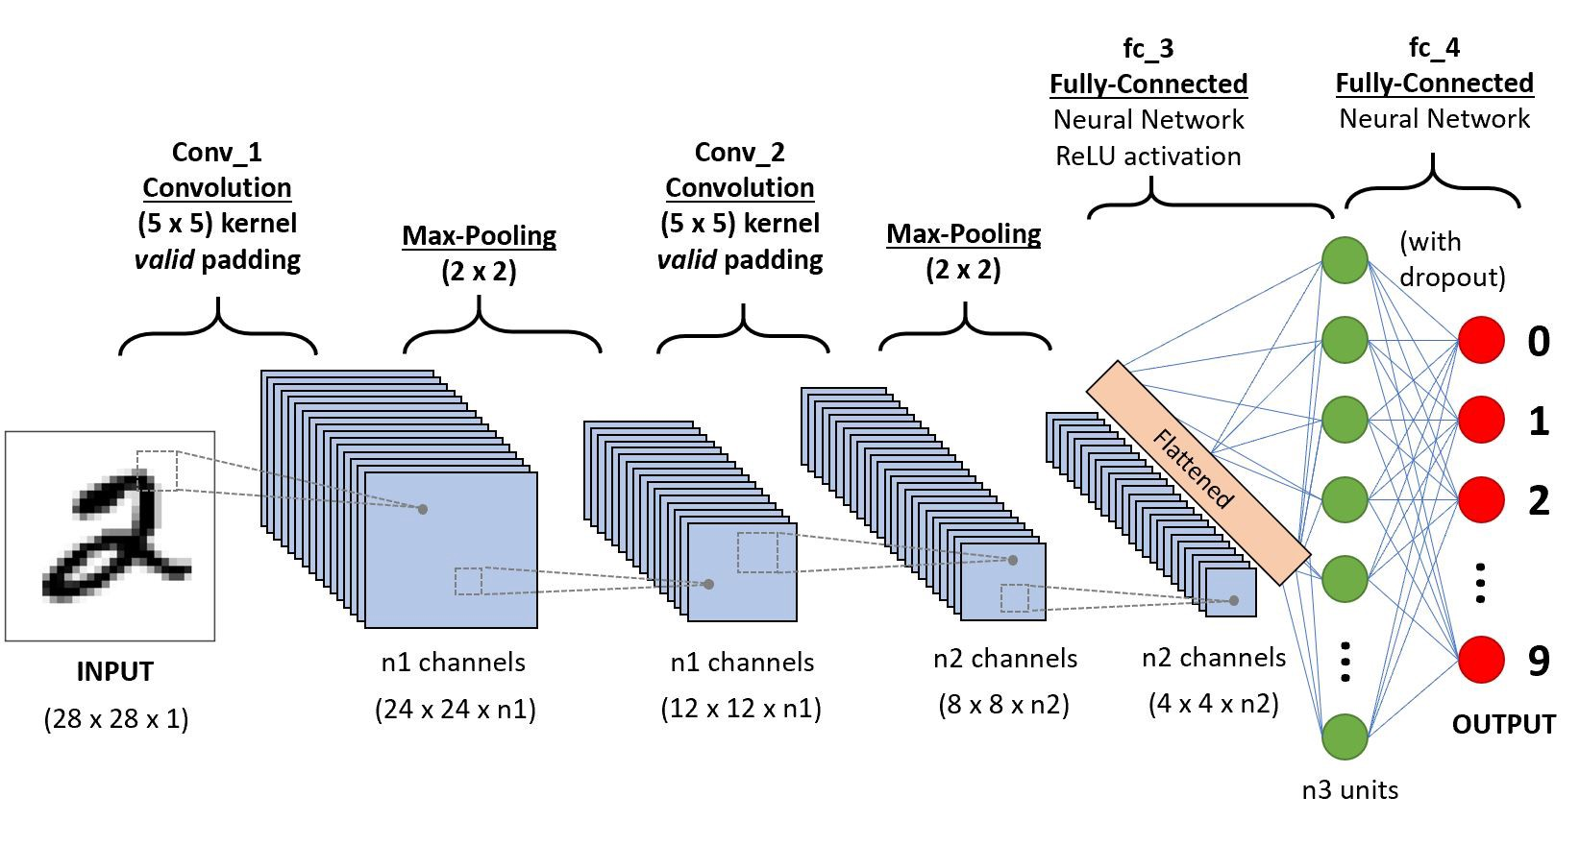
Convolutional Neural Networks
Notes:
3

